Slide 1
Talk Time
Unit 3, Week 3

Slide 2
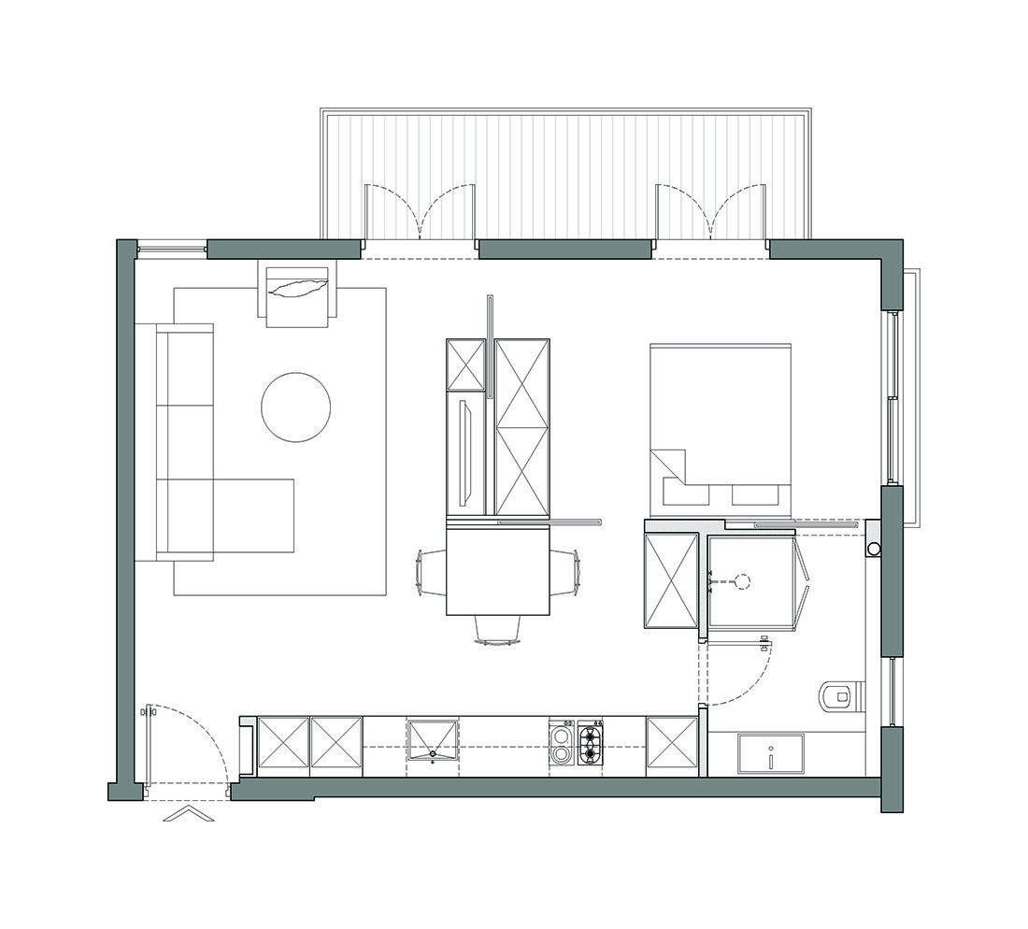
http://www.rothem.co.il/blog/2020/1/30/50-square-meters-540-square-feet
Notes:
Look carefully at this plan for an apartment. What do you see?
What materials might be used to build the different parts of this apartment?

