Slide 1
Talk Time
Unit 3, Week 6

Slide 2
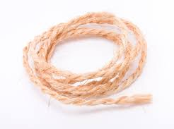
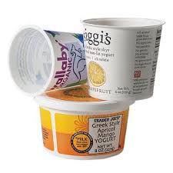
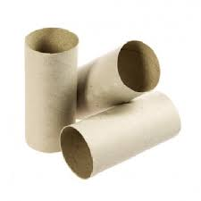
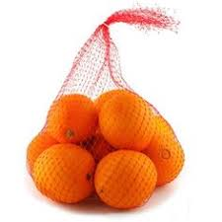
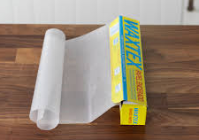
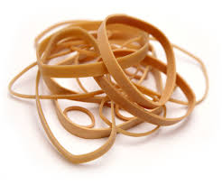
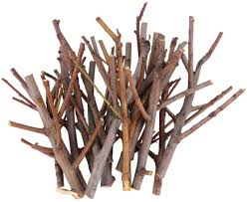
String screenshots, images and pictures, Toilet Paper Tubes - Northwestern Early Intervention, 13 Genius Wax Paper Uses, Rubber Band Size Guide, Can mesh produce bags be recycled? - Sustainable Living Stack Exchange
Notes:
Look at each of these materials.
What could you construct with them?
Talk about your plan.
What other materials would you need?

