Slide 1
Talk Time
Unit 2, Week 6

Slide 2
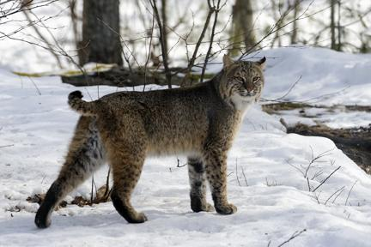
https://www.colsa.unh.edu/nhaes/article/2016/10/bobcats
Notes:
A bobcat shares an owl’s habitat.
What do you notice about this animal? What do you wonder?

