Slide 1
Talk Time
Unit 2, Week 5

Slide 2
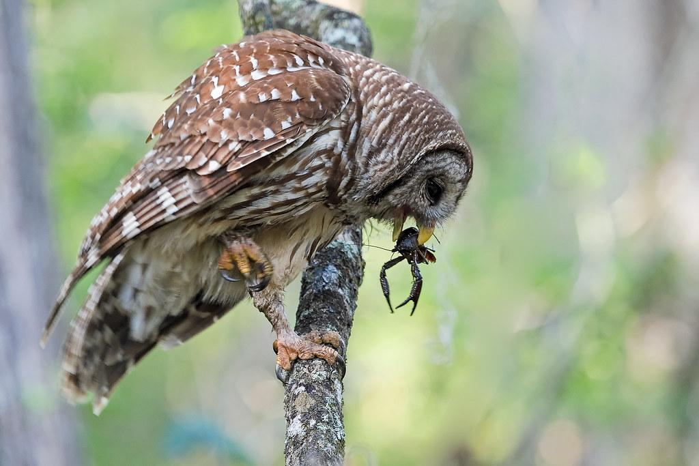
https://www.chesapeakebay.net/S=0/fieldguide/critter/barred_owl
Notes:
What information about owls can you find in this photograph?
What else would you like to know?

