Slide 1
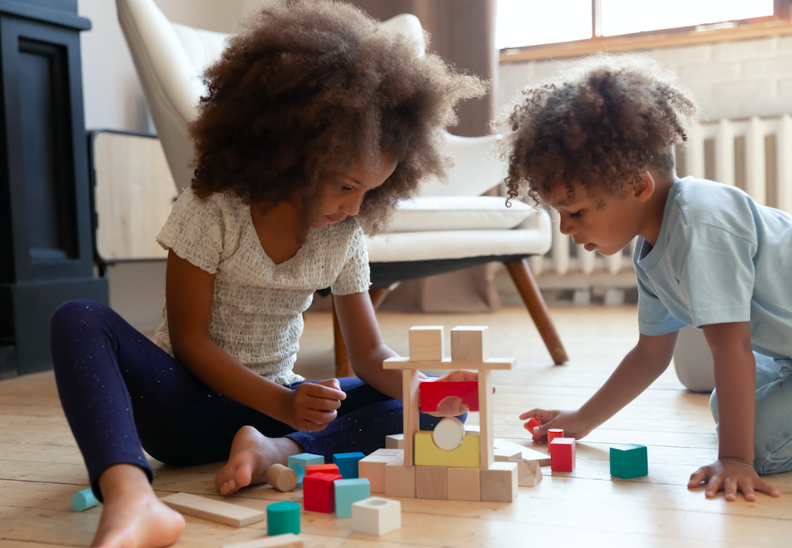
If I Could Make a City

Slide 2
If I could make a city,
I know just what I’d like:
An ice cream store
And toy shop,
A place to get a bike.

Slide 3
If I could make a city,
I hope I’d make a park:
A place for tag,
Slides and swings,
Where it never gets dark!

Slide 4
If I could make a city,
There’s one more thing I’d add:
A home for me
And family
Where we will all be glad!

