Slide 1
Talk Time
Unit 2, Week 2

Slide 2
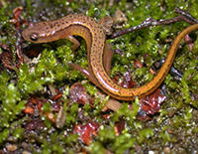
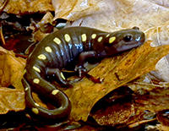
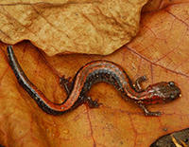
https://www.massaudubon.org/learn/nature-wildlife/reptiles-amphibians/salamanders/salamander-species-in-massachusetts
Notes:
I went for a walk and saw 3 salamanders!
Here’s what I thought…

