Slide 1
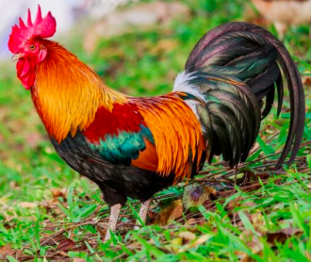
I Had a Rooster
Modified from the song by Pete Seeger

Slide 2
I had a rooster and the rooster pleased me.
I fed my rooster on a red bud tree.
The little rooster goes
“Cock-a-doodle-doo dee doodle-ee doodle-ee doodle-ee do.”

Slide 3
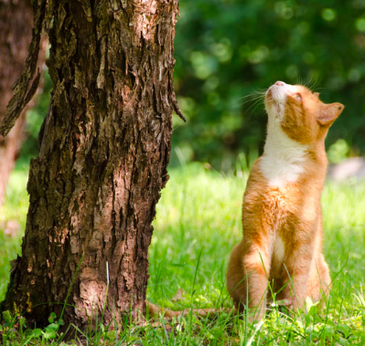
I had a cat and the cat pleased me.
I fed my cat on a red bud tree.
The little cat goes
“Meow, meow.”

Slide 4
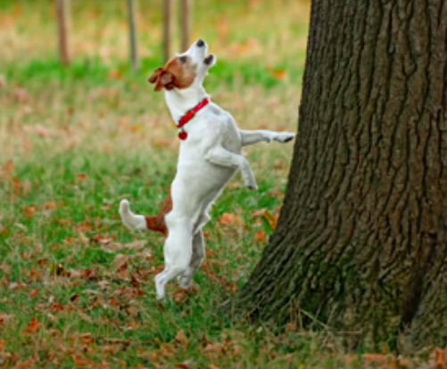
I had a dog and the dog pleased me.
I fed my dog on a red bud tree.
The little dog goes
“Ruff, ruff, ruff.”

Slide 5
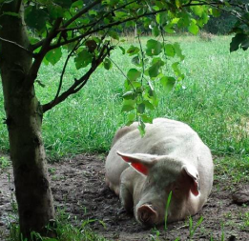
I had a pig and the pig pleased me.
I fed my pig on a red bud tree.
The little pig goes
“Oink, oink, oink.”

Slide 6
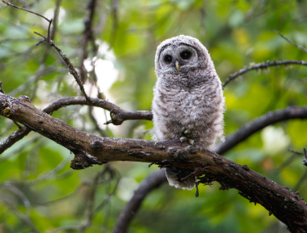
I had an owl and the owl pleased me.
I fed my owl on a red bud tree.
The little owl goes
“Hooooo.”

