Slide 1
End of Unit Assessment
Unit 1

Slide 2
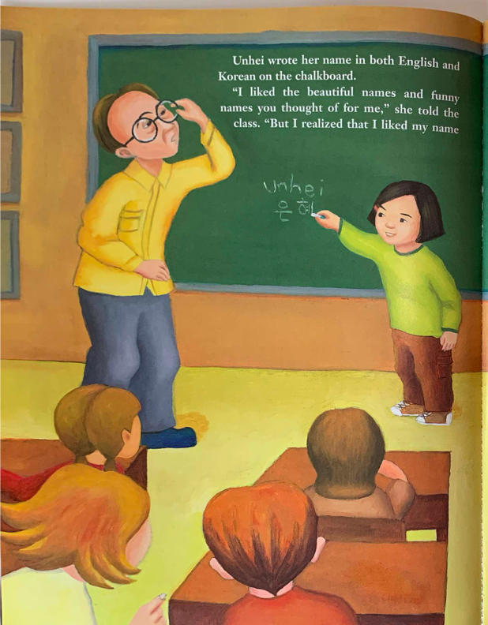
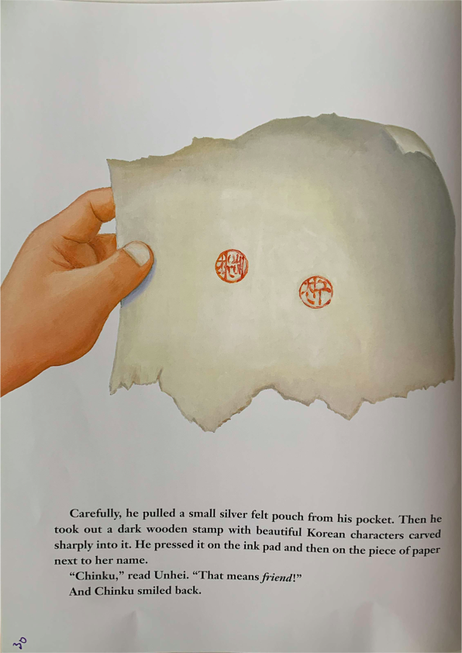

Slide 3
How do Unhei’s classmates act like caring members of a community?

