Slide 1
Talk Time
Unit 1, Week 4

Slide 2
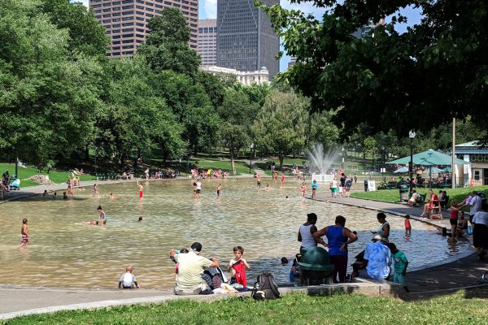
https://copley-wolff.com/frog-pond
Notes:
How can a fountain create community?

