Slide 1
Talk Time
Unit 2, Week 4

Slide 2
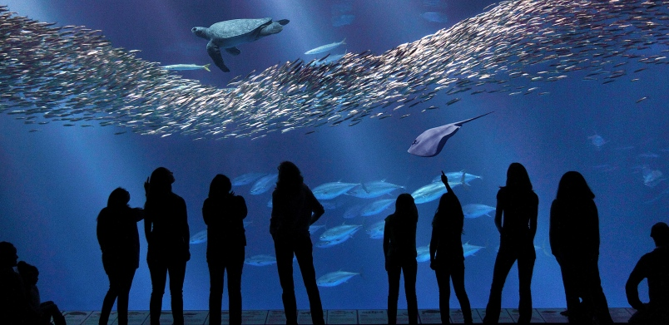
https://www.vancourier.com/news/monterey-bay-makes-splash-as-captive-free-model-1.974620
Notes:
What can you learn from visiting an aquarium?
How else can you learn about life under water?

