Slide 1
Procedure Materials
Writing Week 2, Day 5

Slide 2
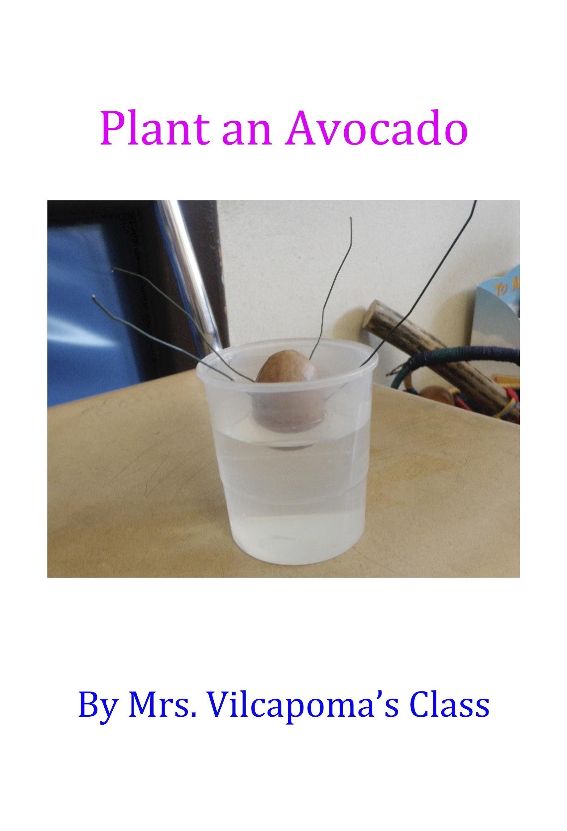

Slide 6
Procedure Language: Adjectives
Adjectives describe the nouns. They answer these questions:
How many/much?
What kind?
What like?
Which ones? Whose?

Slide 7
Procedure Language: Adjectives
noun: cup
How many?
1
What like?
clear
What like?
medium

