Slide 1
Talk Time
Unit 2, Week 9

Slide 2
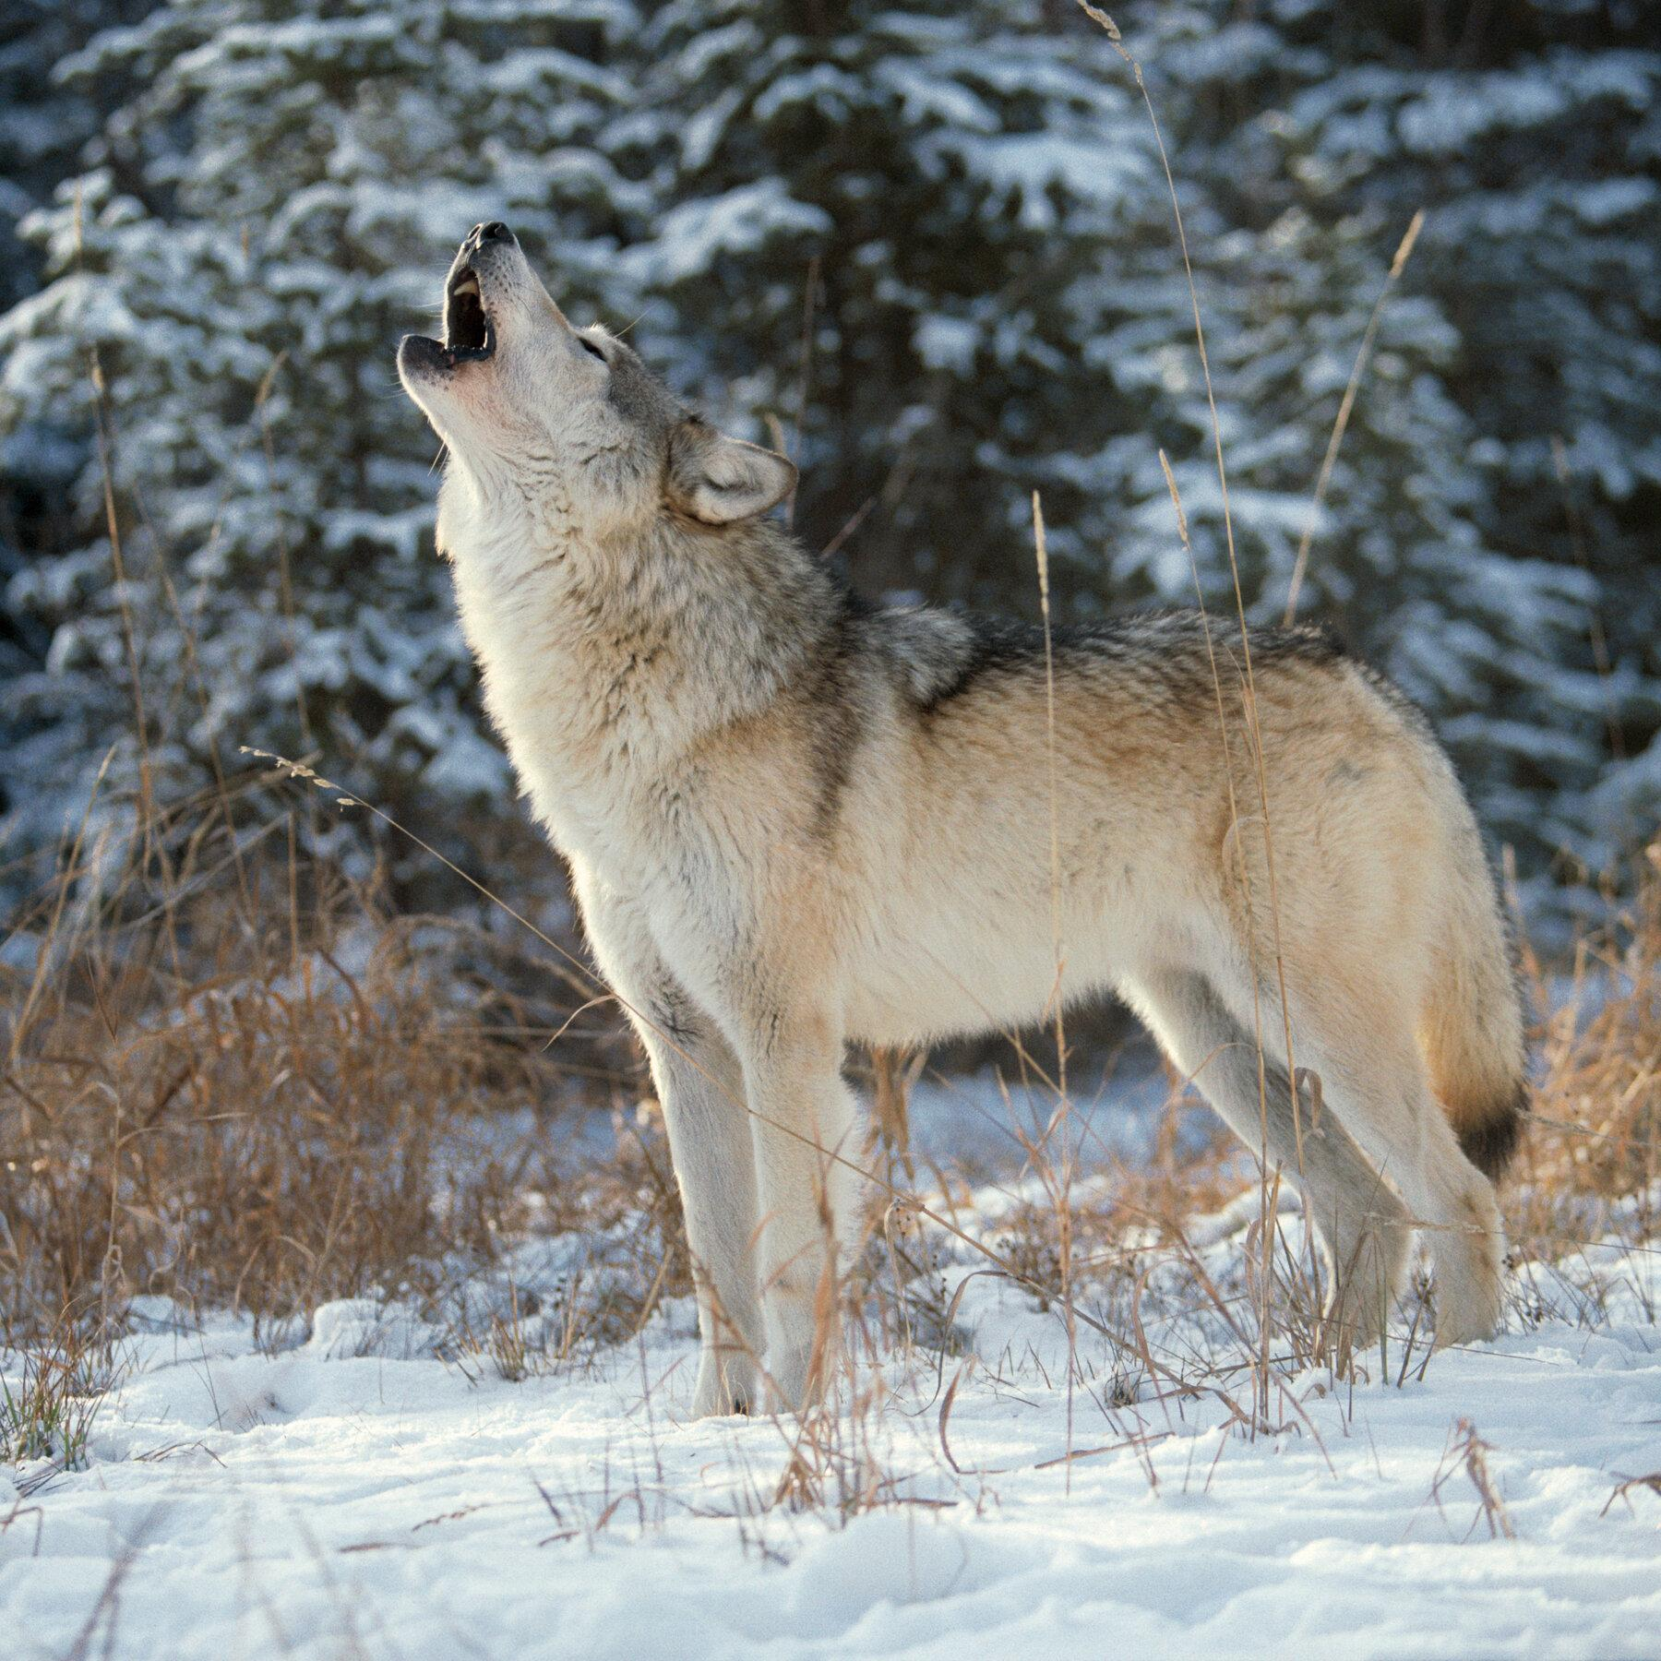
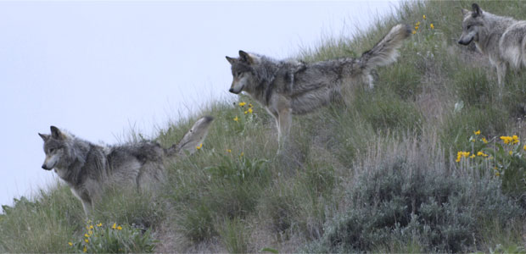
https://www.pbs.org/wnet/nature/river-of-no-return-gray-wolf-fact-sheet/7659/, https://www.nytimes.com/2020/10/29/climate/wolves-endangered-species-list.html
Notes:
What different kinds of information do these two photos tell us about wolves?

