Slide 1
Talk Time
Unit 1, Week 3

Slide 2
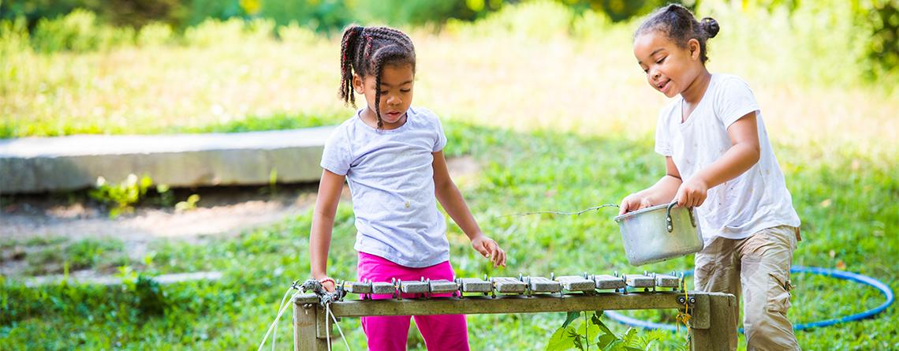
https://www.massaudubon.org/get-outdoors/wildlife-sanctuaries/boston-nature-center
Notes:
What is going on in this picture?

