Slide 1
Talk Time
Unit 1, Week 2

Slide 2
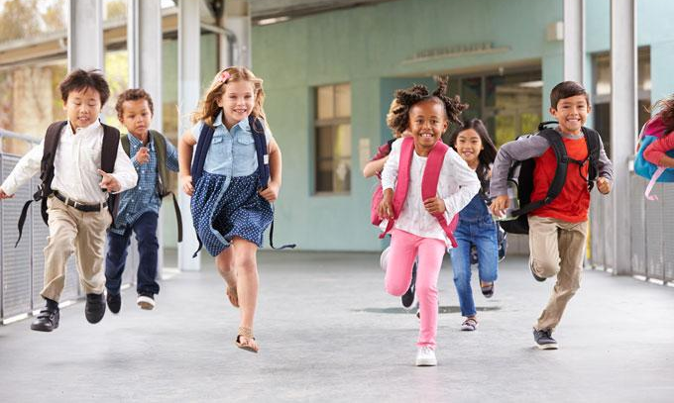
https://www.yaleclimateconnections.org/2018/05/school-goes-solar-saves-money-buys-laptops/052118_school_children/
Notes:
What is going on in this picture?

