Slide 1
The Very Wise Owl

Slide 2
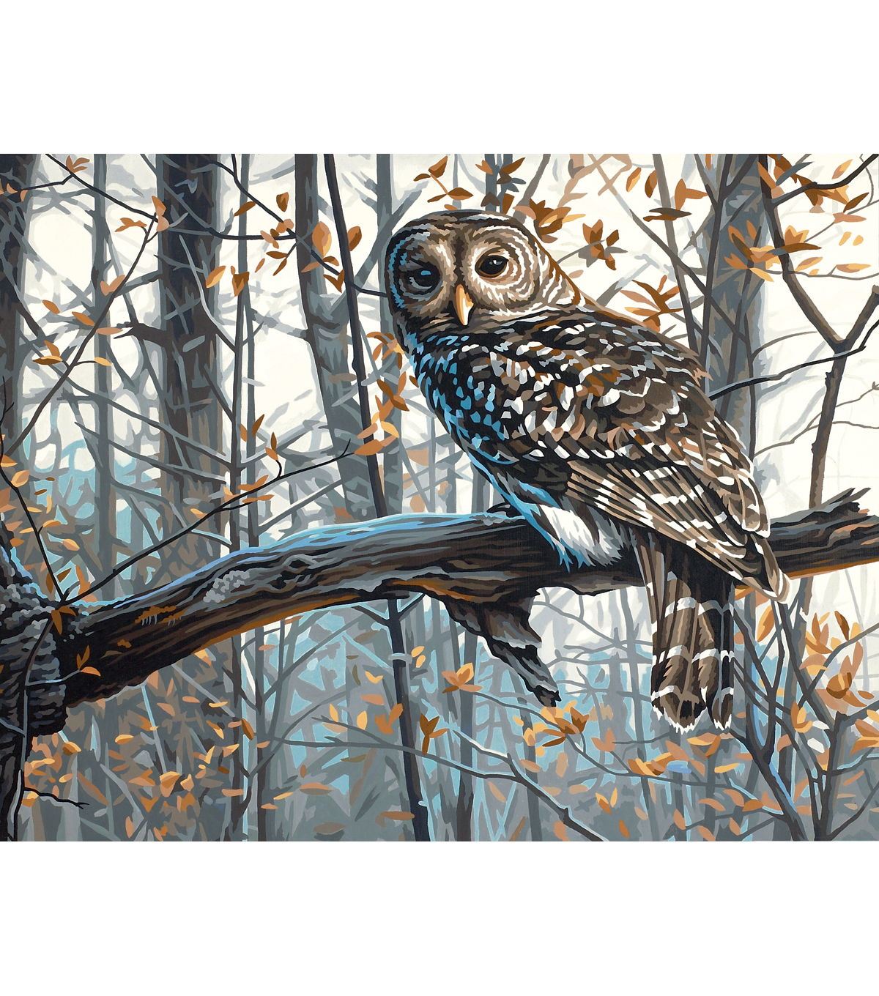
There was a very wise owl,
Who lived up in a tree.
He sat upon the branch,
Watching you and me.

Slide 3
If you see him,
He will visit for a while.
In a loud voice, he’ll say,
“Who? Who? Who?”
With a very wise smile.
Who? Who? Who?

