Slide 1
Talk Time
Unit 3, Week 7

Slide 2
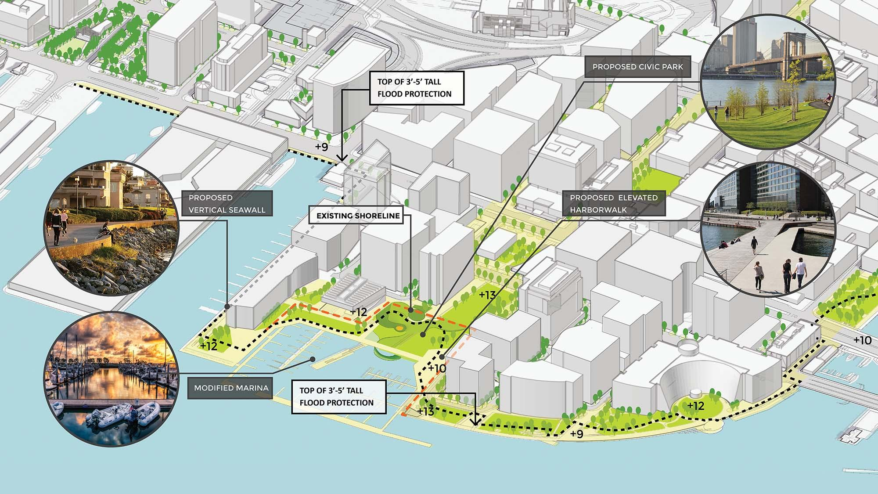
https://www.boston.gov/departments/environment/climate-ready-south-boston
Notes:
Look carefully at this plan for improvements to this city.
What are the designers thinking about? How do you know?

