Slide 1
Talk Time
Unit 2, Week 1

Slide 2
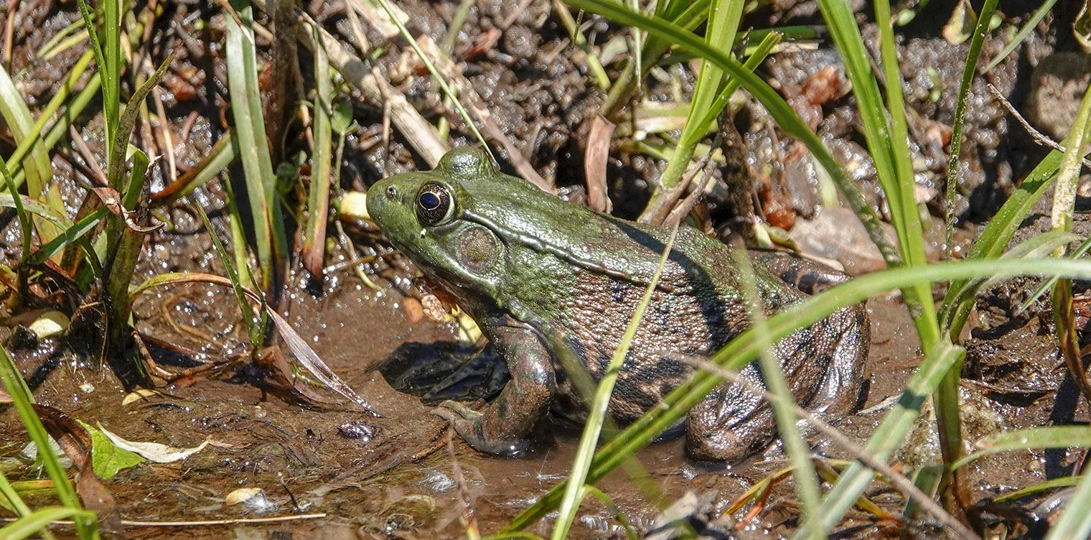
https://wildadirondacks.org/adirondack-amphibians-green-frog-lithobates-clamitans.html
Notes:
What do you notice about the frog?
What do you notice about the frog’s habitat?

