Slide 1
Talk Time
Unit 1, Week 5

Slide 2
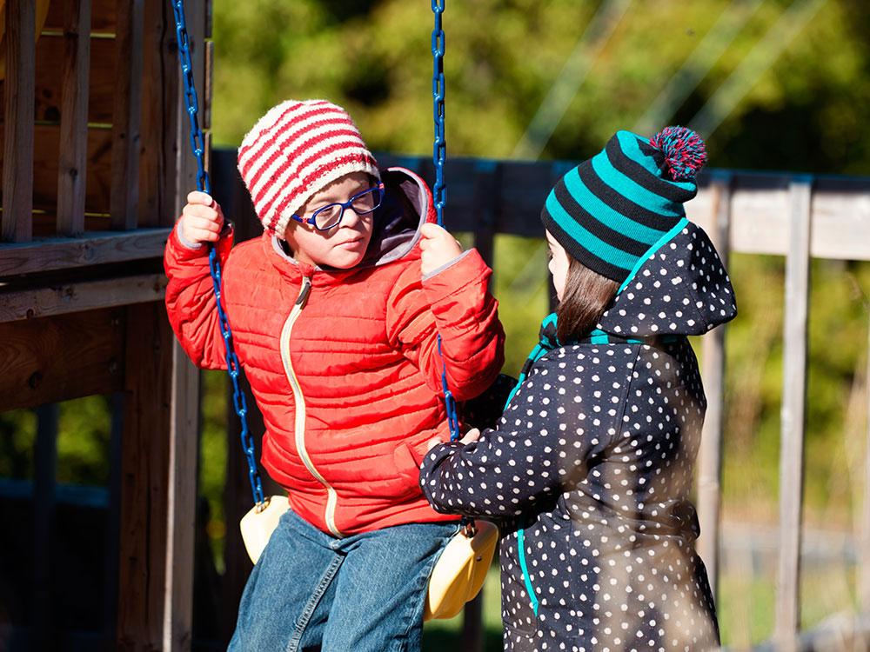
https://raisingchildren.net.au/school-age/connecting-communicating/connecting/supporting-friendships
Notes:
What is going on in this picture?

