Slide 1
Who Built a Home?

Slide 2
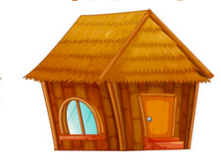
Who built a home
That was made of straw,
Made of straw, made of straw?

Slide 3
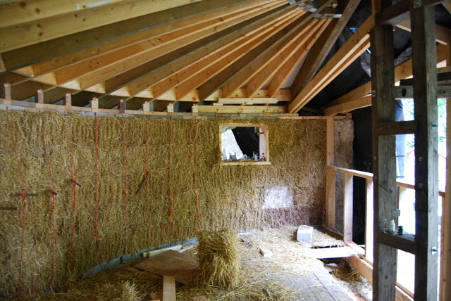
Who built a home
That was made of straw?
The first little pig, that’s who!

Slide 4
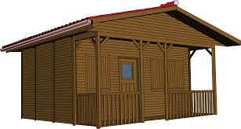
Who built a home
That was made of sticks,
Made of sticks, made of sticks?

Slide 5
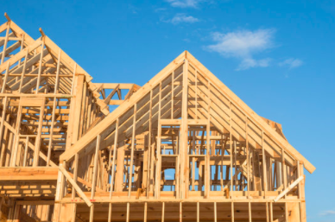
Who built a home
That was made of sticks?
The second little pig, that’s who!

Slide 6
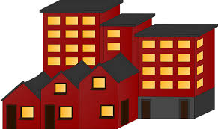
Who built a home
That was made of bricks,
Made of bricks, made of bricks?

Slide 7
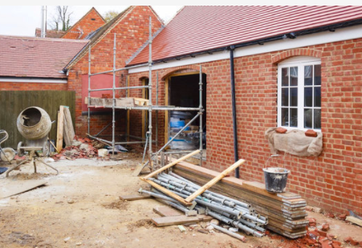
Who built a home
That was made of bricks?
The third little pig, that’s who!

Slide 8
Each pig’s home was right for her,
Right for her, right for her.
Each pig’s home was right for her,
Made with skill and care.

