Slide 1
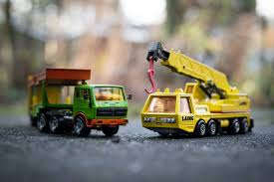
Here Come the Construction Vehicles

Slide 2
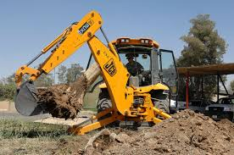
Here comes the backhoe to dig up rocks,
Dig up rocks, dig up rocks.
Here comes the backhoe to dig up rocks,
All around the ground.

Slide 3
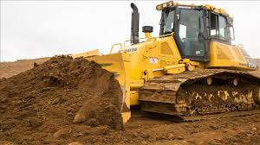
Here comes the bulldozer to push the dirt,
Push the dirt, push the dirt.
Here comes the bulldozer to push the dirt,
All around the ground.

Slide 4
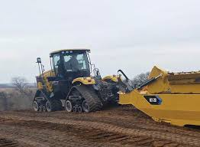
Here comes the scraper to smooth the earth,
Smooth the earth, smooth the earth.
Here comes the scraper to smooth the earth,
All around the ground.

Slide 5
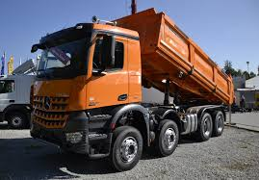
Here comes the dump truck to dump wood chips,
Dump wood chips, dump wood chips.
Here comes the dump truck to dump wood chips,
All around the ground.

Slide 6
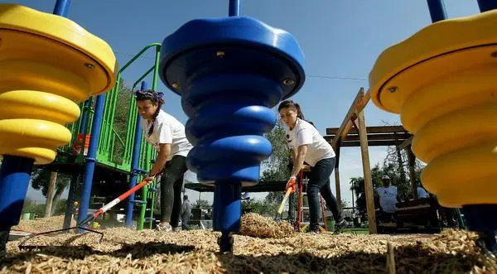
Here come the workers to build a playground,
Build a playground, build a playground.
Here come the workers to build a playground,
All around the town.

