Slide 1
Talk Time
Unit 2, Week 3

Slide 2
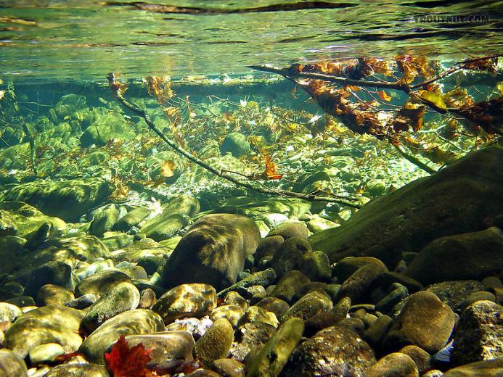
https://wallpapersafari.com/w/LR2ZxM
Notes:
What can you imagine about living where salmon live?

