Slide 1
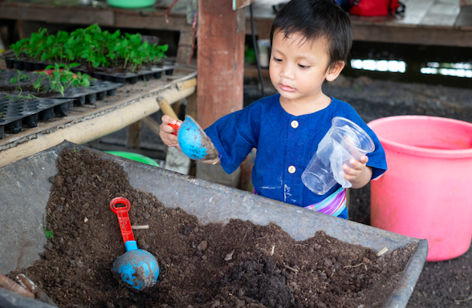
Dig in the Dirt

Slide 2
Dig, dig, dig in the dirt,
Wish and look for bugs,
Use a shovel or a hand,
You might touch worms and slugs.

Slide 3
Dig, dig, dig, in the dirt,
Wish and look for bugs,
If you grab a wiggly worm,
Be gentle and don’t tug!

