Slide 1
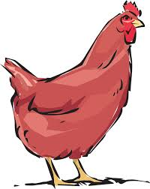
The Generous Little Red Hen

Slide 2
There once was a little red hen who wanted to build a nest box in her coop.

Slide 3
“Who will help me get the wood chips?”
“Not I,” said the cow.
“Not I,” said the horse.
“Not I,” said the sheep,
“Ok. I will do it myself,” said the little red hen.
And so she did!

Slide 4
“Who will help me get the hay?”
“Not I,” said the cow.
“Not I,” said the horse.
“Not I,” said the sheep,
“Ok. I will do it myself,” said the little red hen.
And so she did!

Slide 5
“Who will sit in my cozy nest?”
“I will,” said the cow.
“I will,” said the horse.
“I will,” said the sheep.
And all three animals joined the generous little red hen!

