Slide 1
Talk Time
Unit 2, Week 8

Slide 2
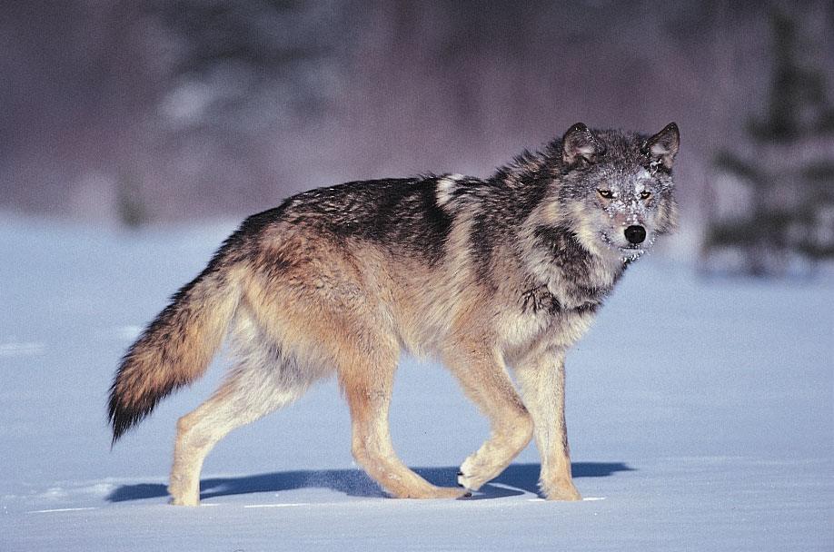
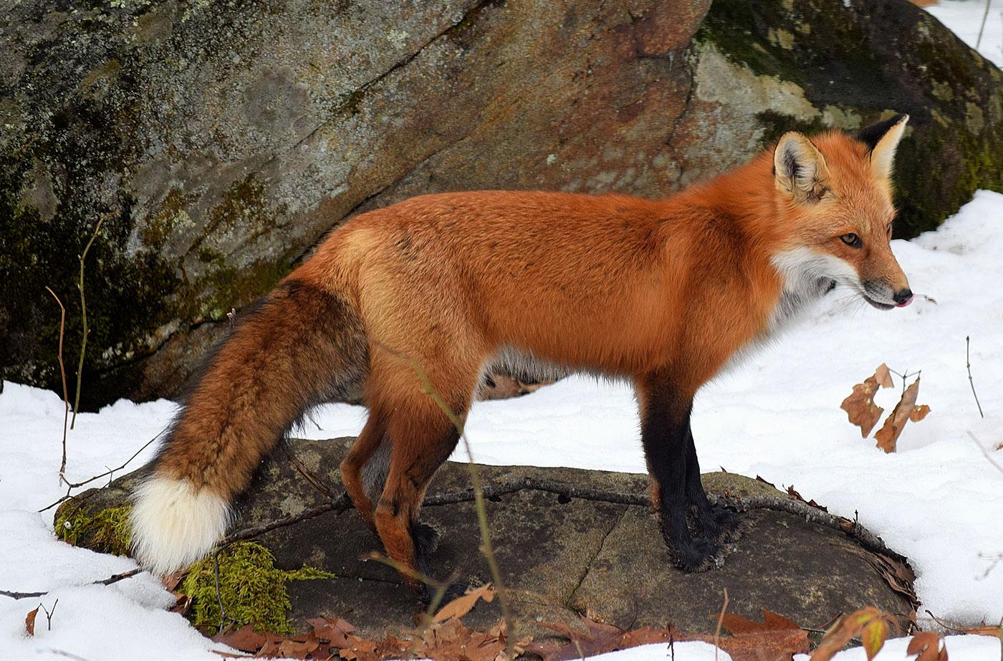
https://www.britannica.com/animal/wolf, https://www.nrcm.org/nrcm-creature-feature/red-fox/
Notes:
Here are a wolf and a fox.
What similarities do you notice? What differences do you notice? What questions do you have?

