Slide 1
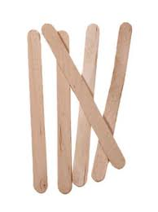
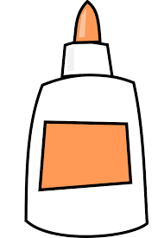
Popsicle Sticks and Glue
Modified from the poem by Leslie D. Perkins

Slide 2
We’re building a creation of popsicle sticks,
Just popsicle sticks and glue.
Houses and fences, sidewalks and streets,
A school and a library, too;
Museums, churches, temples, shops,
A playground, a park and a zoo.

Slide 3
Isn’t it wonderful what we can do
With popsicle sticks and a new tube of glue?
If you’re wondering what it will be,
You’ll have to come and see!

