Slide 1
Discovery Center
Unit 3, Week 6

Slide 2
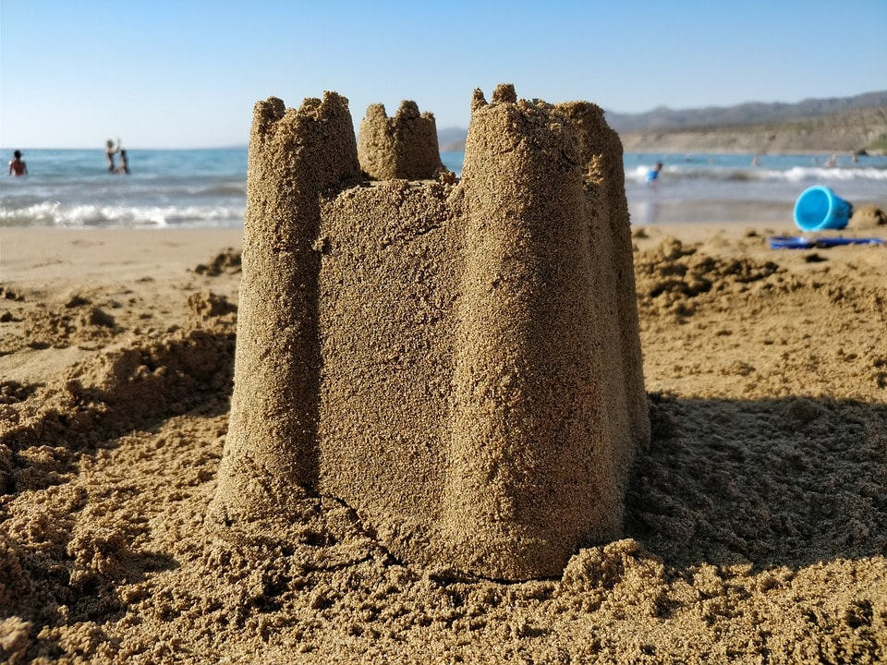
https://30a.com/tips-building-world-class-sandcastle/

Slide 3
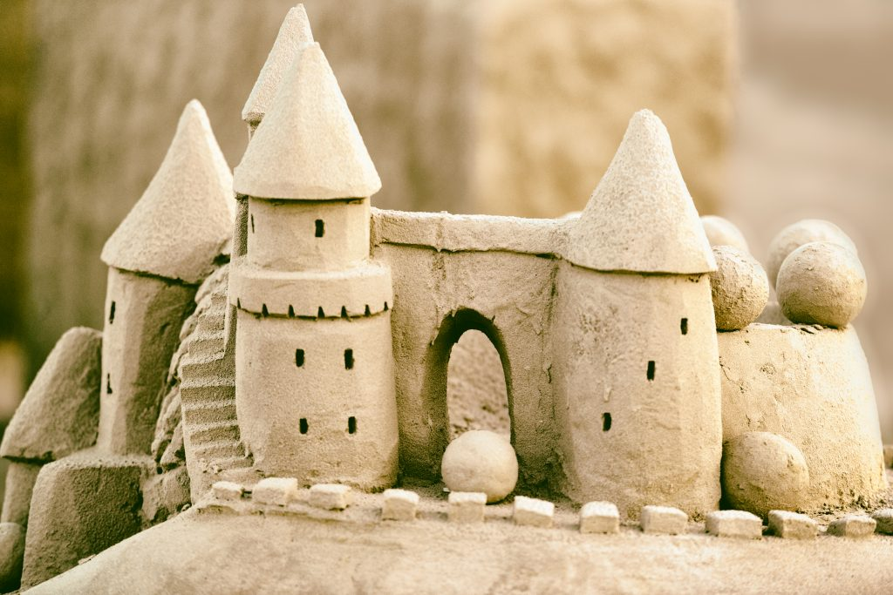
https://www.pbs.org/newshour/science/build-perfect-sandcastle-science

Slide 4
https://www.newfolks.com/activities/kids-sandcastles-build/
mold

Slide 5
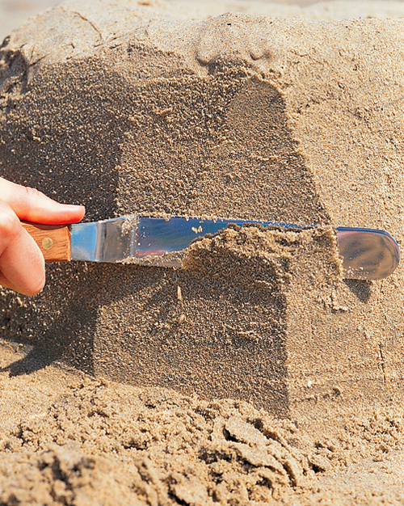
carve
https://www.nj.com/entertainment/2017/07/how_to_build_an_amazing_sandcastle_this_summer_in.html
https://www.marthastewart.com/274725/how-to-build-a-sand-castle

Slide 6
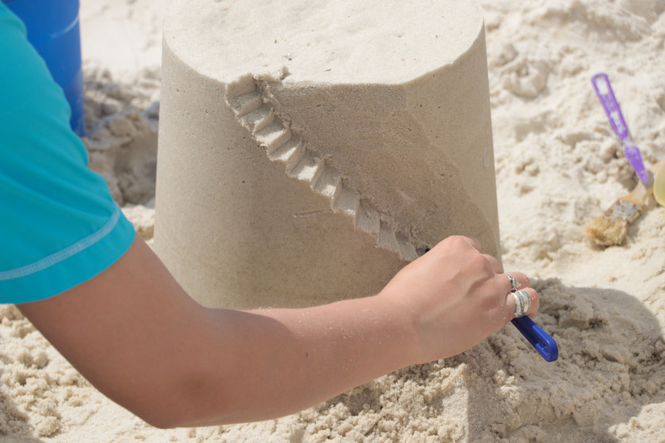
slits
https://www.gulfshores.com/blog/your-guide-to-building-the-perfect-sandcastle/

