Slide 1
Unit 3 Mid-Unit Assessment

Slide 2
Let’s go back and look at some of the natural elements that inspired Zaha Hadid.

Slide 3
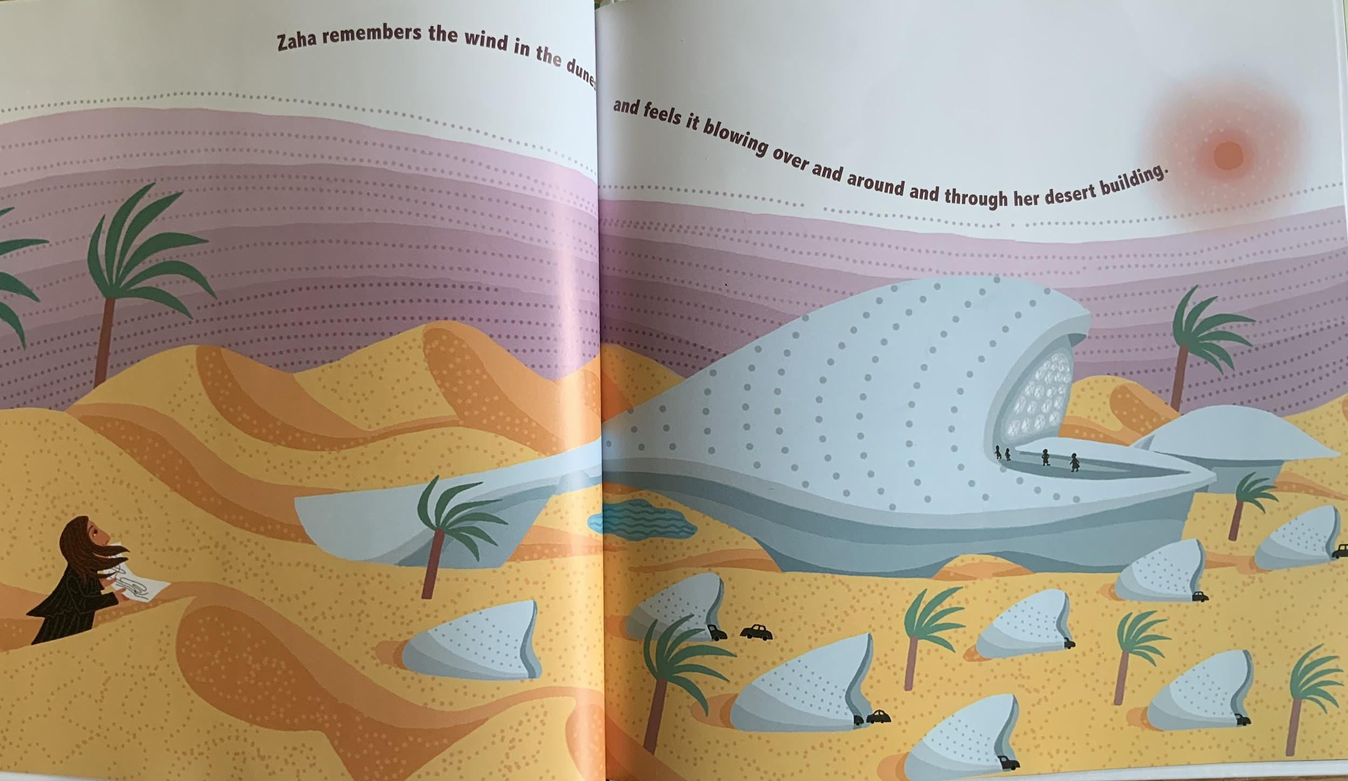

Slide 4
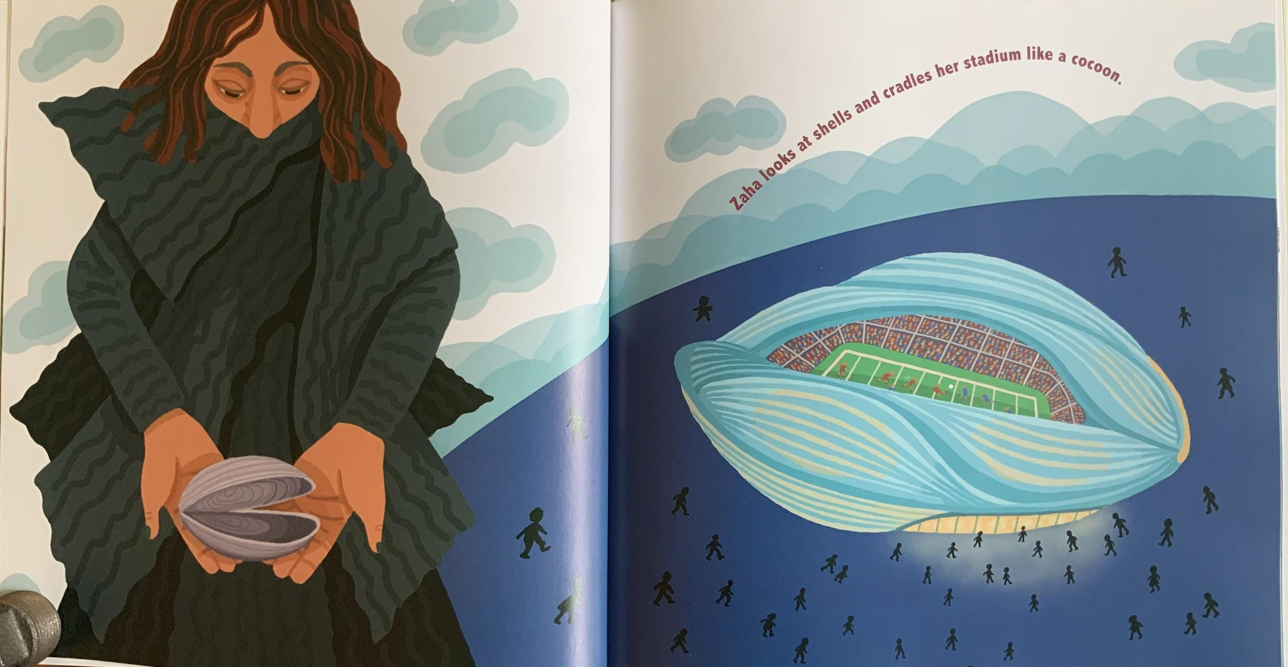

Slide 5
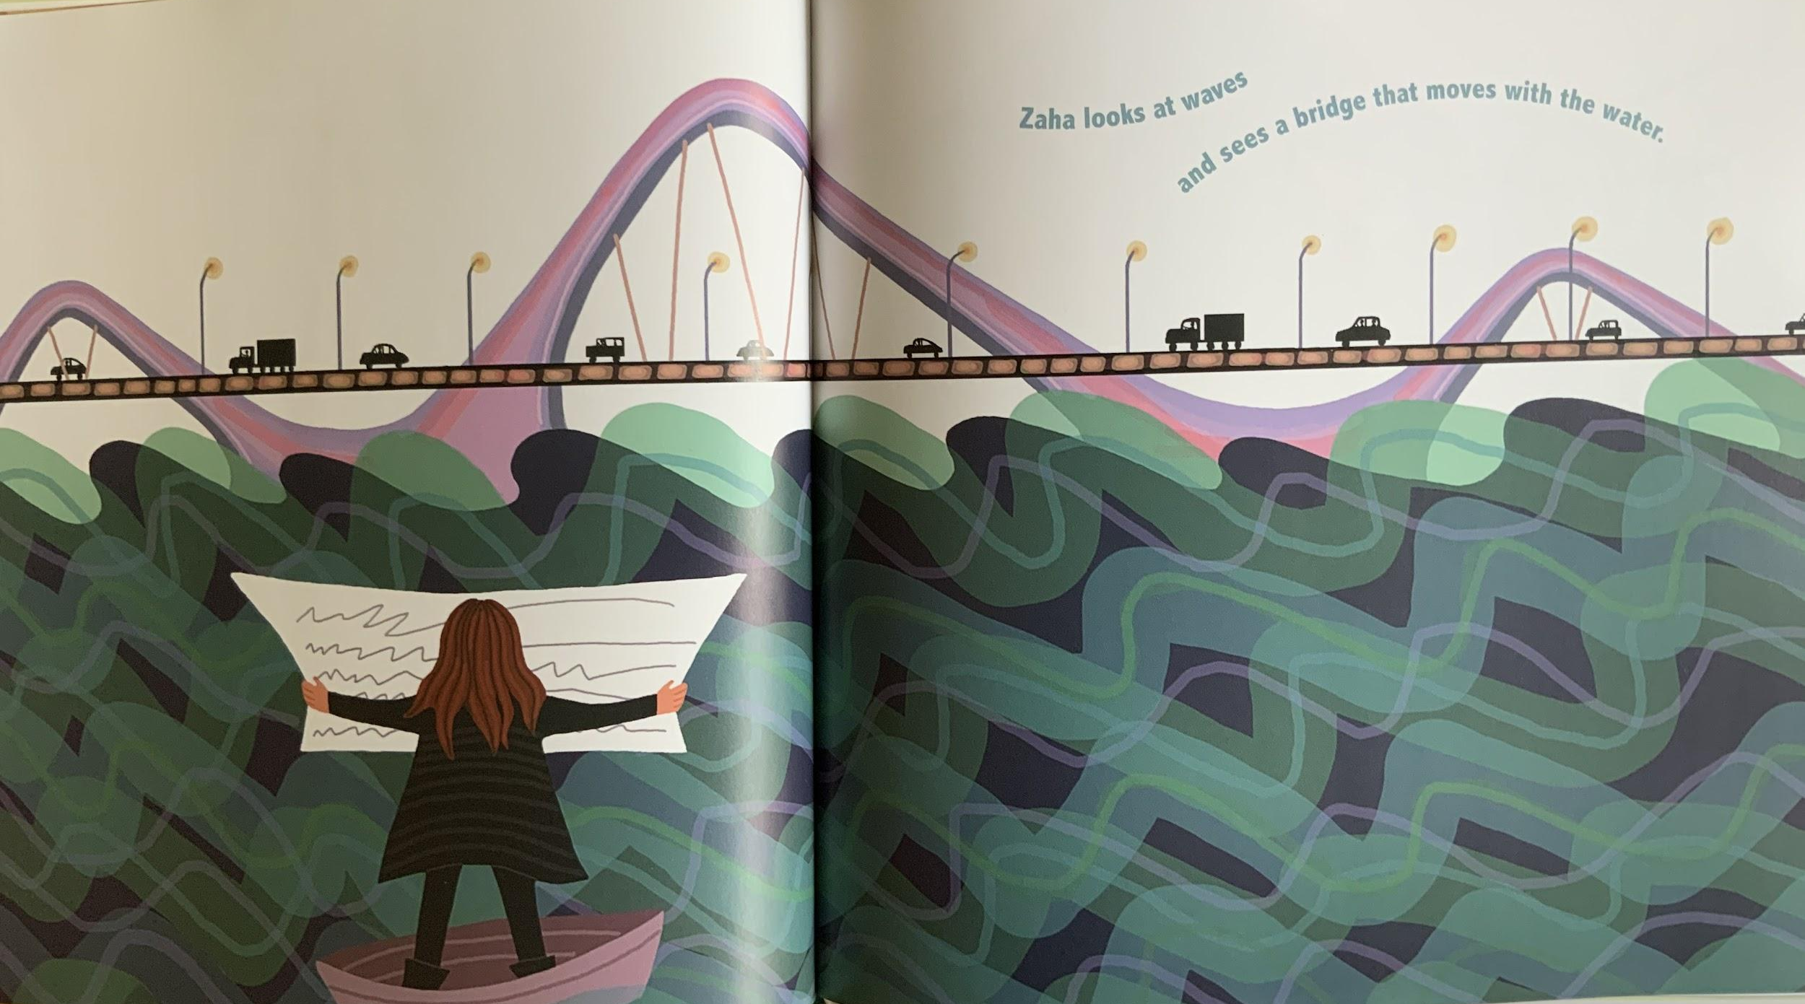

Slide 6
Now let’s look at one of Zaha Hadid’s buildings.

Slide 7
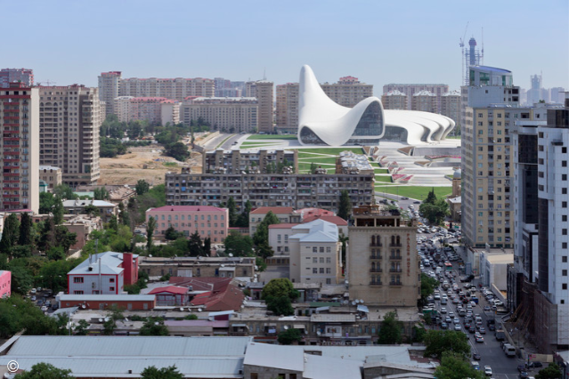
https://www.archdaily.com/448774/heydar-aliyev-center-zaha-hadid-architects
Notes:
Cultural Center Heydar Aliyev Center / Zaha Hadid Architects

Slide 8
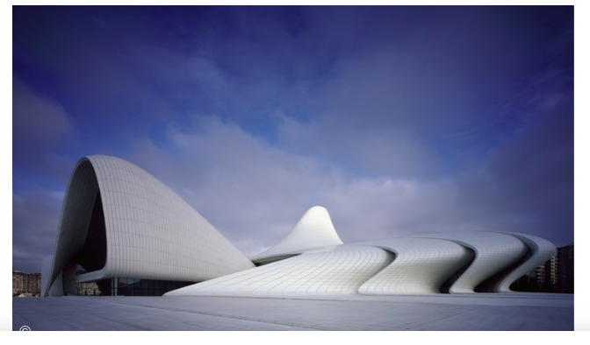
Heydar Aliyev Center, Baku, Azerbaijan
Designed by Zaha Hadid
https://www.archdaily.com/448774/heydar-aliyev-center-zaha-hadid-architects
Notes:
Cultural Center Heydar Aliyev Center / Zaha Hadid Architects

Slide 9
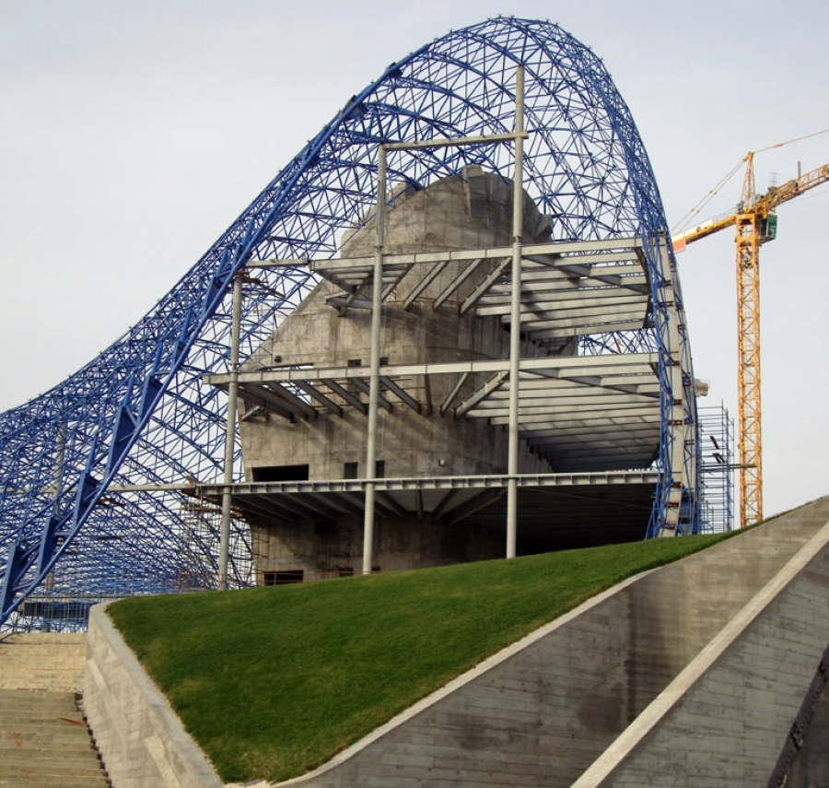
http://buildipedia.com/aec-pros/from-the-job-site/zaha-hadids-heydar-aliyev-cultural-centre-turning-a-vision-into-reality
Notes:
Zaha Hadid’s Heydar Aliyev Cultural Centre: Turning a Vision into Reality

Slide 10
Look closely at details in the photographs of the Heydar Aliyev.
What shapes do you see? Describe them.
What natural elements do you think inspired Zaha Hadid when she was designing this building?
How is this building similar to or different from our school building?

