Slide 1
Talk Time
Unit 3, Week 4

Slide 2
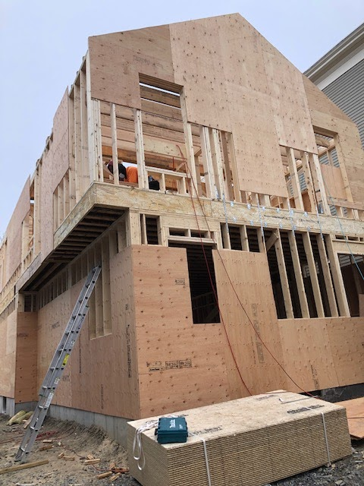
Photo: Melissa Tonachel
Notes:
Look again at this photo of a house being built.
How do you think the builders get their materials to the second floor? What tools or machines might they use?

