Slide 1
One, Two, Buckle My Shoe

Slide 2
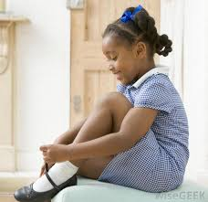
One, two,
Buckle my shoe.
Three, four,
Shut the door.
Five, six,
Pick up sticks.
Seven, eight,
Lay them straight.
Nine, ten,
A big fat hen!

Slide 3
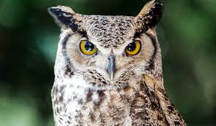
One, two,
Owls say “Hoo!”
Three, four,
Bears say “Roar!”
Five, six,
Dolphins make clicks.
Seven, eight,
They all sound great.
Nine, ten,
Let’s do it again!

