Slide 1
Talk Time
Unit 3, Week 1

Slide 2
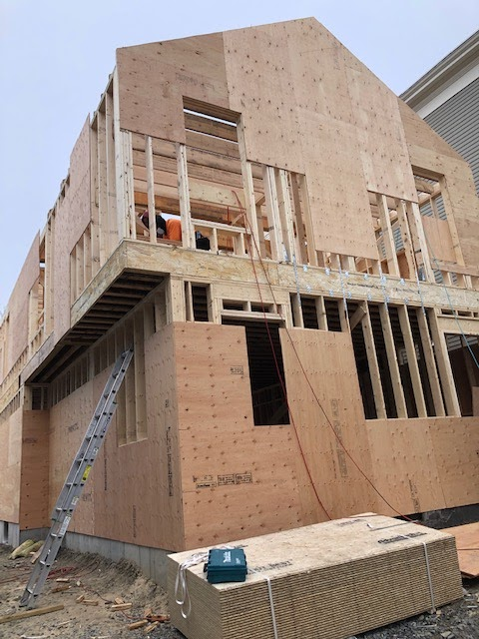
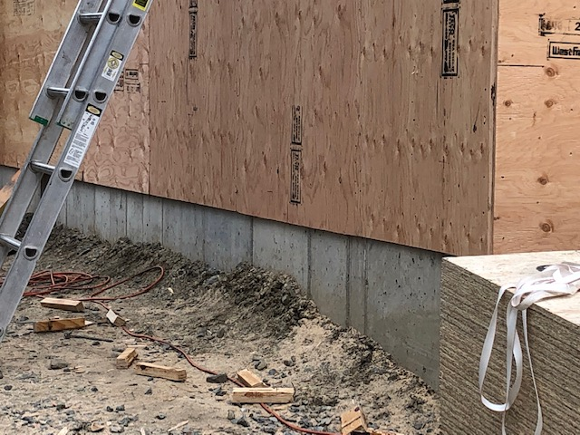
Photos: Melissa Tonachel
Notes:
This house is being built in the city. What do you notice about the materials the builders are using and how they are building it?

