Slide 1
Talk Time
Unit 3, Week 2

Slide 2
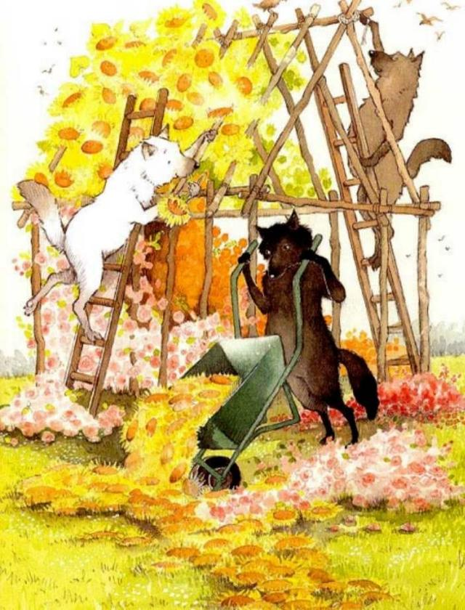
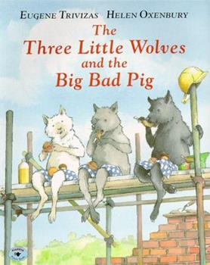
Notes:
Here is another version of a Three Little Pigs story. The wolves build a house of flowers. How does this make us think about wolves?

