Slide 1
Talk Time
Unit 3, Week 5

Slide 2
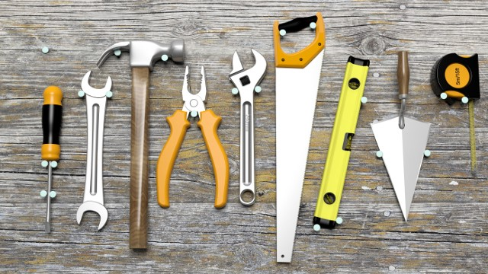
http://constructionexec.com/article/the-impact-of-new-tools-on-construction-productivity
Notes:
Here are some tools.
What specific jobs do you think each one might be used for?

