Slide 1
So Nice to Be Here
by Peter and Ellen Allard

Slide 2
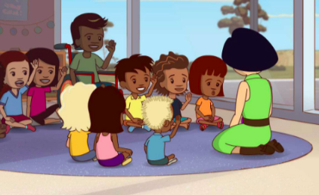
It’s so nice to be here
With my friends today.
Shout hooray!
Let’s all play.
It’s so nice to be here
With my friends today,
With my friends today.

Slide 3
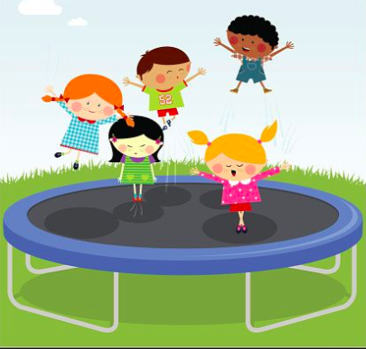
It’s so nice to bounce
With my friends today.
Shout hooray!
Let’s all play.
It’s so nice to bounce
With my friends today,
With my friends today.

Slide 4

It’s so nice to clap
With my friends today.
Shout hooray!
Let’s all play.
It’s so nice to clap
With my friends today,
With my friends today.

