Slide 1
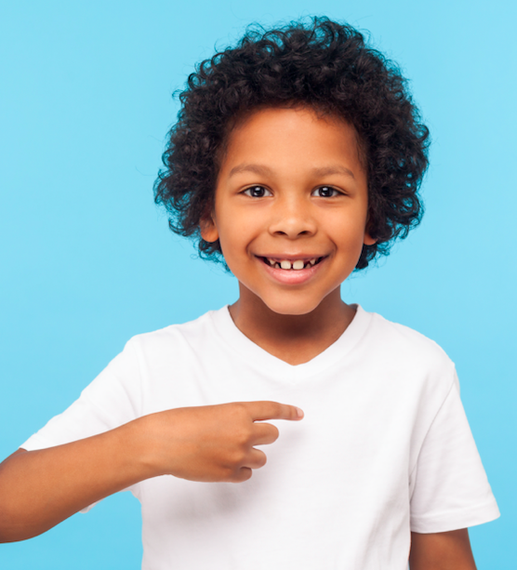
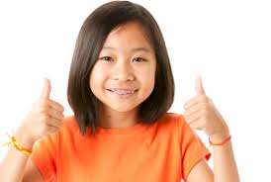
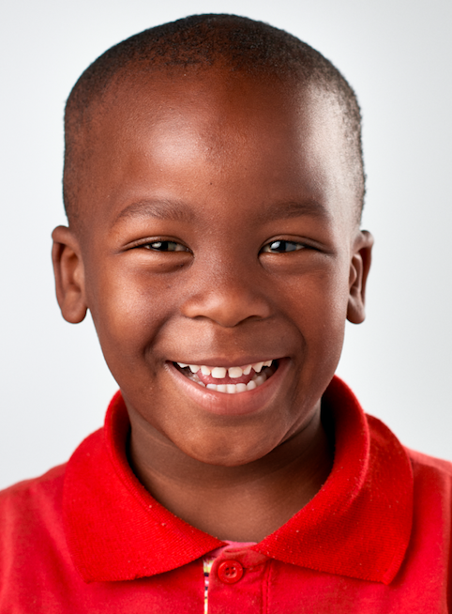
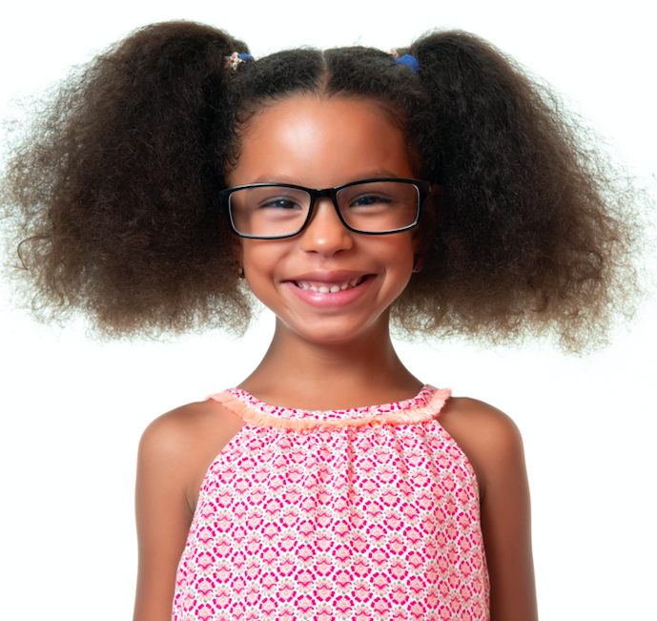
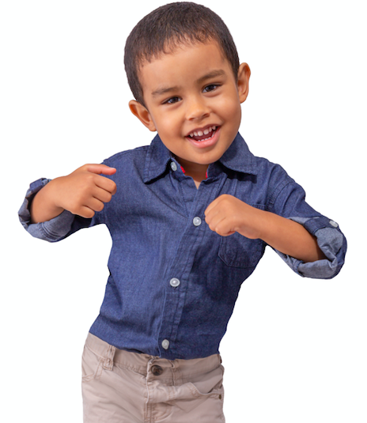
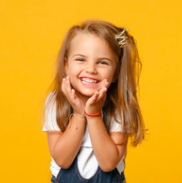
My Name

Slide 2
Everybody has a name
Some are different
Some, the same!

Slide 3
What is new to you,
Is familiar to me.
We each have names
Special to our family.

Slide 4
I like my name,
It’s nice to me.
I am exactly who
I want to be!

