Slide 1
Going to the Zoo
Modified from the song by Raffi

Slide 2
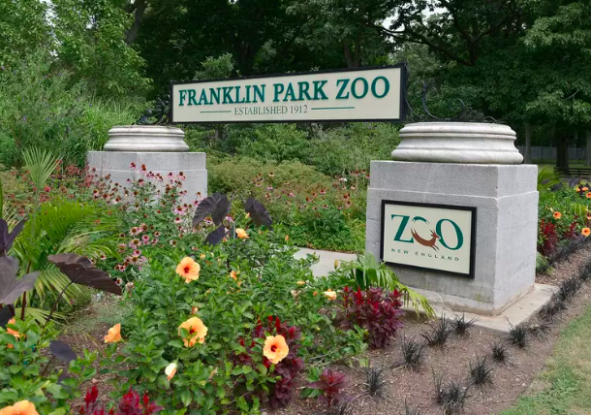
Grandma’s taking us to the zoo tomorrow,
Zoo tomorrow, zoo tomorrow.
Grandma’s taking us to the zoo tomorrow.
We can stay all day.

Slide 3
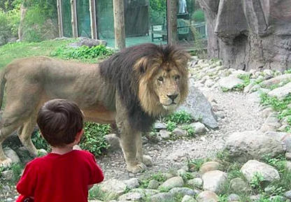
We’re going to the zoo, zoo, zoo.
How about you, you, you.
You can come, too, too, too.
We’re going to the zoo, zoo, zoo.

Slide 4
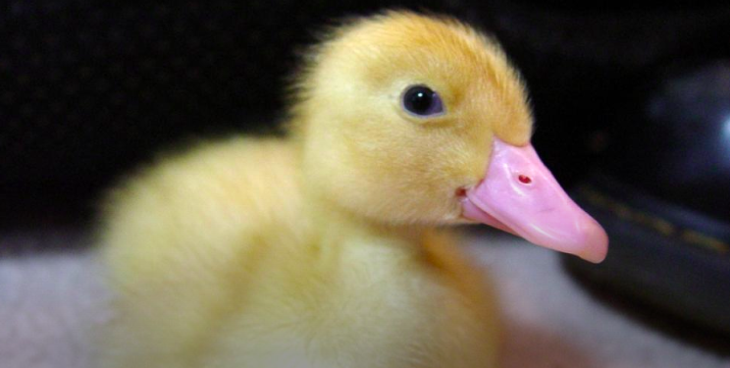
Look at all the yellow ducks a-quack, quack,
quacking.
Great big bills a quack, quack, quacking.
Look at all the yellow ducks a-quack, quack,
quacking.
We can stay all day.

Slide 5
We’re going to the zoo, zoo, zoo.
How about you, you, you.
You can come, too, too, too.
We’re going to the zoo, zoo, zoo.

Slide 6
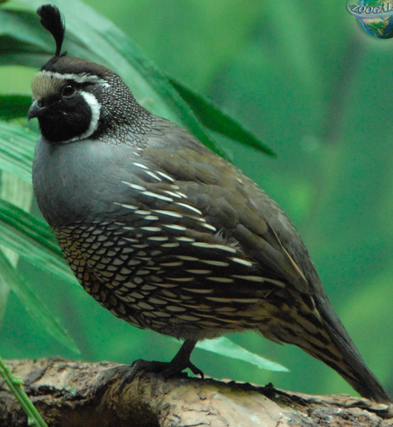
Look at all the quails’ wings flip-flap, flapping.
Quiet, quiet wings flip-flap flapping.
Look at all the quails’ wings flip-flap, flapping.
We can stay all day.

Slide 7
We’re going to the zoo, zoo, zoo.
How about you, you, you.
You can come, too, too, too.
We’re going to the zoo, zoo, zoo.

