Slide 1
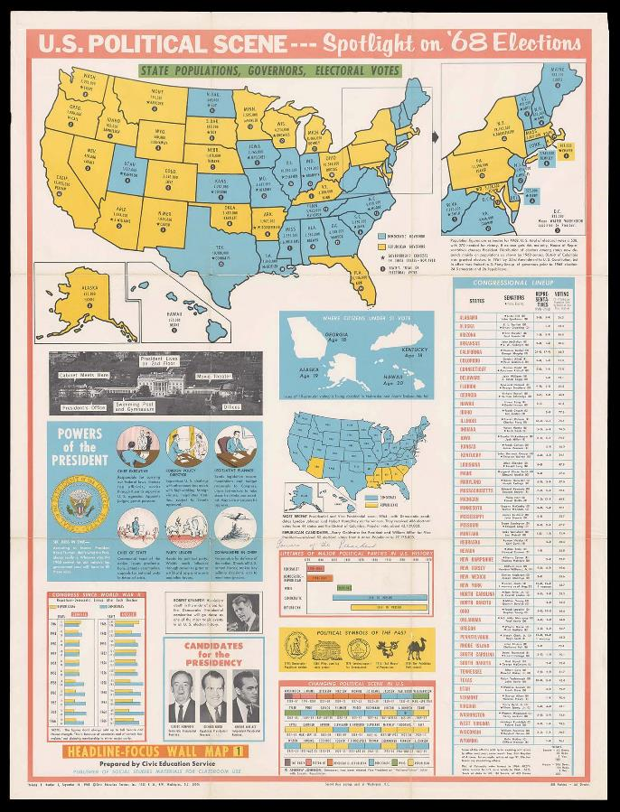
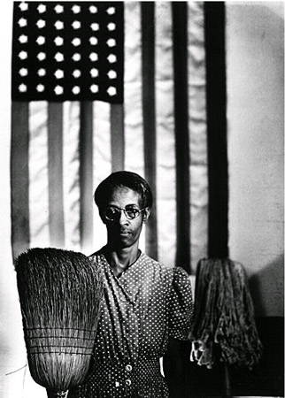
Bringing Visual Primary Sources into the Classroom
Libby Bischof, USM/Osher Map Library

Slide 2
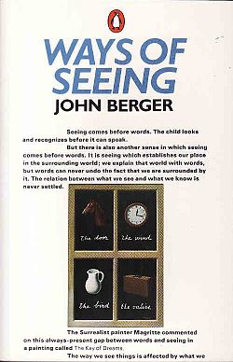
“The relation between what we see and what we know is never settled. Each evening we see the sun set. We know that the earth is turning away from it. Yet the knowledge, the explanation, never quite fits the sight.” ― --John Berger, Ways of Seeing
“Seeing comes before words. The child looks
and recognizes before it can speak.”
1972

Slide 3
“There were teachers and mentors
all along the way who believed in me.
In grade school I couldn’t remember
names and dates in history class, so
instead I made a ten-foot-long
illustrated map of Lewis and Clark’s
expedition. I put it up on the wall, and
the teacher realized that I wasn’t
goofing off but was, in fact, interested
in the material and gave me extra
credit to make up for my performance
on tests and papers. Art was what I
did to convince others that I was
interested in school. It was what I did
to feel good about myself.”

Slide 4
We live in a visual world. We are used to looking FAST. We need to learn [and to teach our students] to look SLOWLY. And we need LOTS of PRACTICE.

Slide 5
In its simplest definition, visual literacy is the ability to understand, create, and use visual images.

Slide 6
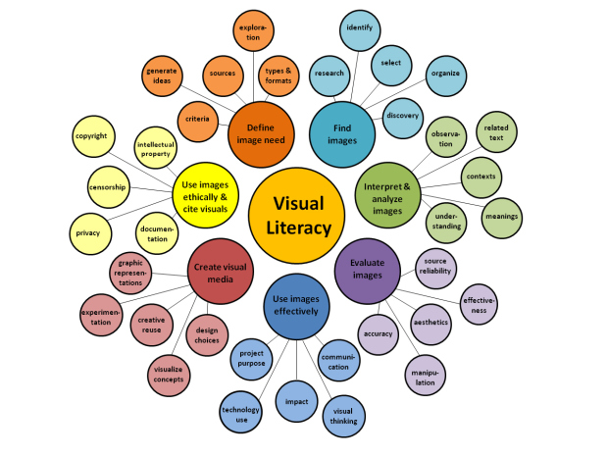
Visual Literacy Array based on ACRL’s Visual Literacy Standards by D. Hattwig,
K. Bussert, and A. Medaille. Copyright 2013 The Johns Hopkins University Press.

Slide 7
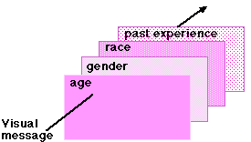
Keep in mind:
WHEN STUDENTS LOOK AT AN IMAGE, THEY
DO NOT ALL SEE THE SAME THING.
PERCEPTION is a key concept.
Also: culture, socio-economics, mood, etc…
Young children see objects and
shapes—as they develop, they
begin to discern concepts and
relationships FROM images.

Slide 8
Visual Thinking Strategies (VTS)
“What’s going on in this picture?”
“What do you see that makes you say that?”
“What else can you find?”
http://www.vtshome.org
[“What more can you say about when this is
happening?” “What would you like to ask the
artist if he or she were here?”]

Slide 9
Think about starting each class with a VTS warm up
(remote or in-person). The more students do it; the better they get!

Slide 10
Don’t reveal the title, caption, and context etc. until AFTER
you’ve done the exercise. VTS is not about getting a ”right”
answer; it’s about getting students comfortable with viewing and
discussing images. LOW STAKES.
Title: Elsie Shaw, a 6 year old cartoner during the summer,
Seacoast Canning Co., Factory #2. Her father is boss of cutting
room in Factory #1. He asked me to take some photos of her, as
he has her do a singing act in vaudeville in the winter, "and she's
old enough now to go through the audience and sell her own
photos."
Location: Eastport, Maine
Creator(s): Hine, Lewis Wickes, 1874-1940, photographer
Date Created/Published: 1911 August.

Slide 11
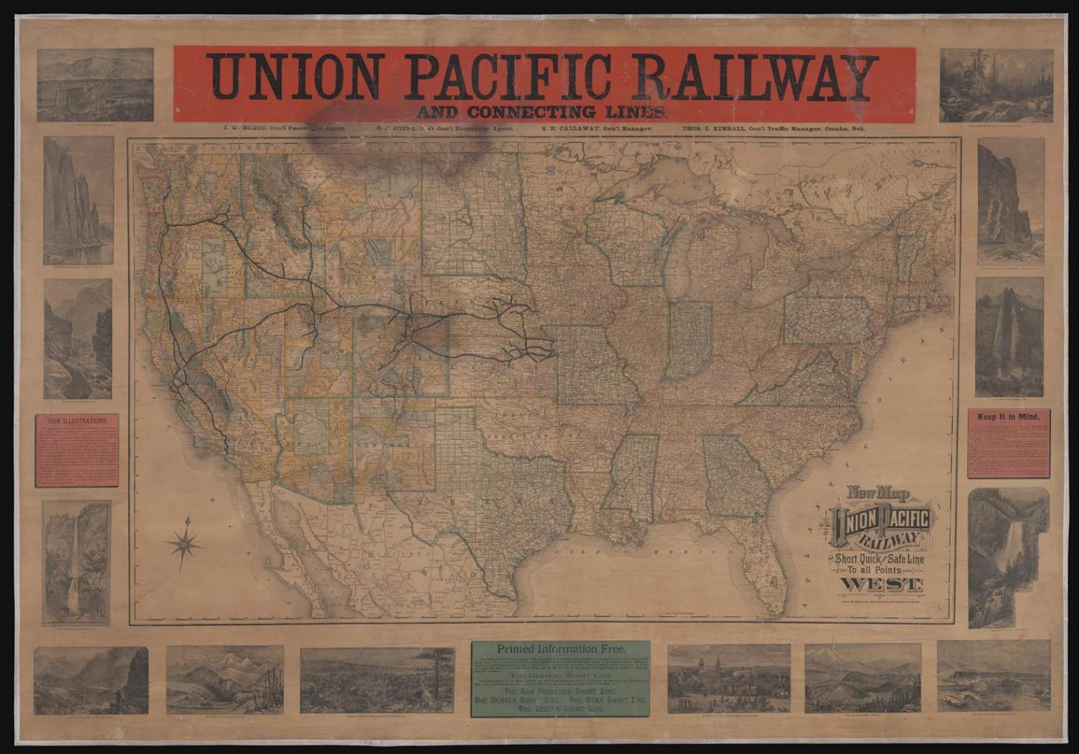
We can do this with maps too!

Slide 12
Title: New Map of the Union Pacific Railway the short, quick and safe line to all
points west
Alternative Title: Union Pacific Railway and connecting lines
Publisher: Rand McNally and Company,
Publishing Location: Chicago
Date Produced: 1887
Brief Description: Wall map issued by Rand McNally and Company for the
exclusive use by the Union Pacific Railroad Company at larger stations and
was not publicly distributed. The map shows the whole of the United States
illustrating routes of the Union Pacific and its many subsidiaries and connecting
routes of competing railroads. Includes 14 vignette views engraved by
Matthews-Northrup Company illustrating the sights along the railroad route,
mainly Colorado, Idaho, Oregon and Utah. Also included is textual advertising
promoting the Union Pacific's safety and economical travel.
Permanent URL: https://oshermaps.org/map/53429.0001

Slide 13
Let’s try another exercise/technique:
Set a timer for two minutes.
1) Look at the whole photograph at first, and then, either in your
head (or on paper, if printed), divide the photograph into
quadrants.
Get a pen and paper and list everything you see in the
photograph. Remember—at this stage we are OBSERVING.
____
2) Who do you think made the photograph? Why? What purpose
does it serve?
____
3) Now, begin to ANALYZE the photograph; list three
CONCLUSIONS you can infer from your OBSERVATAIONS.
You can choose to pair and share or share out after ANY/ALL stages.

Slide 14
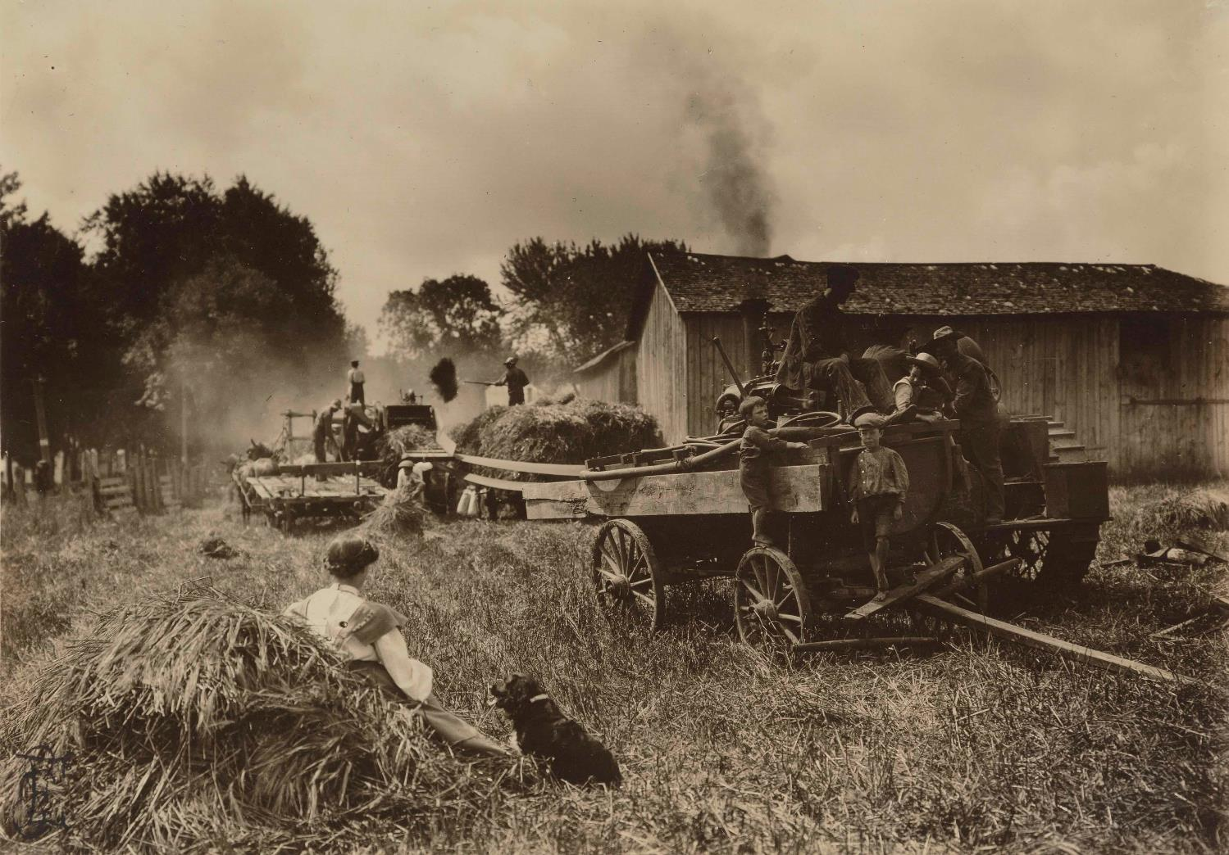

Slide 15
Take a look at this set of visual analysis strategies from the
Nasher Museum of Art, Duke University. Ultimately, this is
what we are trying to get our students to do:
Look Long
Look Close
Look Again
Look Critically
Look Thoughtfully

Slide 16
U.S. Political Scene—
Spotlight on ‘68
Elections
1968
These close looking and
visual analysis strategies
are especially important
with more complex
Infographics that include
multiple visuals and text!
Permanent URL:
https://oshermaps.org/map/54010.0001

Slide 17
Ad*Access
https://repository.duke.edu/dc/adaccess
1924

Slide 18
Do images illustrate, or do images tell the story? How does text inform visual understanding? How do images inform textual understanding?

Slide 19
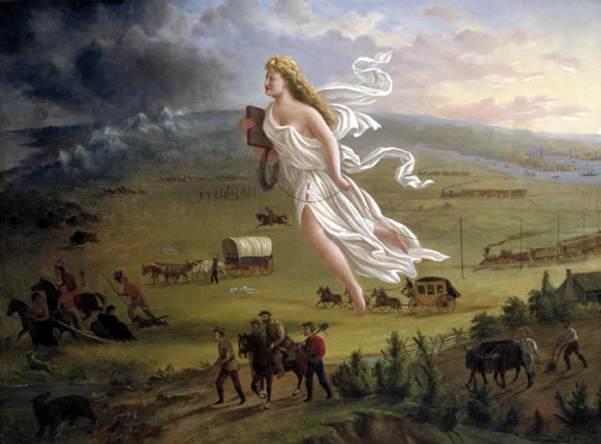

Slide 20
CAPTION
John Gast, American Progress, 1872

Slide 21
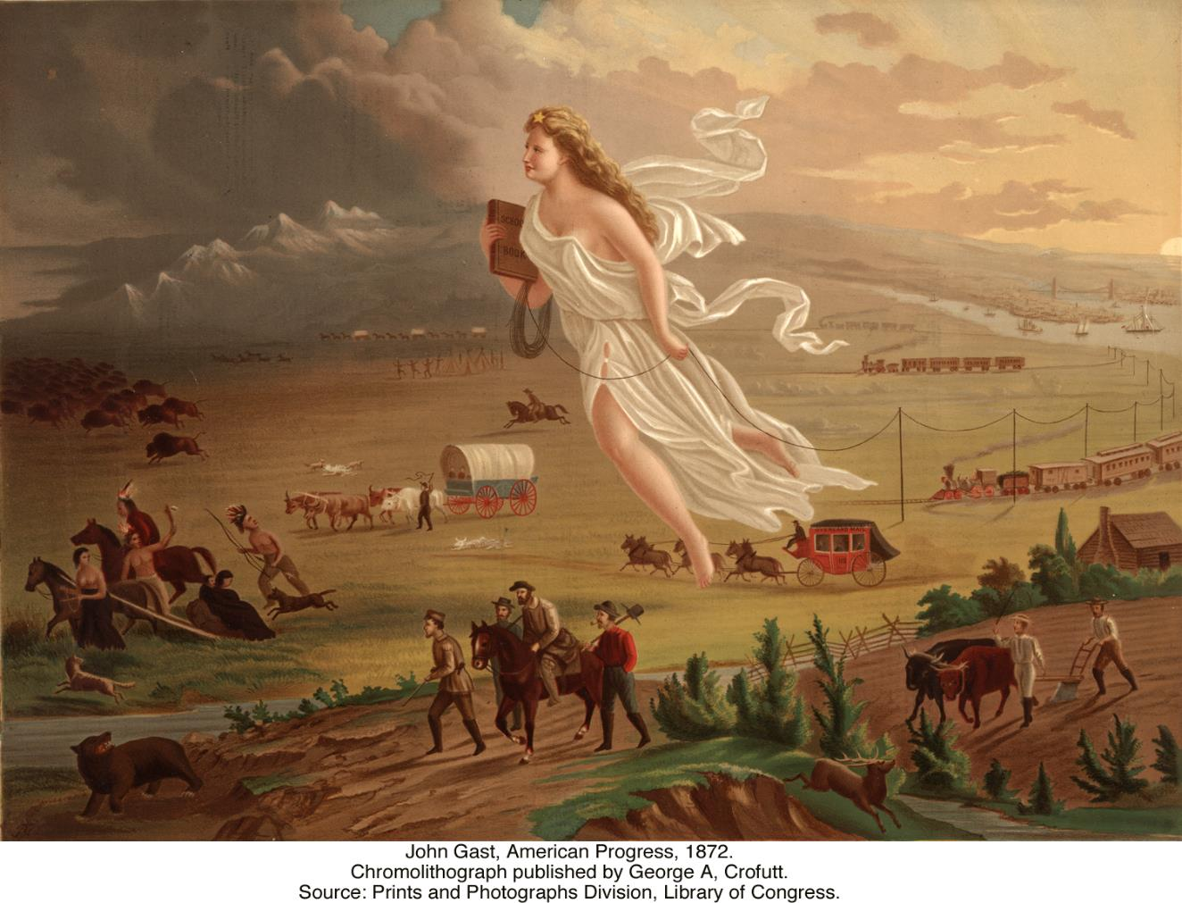

Slide 22
Excerpts from explanatory text that George A. Croffut provided to
market John Gast's 1872 lithograph “American Progress.”
This rich and wonderful country--the progress of which at the present time,
is the wonder of the old world--was until recently, inhabited exclusively by
the lurking savage and wild beasts of prey. If the rapid progress of the
"Great West" has surprised our people, what will those of other countries
think of the "Far West," which was destined at an early day, to be the vast
granary [grain producing region], as it is now the treasure chamber of our
country? …
In the foreground, the central and principal figure, a beautiful and charming
Female, is floating westward through the air bearing on her forehead the
"Star of Empire...." On the right of the picture is a city, steamships,
manufactories, schools and churches over which beams of light are
streaming and filling the air--indicative of civilization. The general tone of
the picture on the left declares darkness, waste and confusion. From the city
proceed the three great continental lines of railway.... Next to these are the
transportation wagons, overland stage, hunters, gold seekers, pony express,
pioneer emigrant and the warrior dance of the "noble red man." Fleeing from
"Progress"...are Indians, buffaloes, wild horses, bears, and other game,
moving Westward, ever Westward, the Indians with their squaws, papooses,
and "pony lodges," turn their despairing faces towards, as they flee the
wondrous vision. The "Star" is too much for them.
...What home, from the miner's humble cabin to the stately marble mansion
of the capitalist, should be without this Great National Picture, which
illustrates in the most artistic manner all the gigantic results of American
Brains and Hands! Who would not have such a beautiful token to remind
them of the country's grandeur and enterprise which have caused the mighty
wilderness to blossom like the rose!!!

Slide 23
Have a discussion with students about how we interpret something NOW and how it might have been interpreted when the image was created? We have to at least try to shed our 21st century baggage.

Slide 24
Even very young students can perceive historical information from an image. Sometimes I teach third-graders in Portland the History of Portland. I show them this image, and start with a very simple question:

Slide 25
What can you tell about the city from looking at this painting?

Slide 26
Prior learning and knowledge also inform our perception of new images. Do you know what historical era these photographs are from? How do you know?

Slide 27
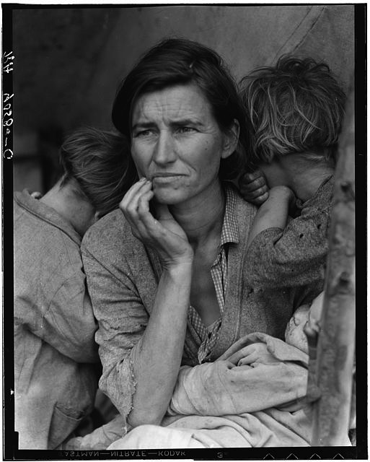

Slide 28
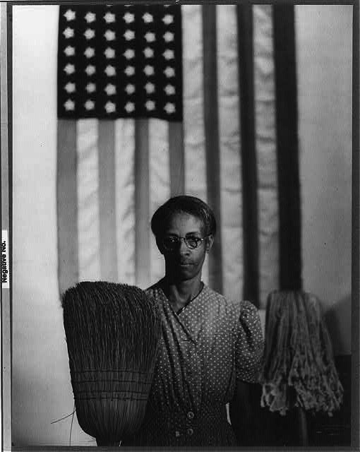

Slide 29
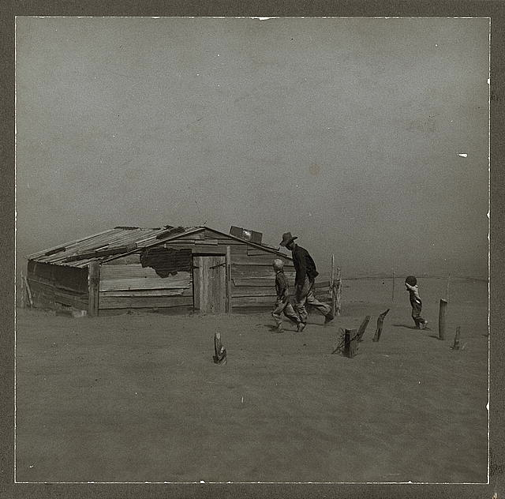

Slide 30
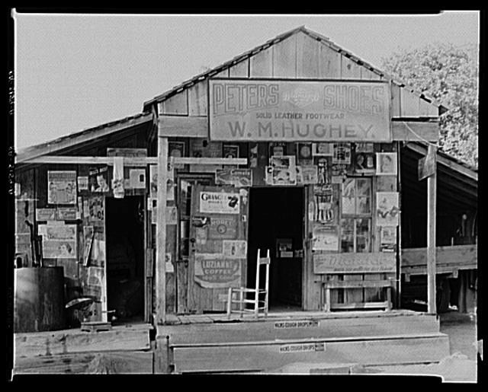

Slide 31
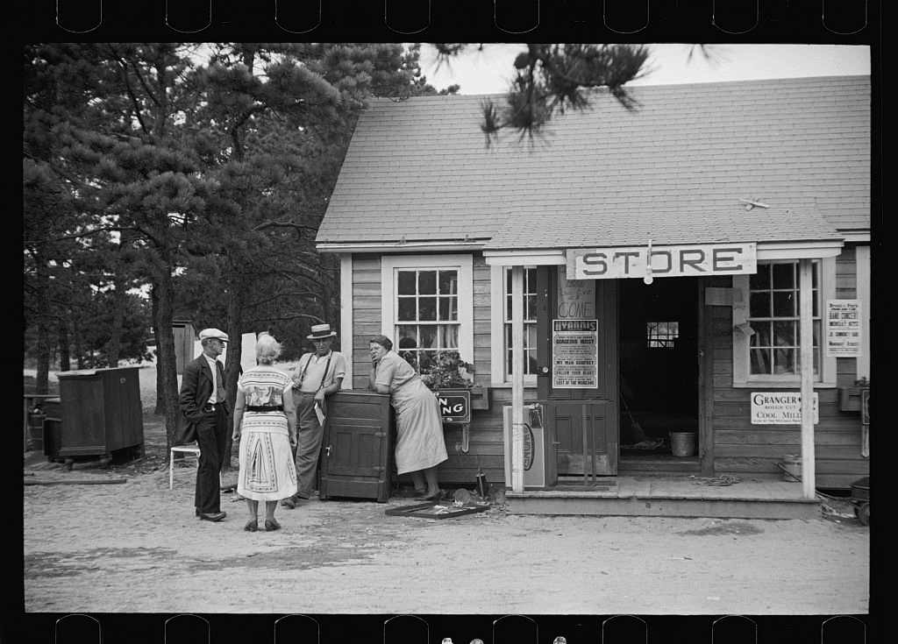

Slide 32
We tend to imagine the 1930s and 1940s in black and white because that’s how we’ve always seen them. What happens when you view the Great Depression in color?

Slide 33
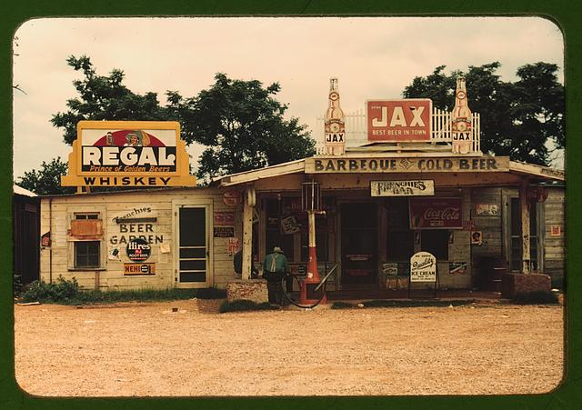

Slide 34
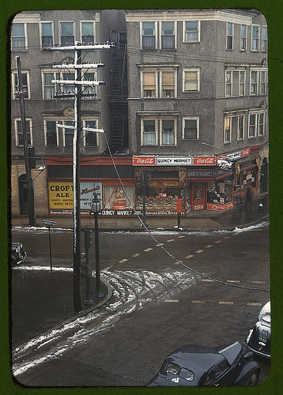

Slide 35
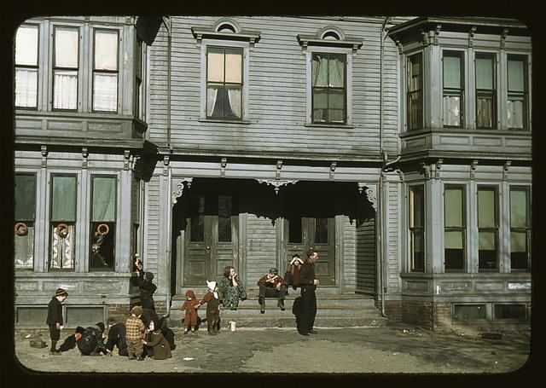

Slide 36
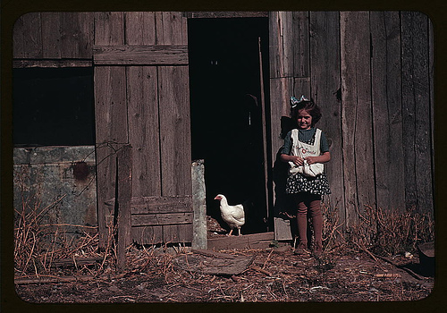

Slide 37
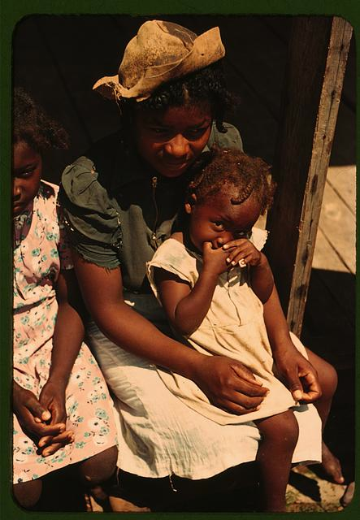
Does the use of color film
change your perception
of the 1930s and 1940s?
Why?
How?

Slide 38
“When historians look at photographs, they see historical matters
differently from those practicing other disciplines. They question
if and how the evidence establishes demonstrable linkages,
takes into account contingency and accident, and verifies
causality. The results of such inquiry can both expand the
purview of the history of photography and revise our
understanding of the significance of events and experiences in
the past. But historical scholarship informed by photography is
still a rarity.
For their part, historians must be willing to treat
photographs and other archival visual evidence with the same
seriousness and rigor they apply to text. Until they recognize
photographs as a legitimate resource, the value of historical
inquiry will never be adequately tested or fully realized.”
--Joshua Brown

Slide 39
In short, we need to learn how to [and teach our students to] READ photographs and other visuals as evidence. We need to go beyond the photograph or image as illustration.

