Slide 1
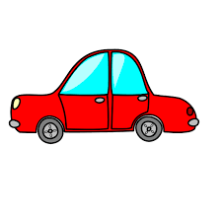
Riding in My Car
Modified from the song by Woody Guthrie

Slide 2
Take me riding in the car, car
Take me riding in the car, car
Take you riding in the car, car
I'll take you riding in my car

Slide 3
Click clack, open up the door, friends
Click clack, open up the door, friends
Front door, back door, clickety clack
Take you riding in my car

Slide 4
Click clack, open up the door, friends
Click clack, open up the door, friends
Front seat, back seat, sit on the seat
Take you riding in my car

