Slide 1
End of Unit Assessment
Unit 2

Slide 2
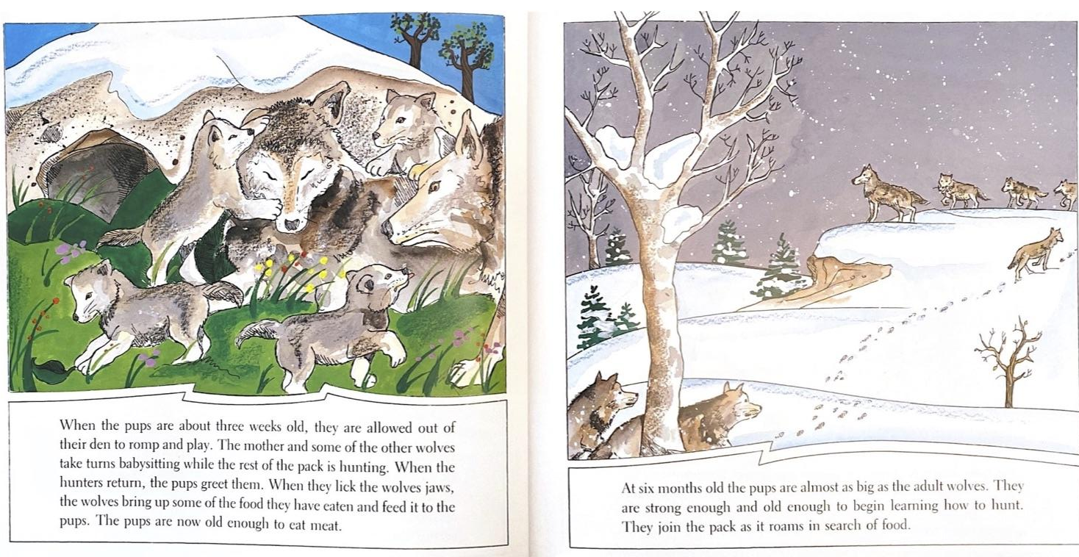

Slide 3
How do wolves grow and change?
Use details from the words and illustrations to support your ideas.

