Slide 1
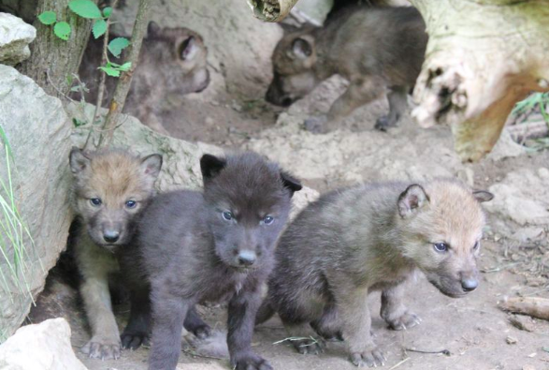
Five Little Wolves

Slide 2
Five little wolves sat in a den.
The first one said, “I see a hen.”
The second one said, “The hen is big.”
The third one said, “Let’s find a pig.”
The fourth one said, “I’ll take a cat.”
The fifth one said, “I can do that.”

Slide 3
So the five little wolves ran out in a dash,
and away they went
in a flash.

