Slide 1
Towns in Maine
K for ME Read Aloud, Unit 1 Week 2, Day 3

Slide 2
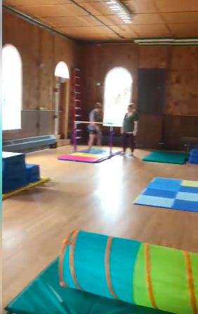
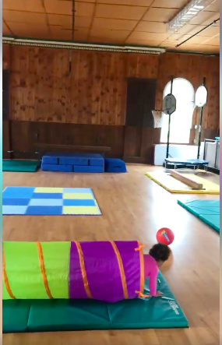
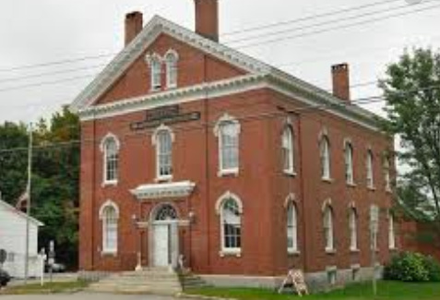
When the Line School was built, the town of Limerick moved the town hall into the old school. The old Limerick Town Hall is now a place where you can take tumbling lessons and dance classes.

Slide 3
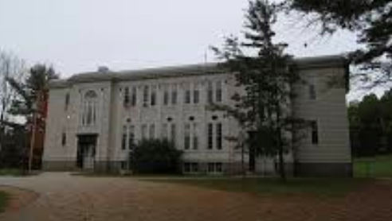
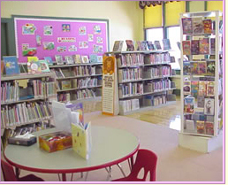
Limerick has a library where you can check out books! This building used to be the school.

Slide 4
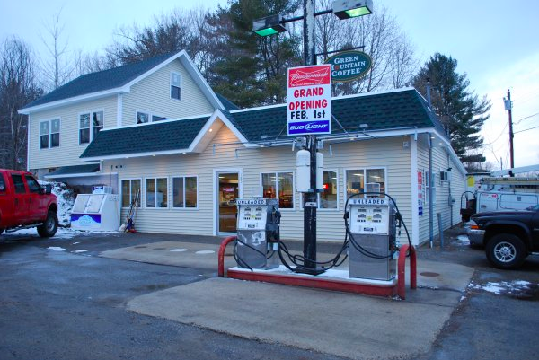
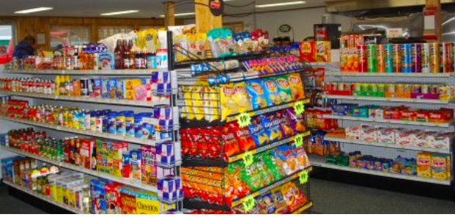
The town of Newfield has grocery stores that sell food and gas. K & D Corner Store is a great place to get pizza!

Slide 5
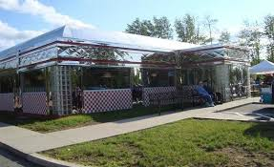
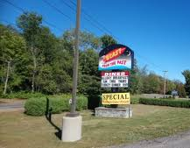
In Waterboro, Vandy’s and Blast from the Past diner are favorite places to eat.

Slide 6
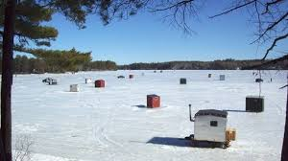
Boats come and go on Little Ossipee and Arrowhead Lake in Waterboro. You can swim in the summer and ice-fish in the winter. A lot of people live around the lakes.

Slide 7
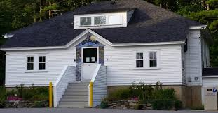
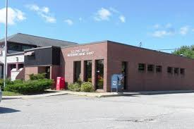
Waterboro has a library where you can check out books and a post office to send and pick up mail.

Slide 8
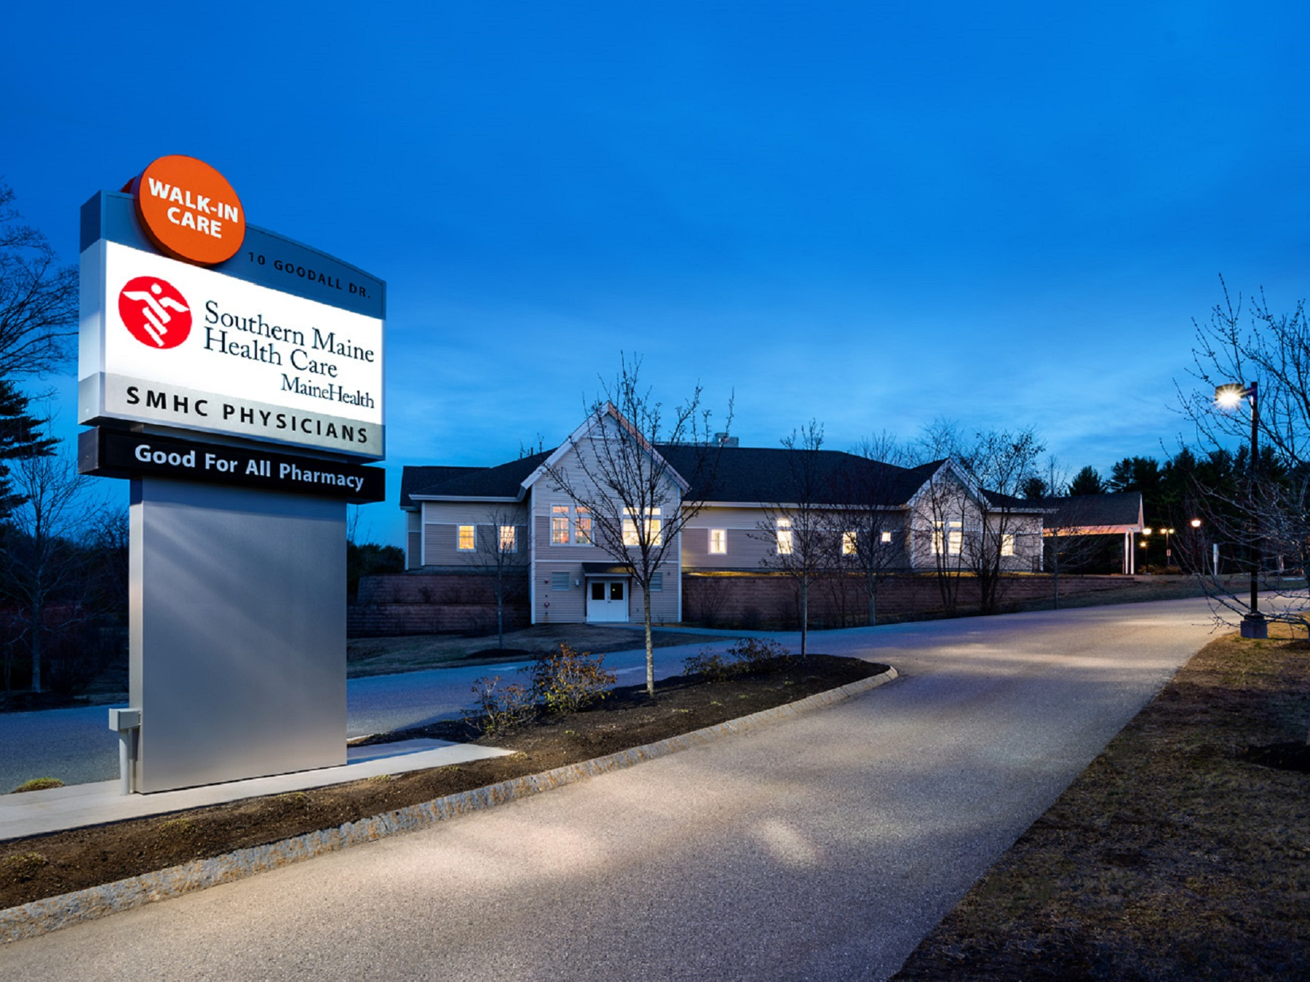
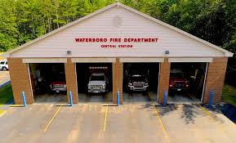
You can see nurses and doctors at Goodall Hospital and Village Pediatrics. You can see firefighters at the Waterboro Fire Department.

Slide 9
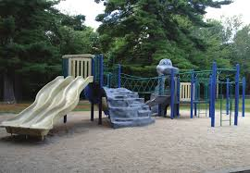
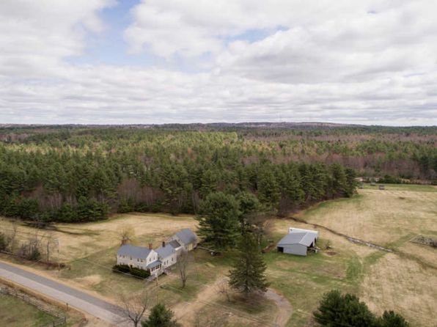
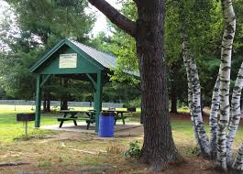
Waterboro has Friendship park. You can picnic and play with friends and family. You can hike and sled on Ossipee Hill Trail.
Notes:
What kind of community places do you see in Jamaica Plain? What else do you see? What do you wonder? (I notice a flag from the Dominican Republic, so I wonder if the restaurant serves Dominican Food?

Slide 10
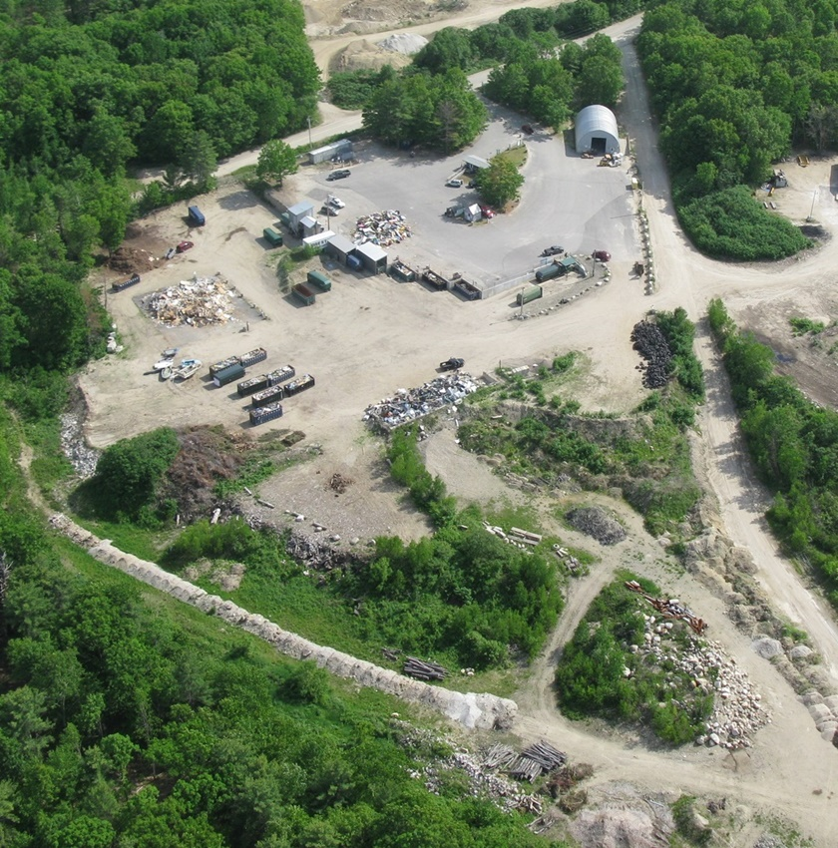
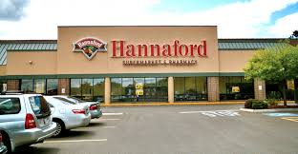
People shop at Hannaford in Waterboro. You bring your trash and recyclables to the transfer station.

Slide 11
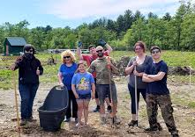
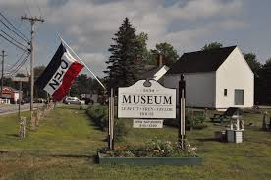
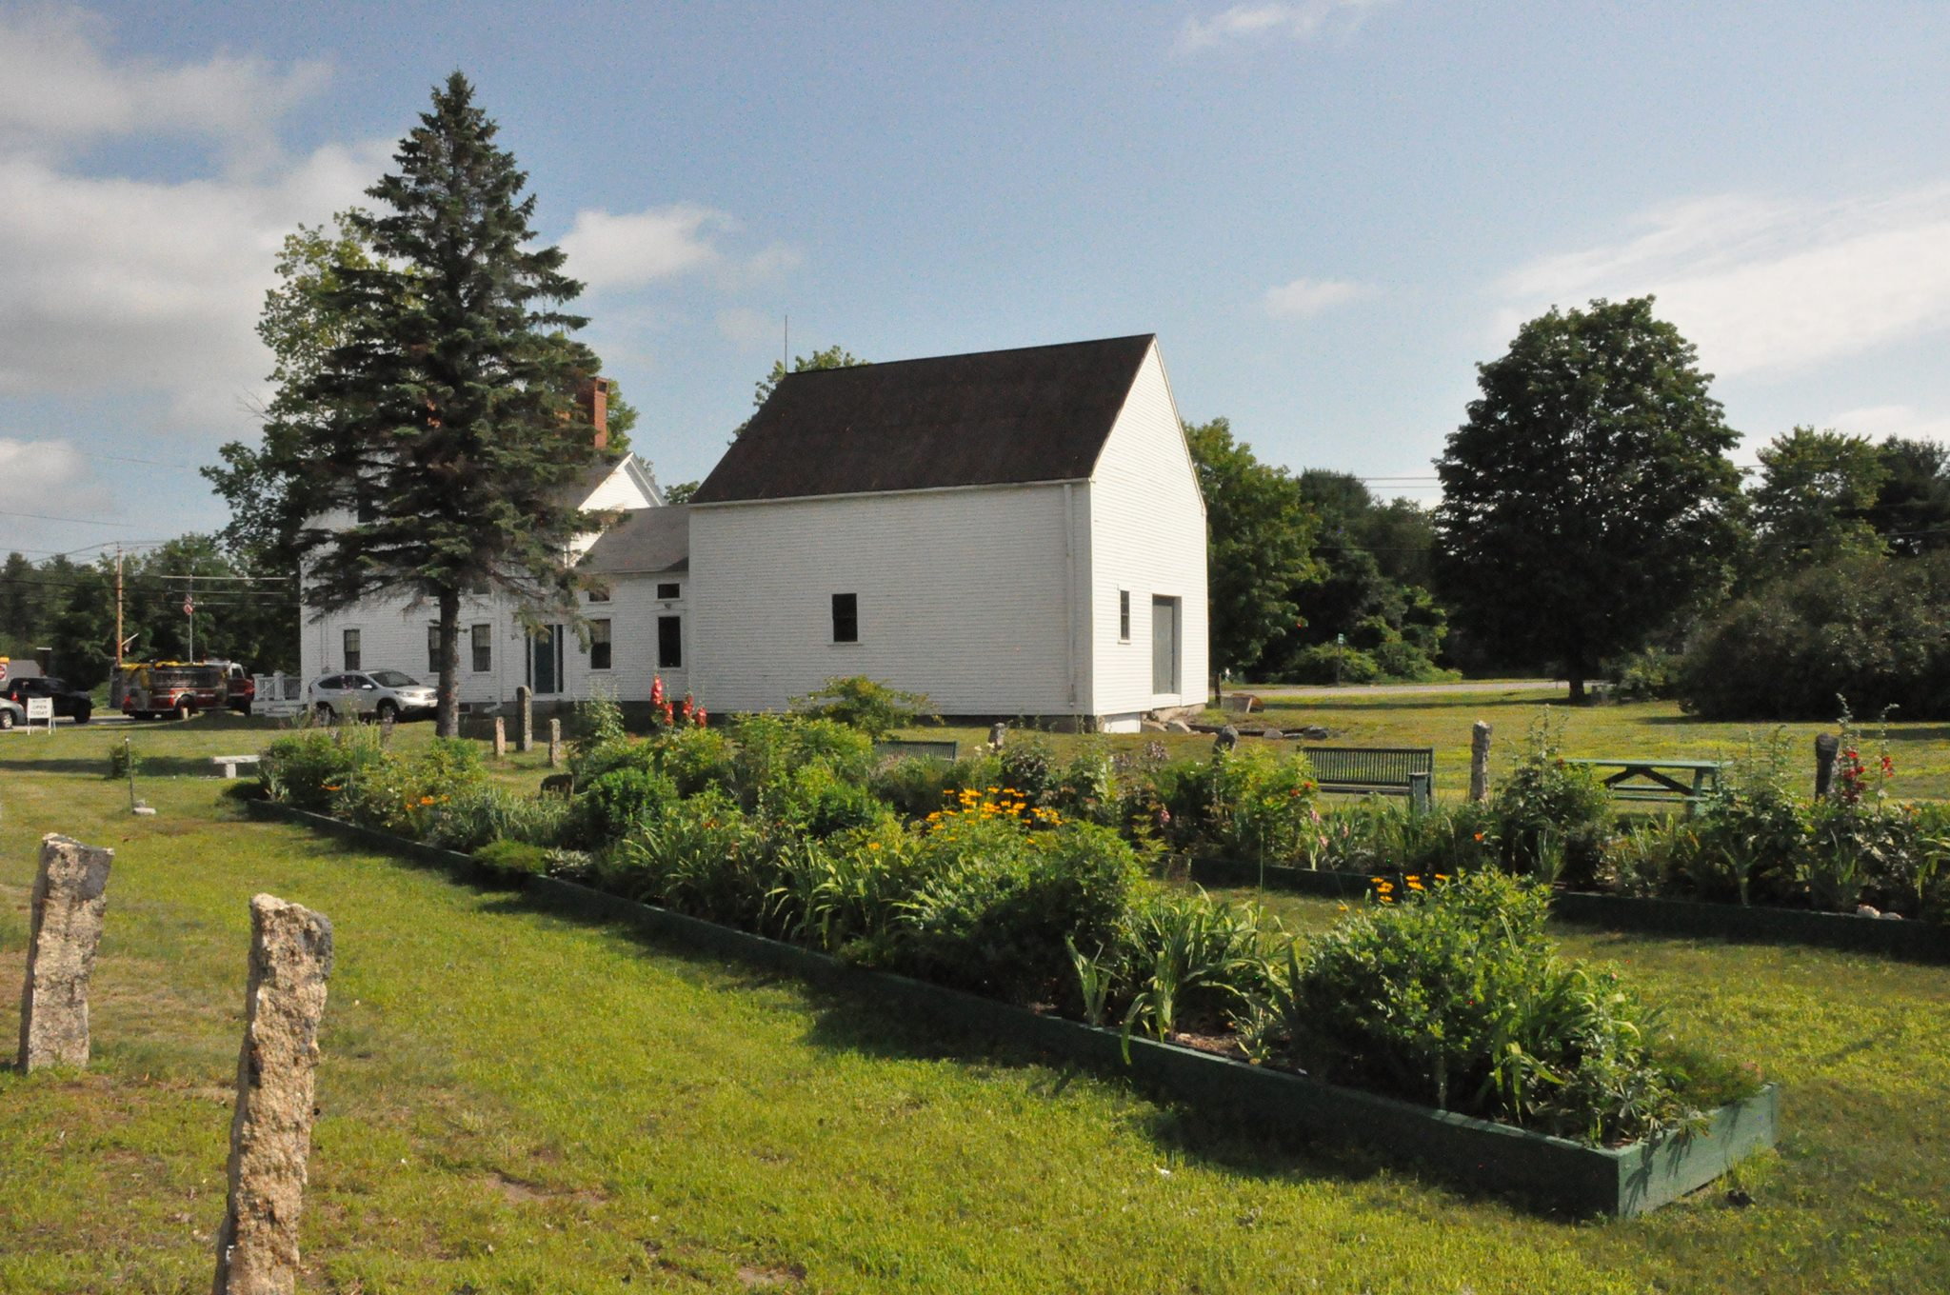
Communities gather at the community garden to grow food and at the Taylor/Frey/Leavitt House to enjoy music in the summer and ice-skate in the winter.

