Slide 1
PLANNING FOR THE NEXT NORMAL
PREPARE FOR THE WORST
HOPE FOR THE BEST

Slide 2
Session recorded May 19, 2020
https://youtu.be/ABSKKmfjQKk

Slide 3
WHAT COULD BE
As usual: traditional opening and school year
Open as usual; school year disrupted
Remote opening
Blend – alternating days, some students don’t return to the classroom

Slide 4
HOW DO WE PLAN FOR THE UNKNOWN?

Slide 5
RETHINK OUR FRAME
What is the input (resources or stimulus) for learning?
We focus on text as our source – but can we consider “text” to be any form of input?
Print
Digital
Audio
Video
Visual

Slide 6
RETHINK OUR FRAME
What is the output or artifact of learning?
Can we prepare for various forms of output?
Print
Digital
Audio
Video
Visual

Slide 7
FOCUS
Set clear goals, but not too many
Cluster standards to develop those goals
Focus on the learning before the doing
Determine success criteria before developing tasks
Notes:
Less is more. Be clear about the conceptual goals before determining tasks.

Slide 8
DIVERSIFY
In your current units of study –
Do you have texts that reflect our various contexts for learning?
Do you have opportunities for collaboration, differentiation, and feedback in different formats?
Have you included a variety of forms of presentation – traditional, digital, otherwise?

Slide 9
SIMPLIFY
Be practical – use the media most accessible to your students
Consider equity – develop personalized approaches (which does not mean a unique plan for each student)
Plan your professional choice board – know how you will pivot as needed
Notes:
Pause to explore what personalized approaches really mean.

Slide 10
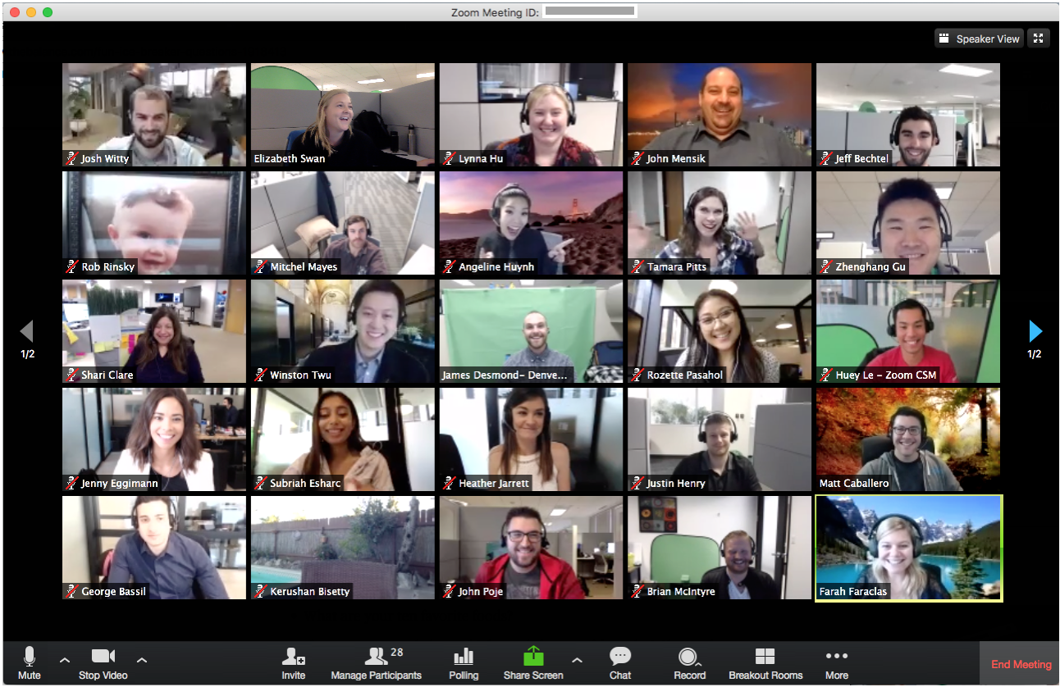
SO HOW DO WE DO IT?

Slide 11
INPUT
Inventory your “text” use – are there forms or media you don’t currently include?
Explore a new text type as a genre study - apply familiar practices
What does the text say? Do students comprehend?
How does the text work? What are the essential elements of the text form?
What does the text mean? Can students analyze, synthesize, and interpret?

Slide 12
Input
Maintain familiar learning moves
Know the genre (or form) common characteristics, uses, typical audiences, purpose
How can students annotate the text?
What will students extract from the text?
How can students “read like a writer” in this text form?
What artifacts demonstrate success?
Notes:
For example, can students analyze an audio presentation like a speaker or review a film like a producer?

Slide 13
Goal: Demonstrate an understanding of an audio text including structure, critical elements, purpose, and preferred qualities.
Essential question (genre study) - When is an audio text a preferred mode of sharing information?
ELA Standards READING: Craft and Structure R.8.6-8: Analyze how the organization and structure of specific features and components in various texts develop ideas and/or meaning, contributing to the author’s purpose for the text as a whole. R.9.6-8: Analyze how and why authors from various contexts (e.g. diverse, intersectional, multicultural, religious) use perspective for intended purposes and/or audiences. READING: Integration of Knowledge and Ideas R.11.6-8: a. Analyze how two or more authors of various texts present information by emphasizing different interpretations of a theme and/or topic. b. Evaluate the advantages and disadvantages of an author’s choice for using a specific form and/or text type. SPEAKING AND LISTENING: Comprehension and Collaboration SL.2.6-8: a. Interpret information, analyze the main ideas and supporting details, and analyze the purpose of information presented in diverse formats. b. Explain how the presentation contributes to or clarifies a topic under study, and evaluate the motives (e.g., social, commercial, political) behind its presentation. c. Delineate a speaker’s argument and specific claims, evaluate the soundness of the reasoning and sufficiency of the evidence, and identify when irrelevant evidence is introduced.
Task(s): analyze and evaluate audio texts
Artifact(s): graphic organizer

Slide 14
"We know that teaching by telling and learning by listening are a really weak form of learning. We know effective learning involves learning by doing, collaboration, mentoring, and coaching."
Harvard Graduate School of Education
Finding the Silver Lining, 5/7/2020

Slide 15
Collaboration and Output
What methods of collaboration can you access?
Are students using digital tools to collaborate in the traditional classroom?
Collaborate to reflect, plan, draft, and revise.
How does a peer edit work when the output is not an essay?
What structures of collaboration are universal?

Slide 16
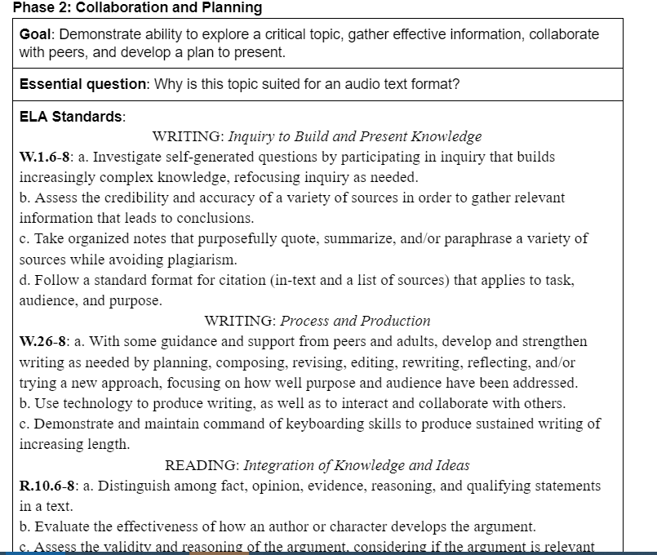

Slide 17
Present and Respond
Engagement doesn’t end with the final product

Slide 18
Output
Purpose – for the content and for the type of text
Audience – who will engage with the text and what is the intended effect on the audience?
Form and format – genre qualities
Response –practice appropriate response to peer work
Notes:
Digital literacy is a critical skill. Using digital media wisely and responding ethically and appropriately takes direct instruction and practice. Voice, shades of meaning, interpretation of visuals, one, precise language, all are part of digital literacy development.

Slide 19
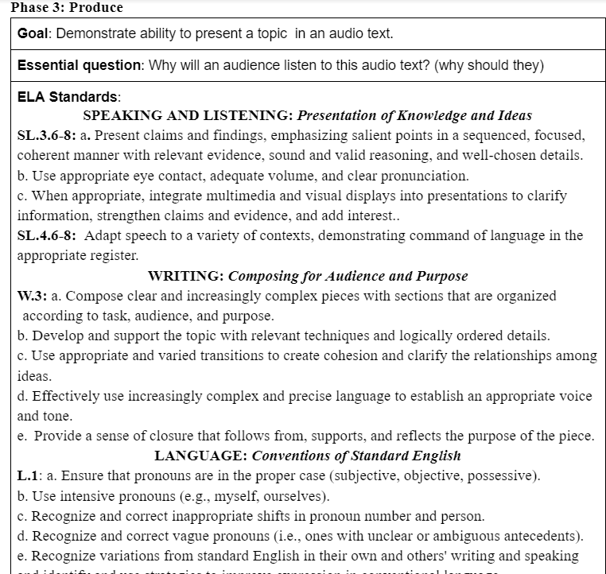

Slide 20
Information, media, and digital literacies
Now more than ever
Notes:
What do these mean to you?

Slide 21
“Literacy” – what it currently means
Literacy: having knowledge or competence – from Miriam Webster
Information literacy is a primary topic for libraries.
Media literacy (competence) is included in many states’ ELA standards. Maine’s are embedded and implied.
Digital literacy is often defined as digital citizenship and must be coupled with media literacy!
Notes:
Review the standards with an understanding of media literacy as a component for each of the strands. Consider how media and digital literacy are intertwined.

Slide 22
HOW WE WILL HELP
Maine DOE’s Plans to Prepare for the Next Normal

Slide 23
POLL

Slide 24
Resources
“text” dependent questions link
Audio text – 6-8 template, 9-12 template
Visual text – 6-8 template, 9-12 template
Other lesson plans exemplars

Slide 25
Professional Learning June - August
Grading for Equity text study
Updated ELA standards resources
Learning goals with clustered standards
Model success criteria
Lesson plan templates to address new texts
Something instruction
Collaborative/multi-discipline development
Project based learning
Platform – how do I use this?

Slide 26
Resources to access now
https://padlet.com/morgan_dunton/2020ELAvirtual
https://www.maine.gov/doe/learning/content/ela/prolearning
Study or review previous session

Slide 27
What to do next
Register for grading equity text study
http://events.egov.com/eventreg/ME/event.htm?name=insearchofmoreequitablegrading
and buy your book https://us.corwin.com/en-us/nam/grading-for-equity/book258205 ($26.21)

Slide 28
What to do next
Complete the feedback – indicate what you might be interested in studying over the summer
Get your contact hour certificate
Next Normal feedback: https://forms.gle/BovnrrcFDTeXpJtM9

Slide 29
STAND DOWN!
WHAT WILL YOU READ THAT IS NOT A PROFESSIONAL TEXT OR CLASSROOM TEXT?
Notes:
This can also include viewing or listening!

