Slide 1
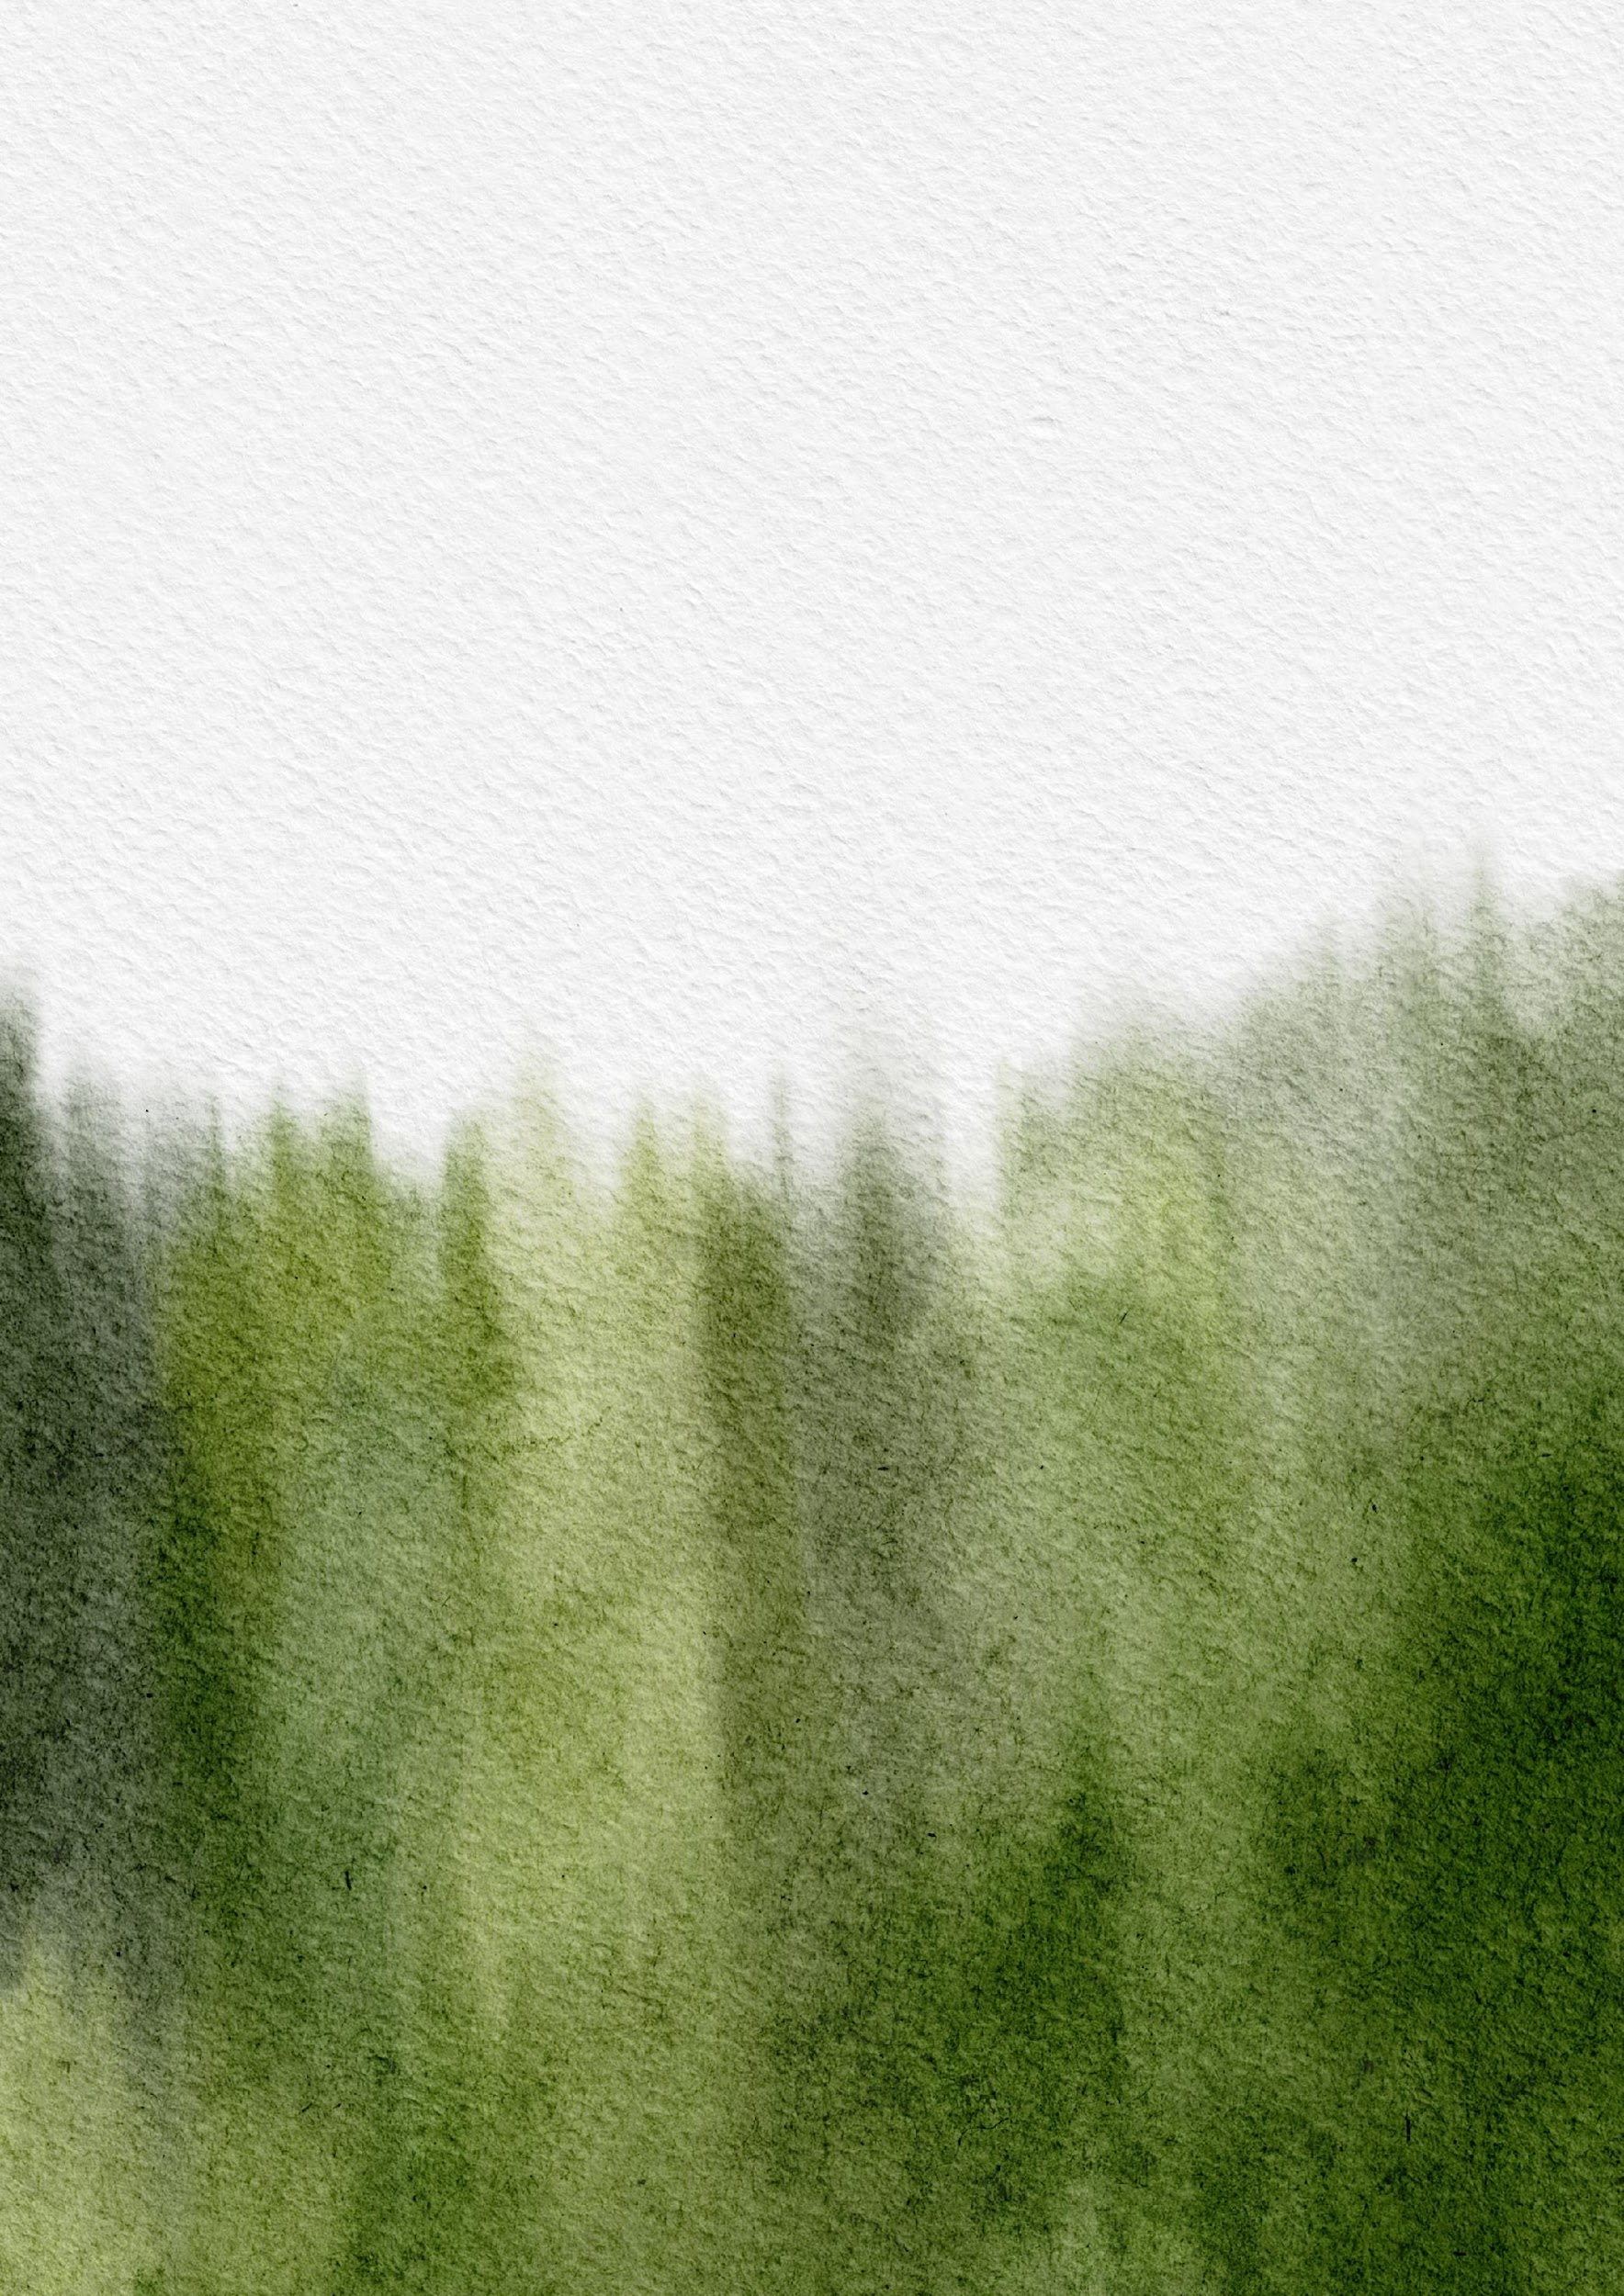
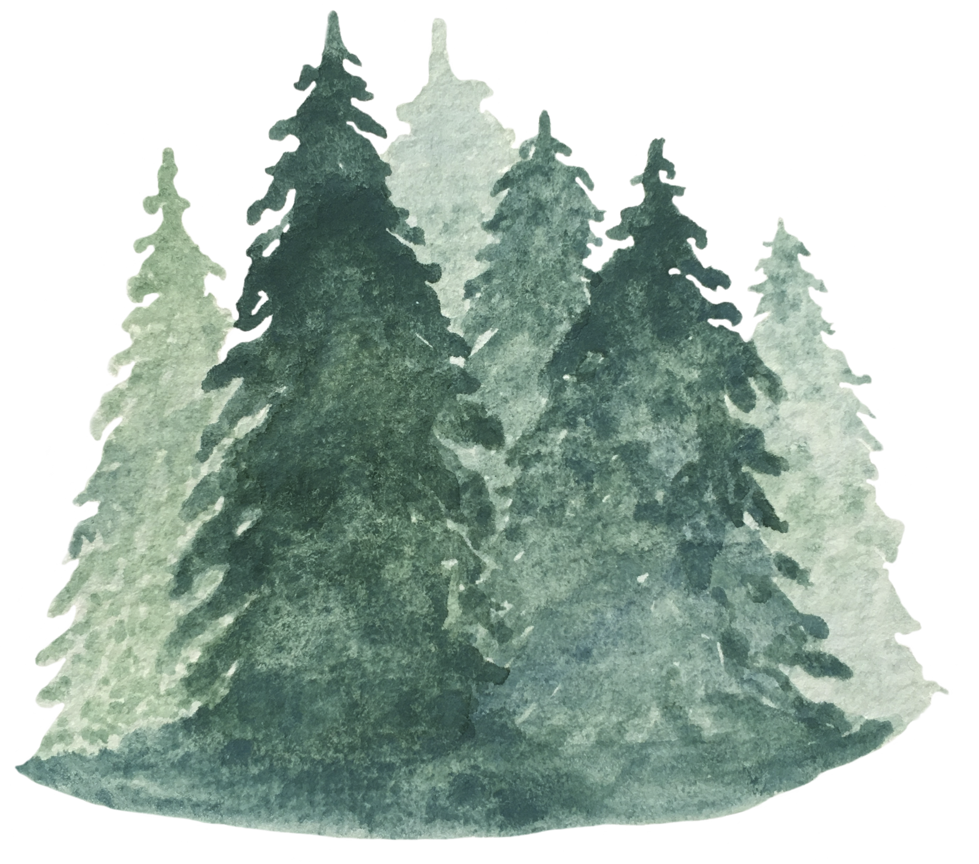
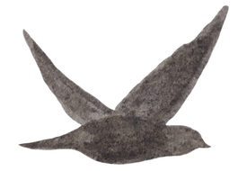
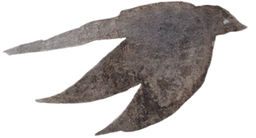
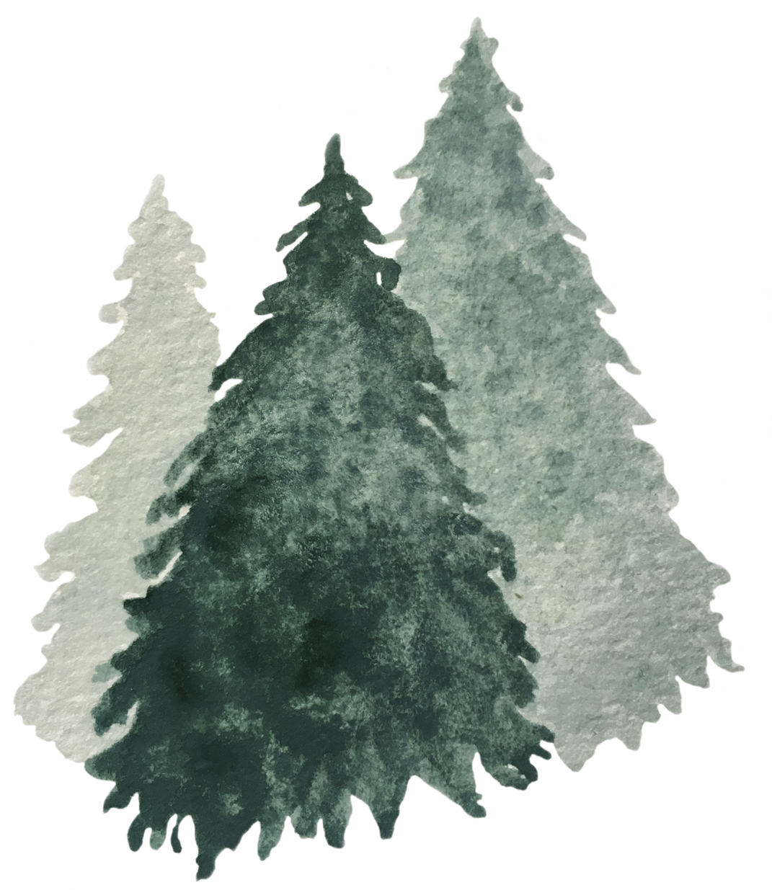
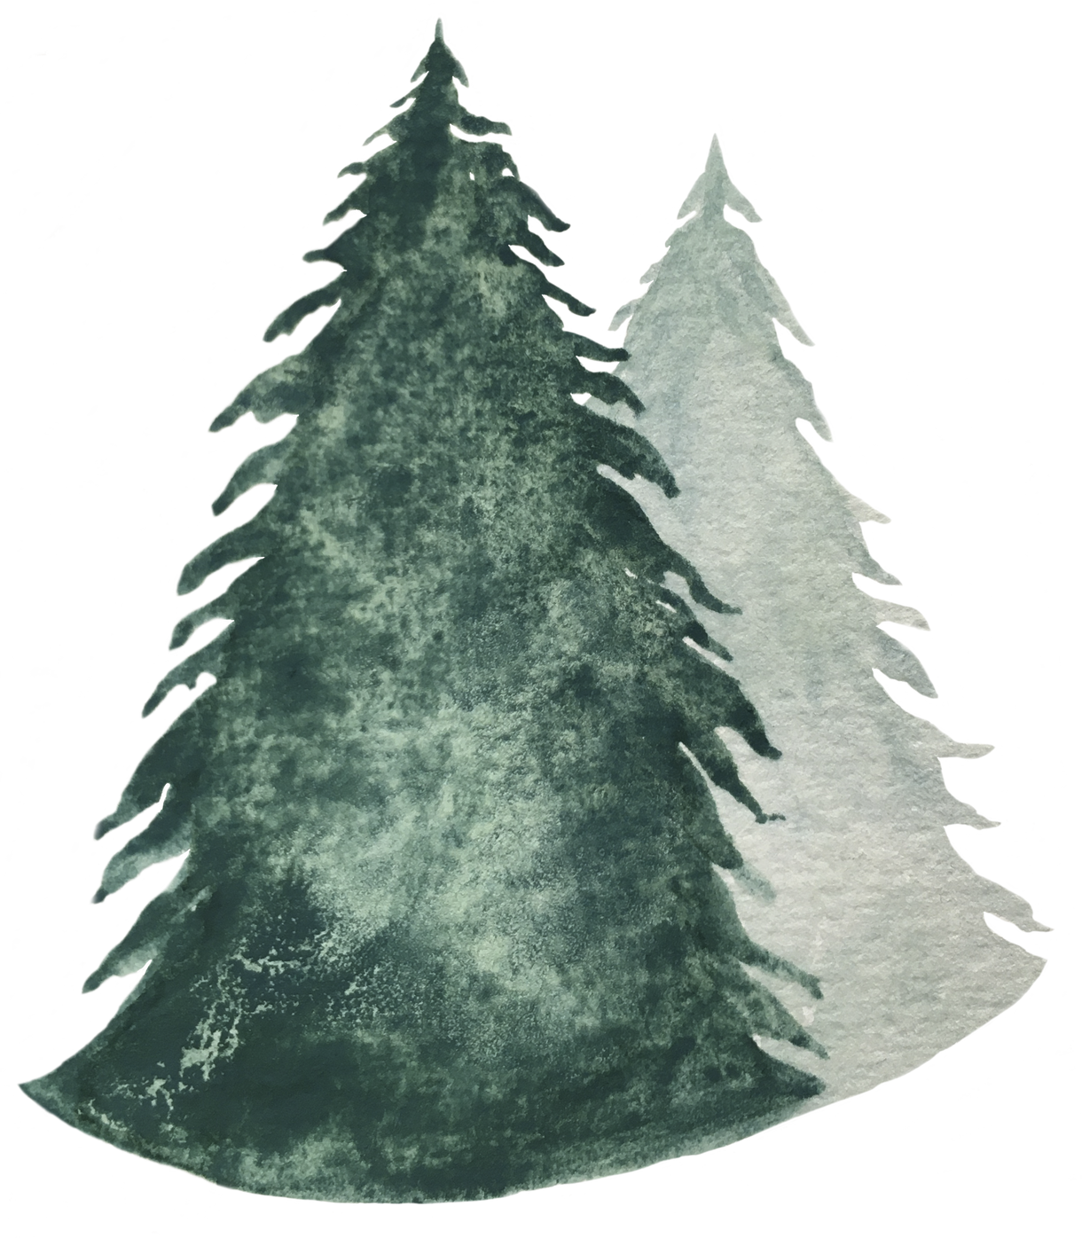
Maple Bytes:
Tradition, Science & Technology
Wabanaki and Maple Syrup Production Resources

Slide 2

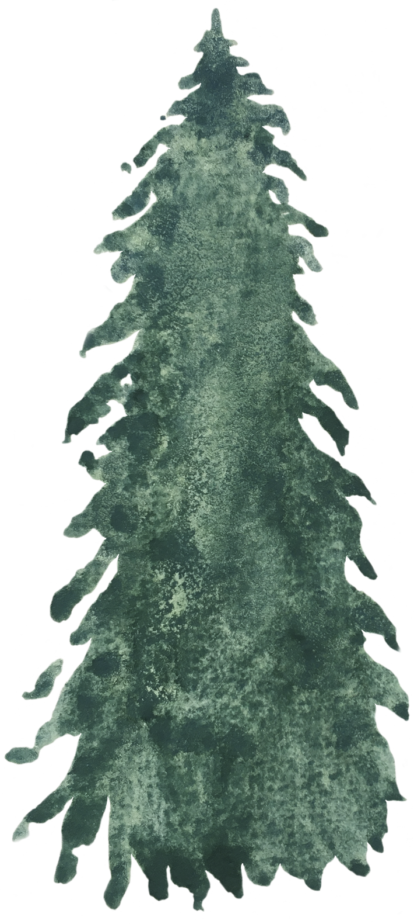
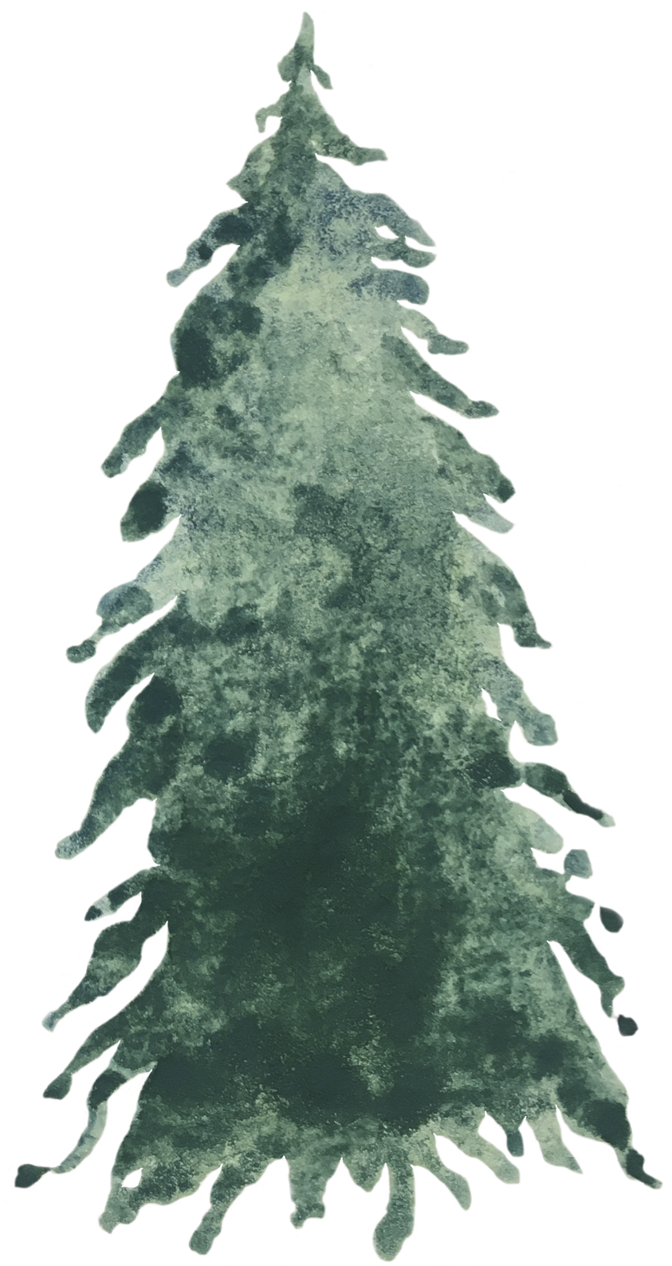
Who are the Wabanaki Nations?

Slide 3
The Wabanaki
The Wabanaki Confederacy is made up of Indigenous Nations from the northeastern part of North America, primarily located in what is now Maine, New Hampshire, and parts of Canada, including the Maritimes. The term "Wabanaki" means "People of the Dawnland," referring to the sunrise, as their lands are located in the easternmost part of North America.
Notes:
The Wabanaki Confederacy - Waponahki - means People of the First Light or People of the Dawnland — has five principal nations: the Panawahpskek (Penobscot), Peskotomuhkati (Passamaquoddy), Mi’kmaq, Wolastoqiyik (Houlton Band of Maliseet Indians), and Abenaki.

Slide 4
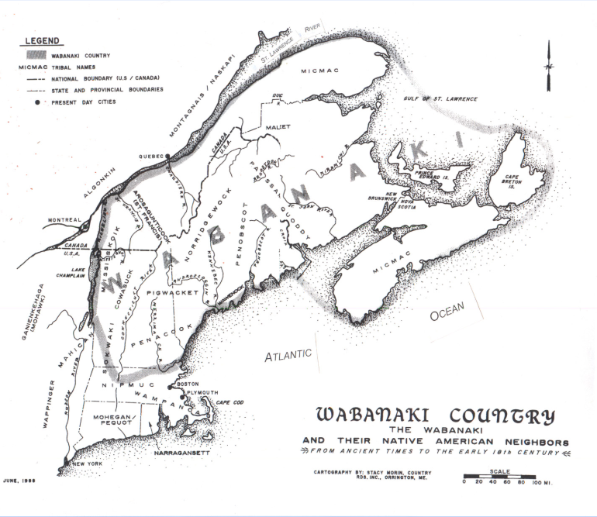
Wabanaki 5 nations
  Penobscot
  Passamaquoddy
  Micmac
  Maliseet
  Abenaki
Notes:
Replace language: Panawahpskek (Penobscot), Peskotomuhkati (Passamaquoddy), Mi’kmaq, Wolastoqiyik (Houlton Band of Maliseet Indians), and Abenaki. Use map on slide 3: https://docs.google.com/presentation/d/1VjcJX-6dJdWL_6YZnOjJ8W0wl9_rGyhCb3_t1M-64ms/edit?usp=sharing I’ll try to find a jpg already made of it.

Slide 5
Wabanaki 5 nations
  Penobscot
Primarily located in central Maine, the Penobscot people are known for their expertise in river navigation and their historical ties to the Penobscot River.
Notes:
Panawahpskek

Slide 6
Wabanaki 5 nations
  Passamaquoddy
Residing primarily in the coastal areas of Maine and parts of New Brunswick, Canada, the Passamaquoddy are known for their fishing, hunting, and canoe-building traditions.

Slide 7
Wabanaki 5 nations
  Micmac (Mi’kmaq)
The Mi'kmaq live in the eastern provinces of Canada (Nova Scotia, New Brunswick, Prince Edward Island) and parts of Maine. They are known for their maritime culture, particularly fishing and boat-building.

Slide 8
Wabanaki 5 nations
  Maliseet (Wolastoqiyik)
The Maliseet people are primarily located in the regions of New Brunswick, Canada, and parts of Maine. They have a deep cultural connection to the St. John River, which is central to their way of life.

Slide 9
Wabanaki 5 nations
  Abenaki
The Abenaki historically lived in the areas that now encompass parts of Vermont, New Hampshire, and Quebec. They are known for their involvement in agriculture, hunting, and fishing.

Slide 10
Traditional Wabanaki Maple Syrup Resources

Slide 11
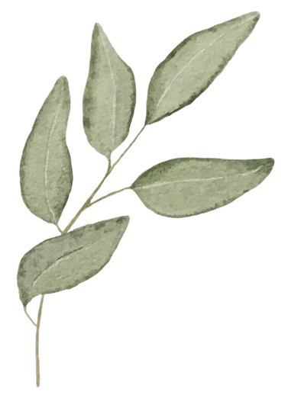
News Articles
  Passamaquoddy Maple Carries on Tribal Tradition, November 29, 2022
    Article Link
  Indigenous Maple Syrup Makers Tap Into Tradition, February 27, 2023
    Article Link
  Maple Sugaring Among the Abenaki, March 2021
    Article Link
Notes:
*Abenaki article is from a group that is not recognized by Abenaki from Odanak (who are connected and related to Wabanaki)

Slide 12
News Articles
  The Indigenous Origins of Maple Syrup, Winter 2022
    Article Link
  History of Maple Syrup
    Article Link
  From Tree to Table: The Sweet Story of How Maine Maple Syrup is Made, February 2024
    Article Link

Slide 13
You Tube Videos
  Maple Syrup: Tapping Tutorial, by Wabanaki Public Health & Wellness
    https://youtu.be/pCjUqRpqemI?si=0Kf5Ku7U_FBR5x2W
  2021 Native American Heritage Month - Maple Syrup Harvesting
    https://www.youtube.com/watch?v=OSsi_Jo9bRI
  Traditional Native Ways of Making Maple Syrup
    https://www.facebook.com/groups/1030933133632407/posts/7456601367732186/

Slide 14
Current Maple Syrup resources

Slide 15
You Tube Videos
  How Sweet it Is, University of Maine
    https://www.youtube.com/watch?v=cEjQw0dqGwk
  How Do I Identify A Maple Tree?, Cincy Nature
    https://www.youtube.com/watch?v=_w-6YXmvZ9Q
  When do I Tap A Maple Tree?, University of Maine
    https://www.youtube.com/watch?v=xtvVlivaoRs
  How do I Tap a Maple Tree?, University of Maine
    https://youtu.be/pCjUqRpqemI?si=0Kf5Ku7U_FBR5x2W
  Maple Syrup Grading and Tasting, University of Maine
    https://www.youtube.com/watch?v=lcw97n3l3uU
Notes:
GREAT videos: https://youtu.be/xX8bXdWFljk?si=0ixsPFhmHYbNqPKd https://youtu.be/bihxK0fTTZs?si=HgApvFmYEUx208Rt

