Slide 1
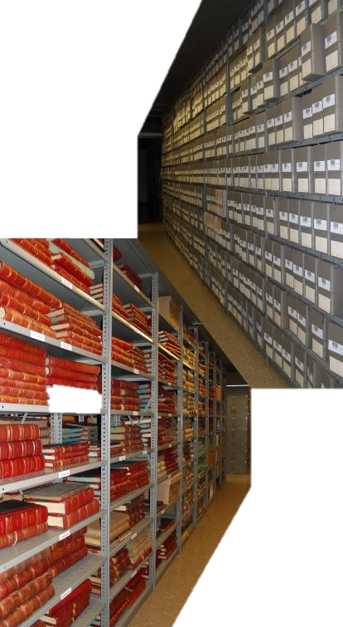
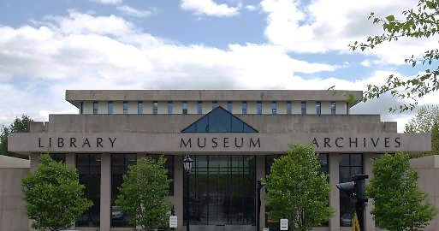
Teaching with Primary Sources:
Maine State Archives
Heather Moran
Reference & Outreach Archivist

Slide 2
Who We Are:
Bureau Under the Secretary of State
Archives Services and Records Management divisions
State records: Permanent and Non-Permanent material
95 million pages and counting…

Slide 3
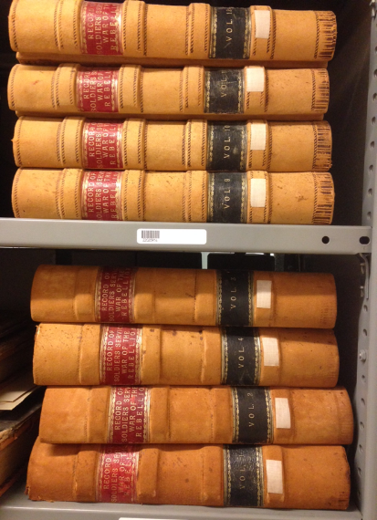
What We Hold
Executive
Governor’s Office
Executive Council
Legislative
Enacted Laws of Maine
Legislative Graveyard
Committee Files
Judicial
Other State Agencies

Slide 4
Outreach
“Show us all the cool stuff”
“Can we touch it?”

Slide 5
Teaching With Primary Sources
Goals
Learn the values of primary and secondary material
Practice critical thinking and analysis
Evaluate opposing sides
Example: Settlers vs. indigenous peoples
Partners
Archives, State Library, State Museum, Dept. of Education
Primary Source Sets – Bicentennial, Civil War, Slavery, Wabanaki, Mapping Maine, & more to come

Slide 6
How Can Our Collections Help Your Students?
European exploration
Baxter Rare Maps
Colonization / Revolution
Early statehood
Land Office surveys
Expansion (1800-1861)
Wabanaki documents
African-American history in Maine
County Atlases
Civil War & Reconstruction
Industrialization & Immigration
Alien Registrations 1940
Vital Records, Census
Native American policy
Indian Affairs & Land Claims
Emergence of Modern America
Suffrage
World War I

Slide 7
European exploration
Baxter Rare Map Collection

Slide 8
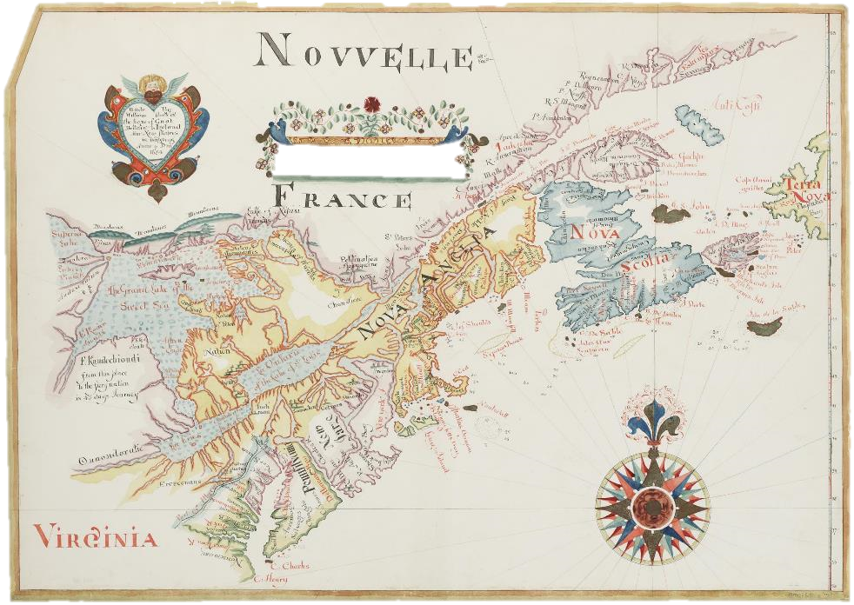
1684
Notes:
James Phinney Baxter Map Collection – Baxter (1831-1921) was philanthropist and 6-term Mayor of Portland. Son was Percival, Gov of ME

Slide 10
MAPs!
https://digitalmaine.com/arc_maps/

Slide 11
Colonization & REvolution

Slide 12
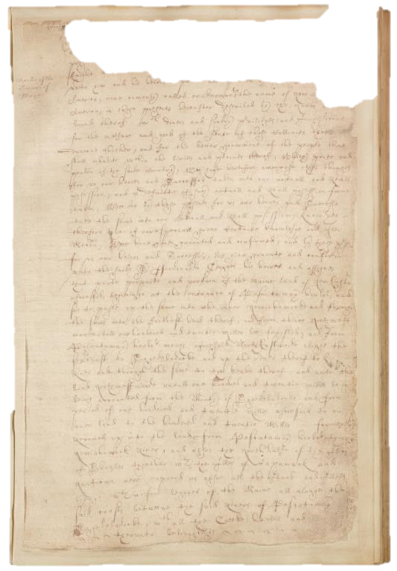
1637 charter from Charles I of England to Ferdinand Gorges giving him the Province of Mayne
https://www.familysearch.org/search/catalog/results?count=20&placeId=183328&query=%2Bplace%3A%22United%20States%2C%20Maine%2C%20York%22&subjectsOpen=1249689-50
Notes:
AL

Slide 13
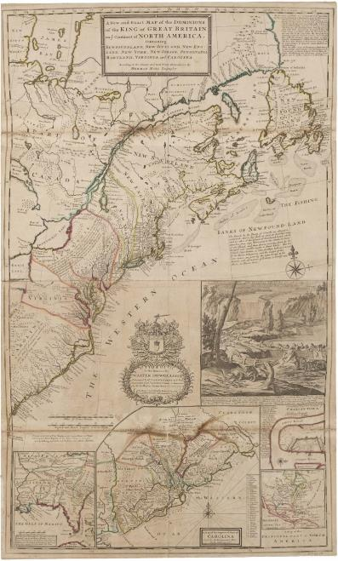
North AMERICA, circa 1722
FORTS, LAKES, & TOWNS OF THE PROVINCE OF MAINE, 1794

Slide 14
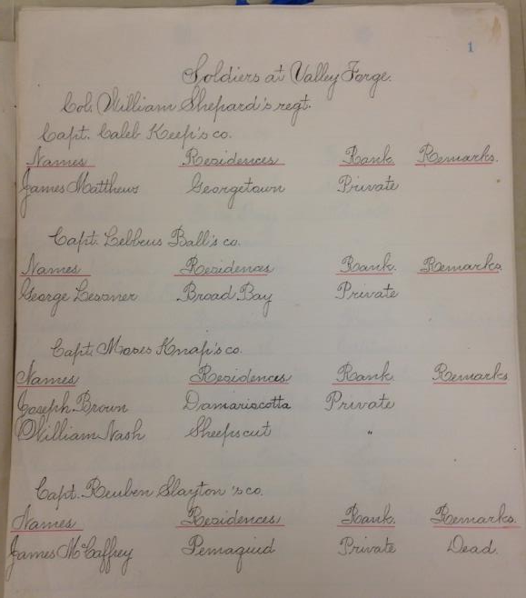
Revolutionary War
Soldiers
at Valley Forge

Slide 15
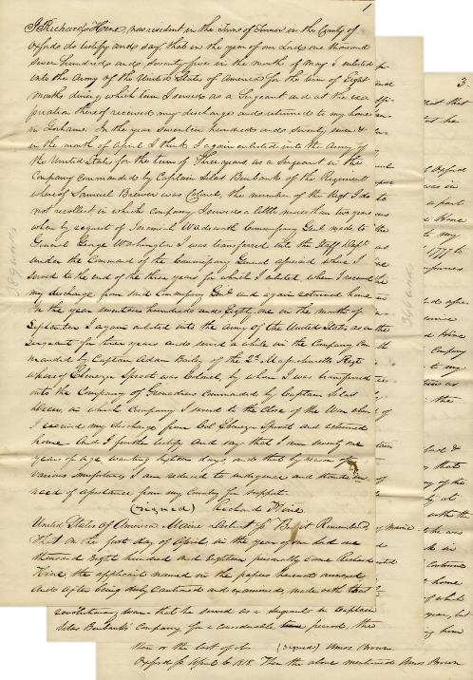
Affidavit of Revolutionary War Service of Richard Hine
https://digitalmaine.com/revolutionary_war/

Slide 16
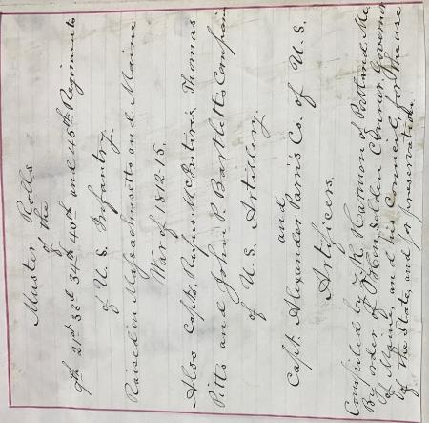
War of 1812
List of Maine soldiers in
Massachusetts regiments

Slide 17
Early Statehood & Expansion

Slide 18
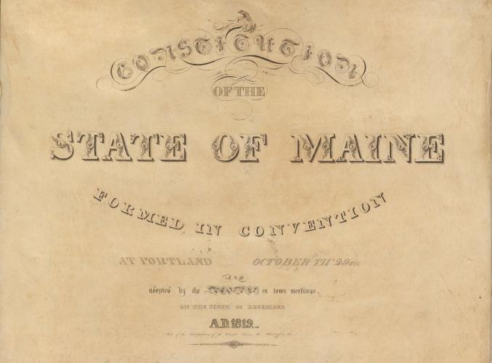
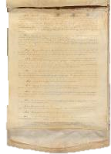
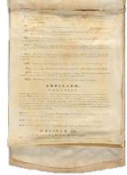
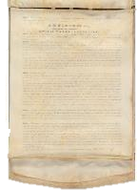
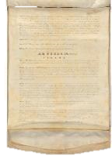
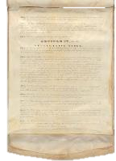
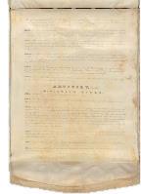
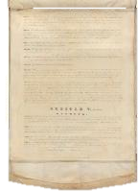
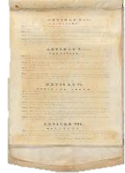
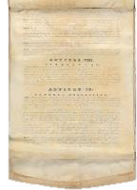
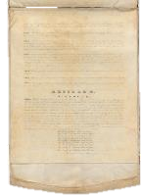
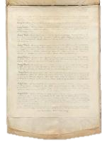
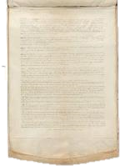
Notes:
Also have 2 working copies showing edits made during the 1819 constitutional convention

Slide 19
Draft copy of 1819 Constitution
https://digitalmaine.com/arc_statehood/

Slide 20
"And what do white people suppose we must think when we see they wish to take from us one piece of land after another, till we have no place to stand on, unless it is to drive us, our wives, and our little children away?
But if so great and so free a country as this would exterminate us, we have no chance anywhere else; we or our children must sooner or later be driven into the salt water and perish.”
John Neptune, Nov. 1829
https://digitalmaine.com/native_tribal_docs/

Slide 21
Digital Maine
www.digitalmaine.com

Slide 22
https://digitalmaine.com/arc_img/
https://digitalmaine.com/atticus_docs/

Slide 23
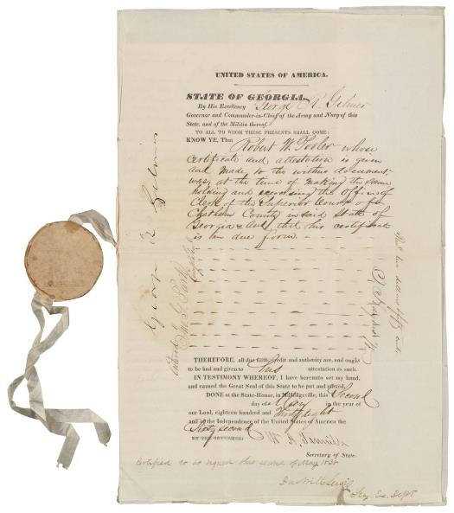
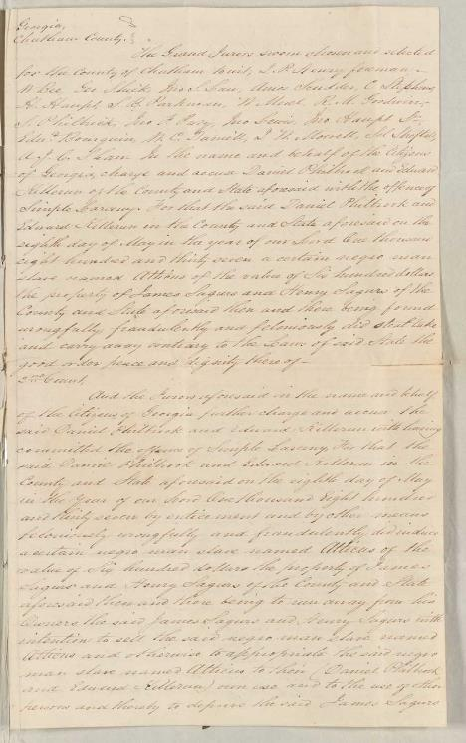
Case of Atticus the Slave, 1838
Extradition request from Georgia

Slide 24
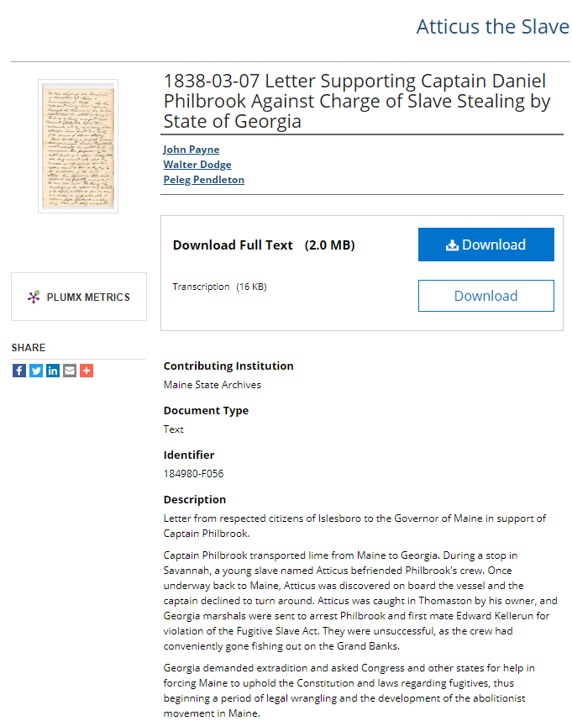

Slide 26
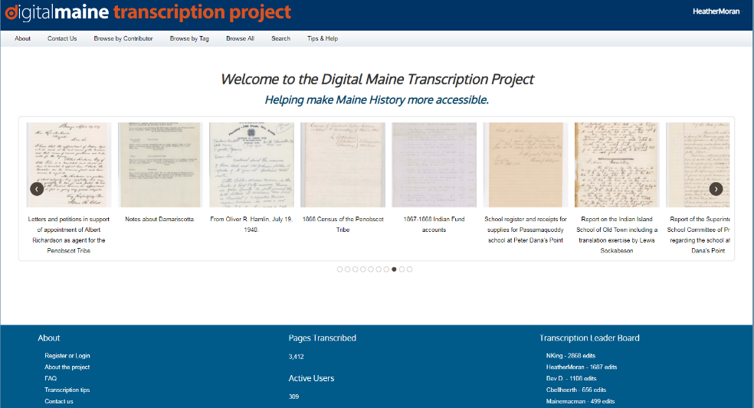
Crowdsourced Transcription – Join Us! www.digitalmaine.net/projects

Slide 27
Unique Collections

Slide 28
Declaration of Independence

Slide 29
Civil War Collection
One of the most comprehensive collections, including:
More than 3000 photographs online
180,000 + pieces of correspondence
14,700 muster rolls
https://digitalmaine.com/civil_war/

Slide 30
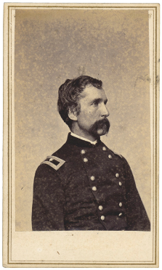
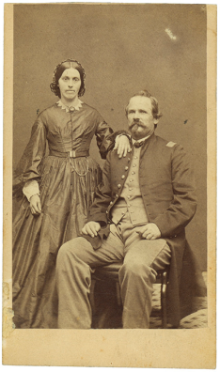

Slide 31
Maine Records on FamilySearch.org
https://www.familysearch.org/search/collection/list/?cqs=maine
https://www.familysearch.org/search/image/index?owc=https://www.familysearch.org/service/cds/recapi/collections/1877829/waypoints

Slide 32
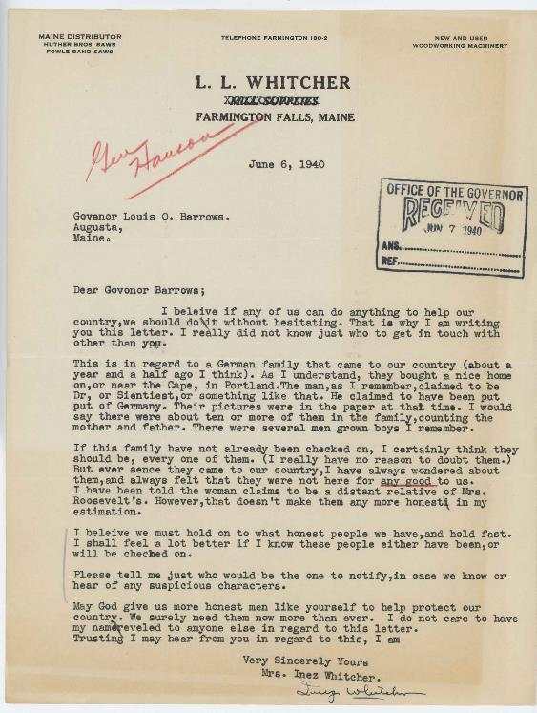
Alien Registrations
&
Correspondence to the Intelligence Section,
Adjutant General’s Office
https://digitalmaine.com/alien_reg/

Slide 33
Primary Source Sets
https://mainestatemuseum.org/learn/bicentennial-teaching-materials/
https://digitalmaine.com/hist_docs/1/ Joseph Treat Journal (Mapping Maine)

Slide 34
Other New Projects
Virtual Reality
Bicentennial Moments

Slide 35
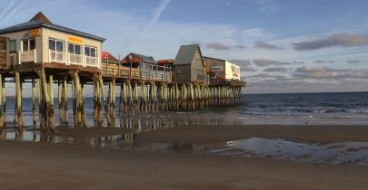
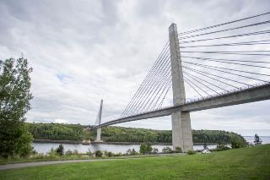
Virtual Reality Experience
Activate pop-ups of historical anecdotes about the site simply by directing one’s gaze (headset required)
Viewable on a desktop computer or mobile device
Headsets available – come visit the Archives and try one!

Slide 36
https://www.maine.gov/sos/arc/bicentennialmsa.html
https://www.thinglink.com/mediacard/1238865147544469505

Slide 37
Bicentennial Moments
30-second PSAs of Maine history
Images and documents from the Archives
Highlight a particular person, place or event
Meant to encourage further exploration

Slide 38
Bicentennial Moments
https://digitalmaine.com/arc_200th_moments/

Slide 39
https://www.maine.gov/sos/arc/collections/exhibits.html

Slide 40
“ask an Archivist” Primary Source Text Sets National History day School Visits
Lacking source material for your curriculum?
Let me know!

Slide 41
What Questions Do you Have?

Slide 42
Heather Moran Reference & Outreach Archivist Maine State Archives 207-287-5789 Heather.Moran@maine.gov

