Slide 1
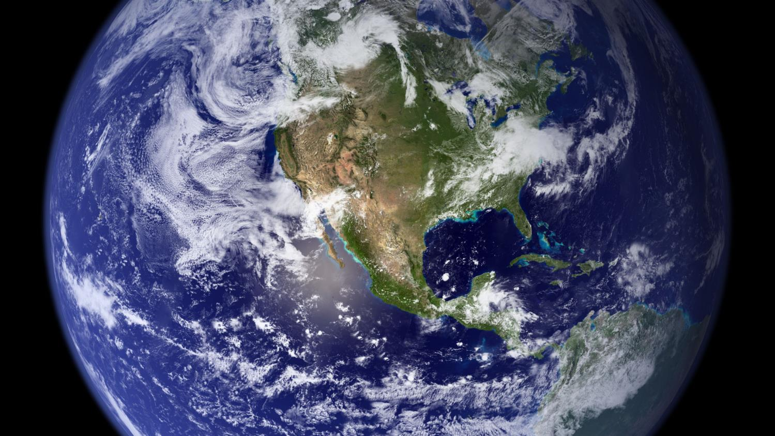
Teacher Abroad
Global Professional Development Programs
Erin Towns, Edward Little High School
etowns@auburnschl.edu

Slide 2
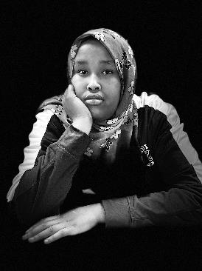
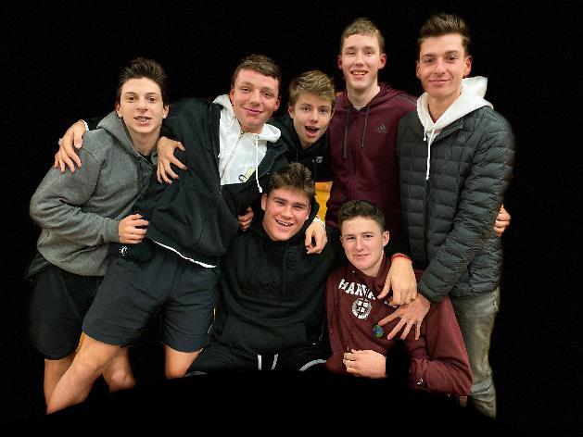
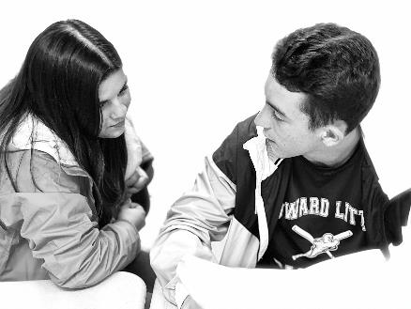
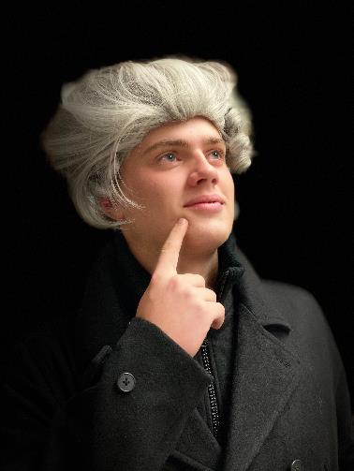
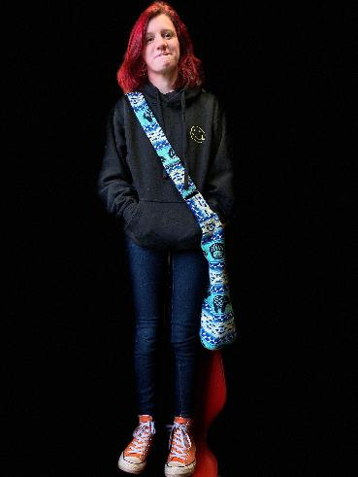
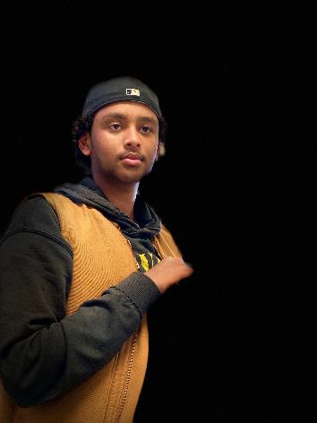
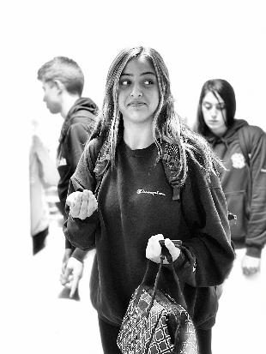

Slide 3
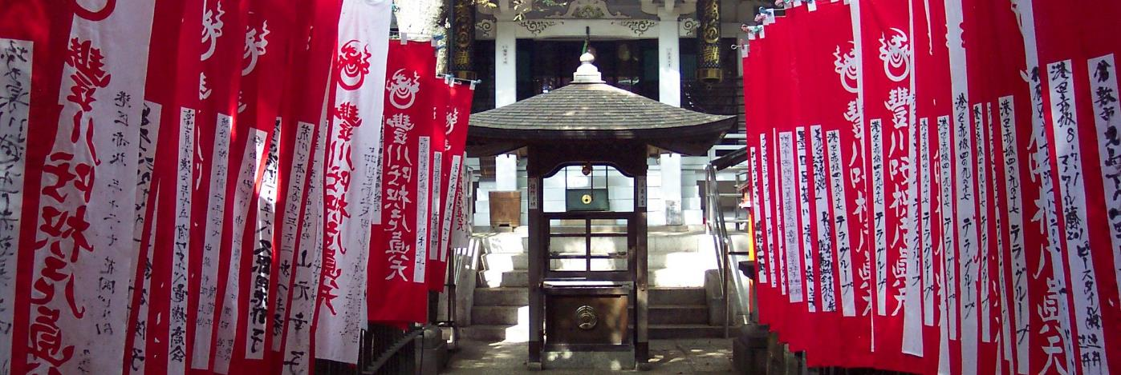

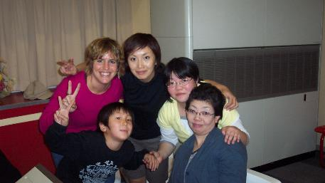
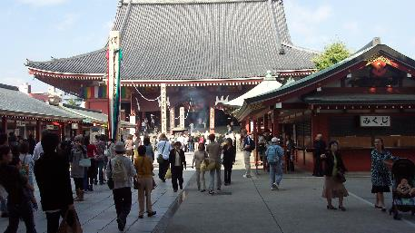

Slide 4
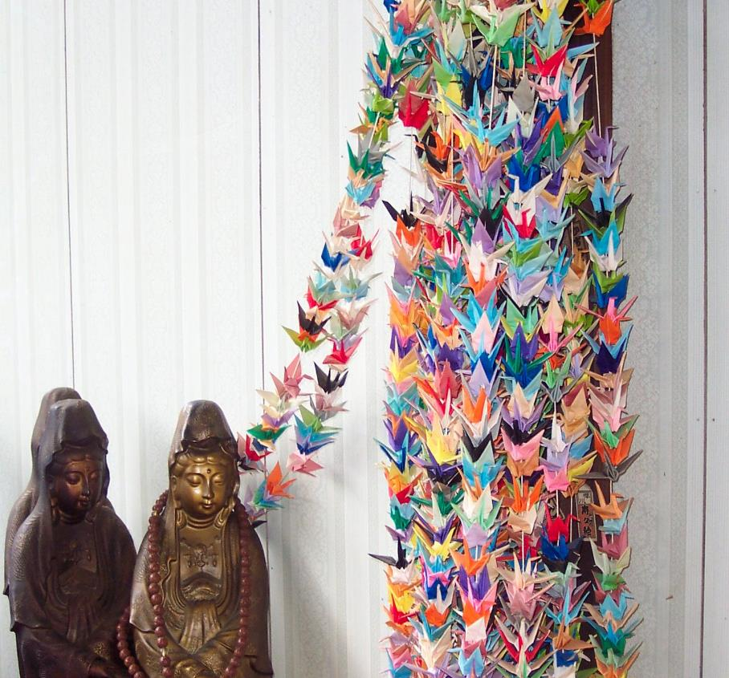
2008 - Japan Fulbright Memorial Fund Teacher Program
No longer available.
Location: Tokyo, Minamisoma, Fukushima Prefecture Japan
Visits to sites to study culture, history, government, education, & economy
Notes:
Applied teaching US History/World History
Goal: Unit Lesson - Peace Education (WWII)
Collected: Photos that explained curriculum I teach, stories, school resources, insights into society, religion, and family
Cost: Covered by Japanese government. Stipend was given upon arrival to Tokyo

Slide 5
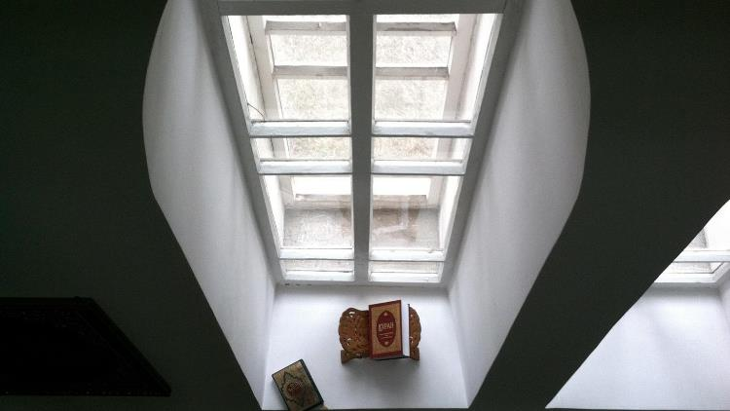
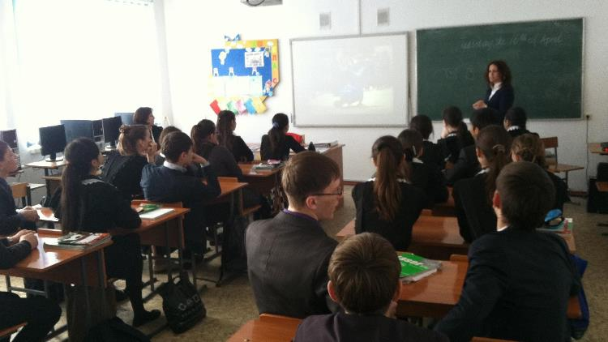
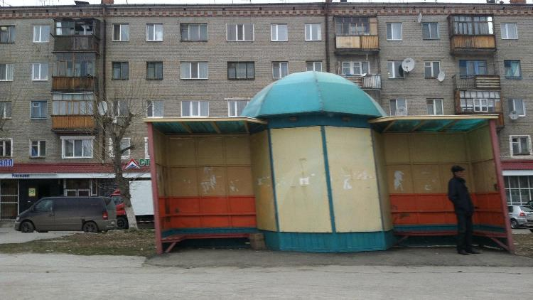
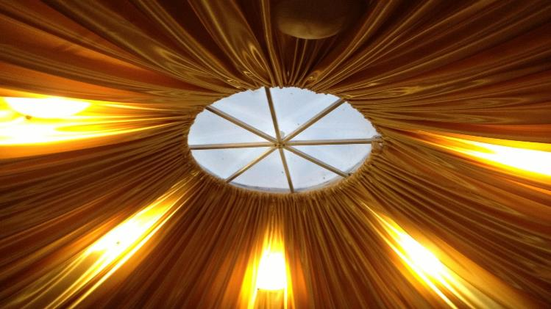

Slide 6
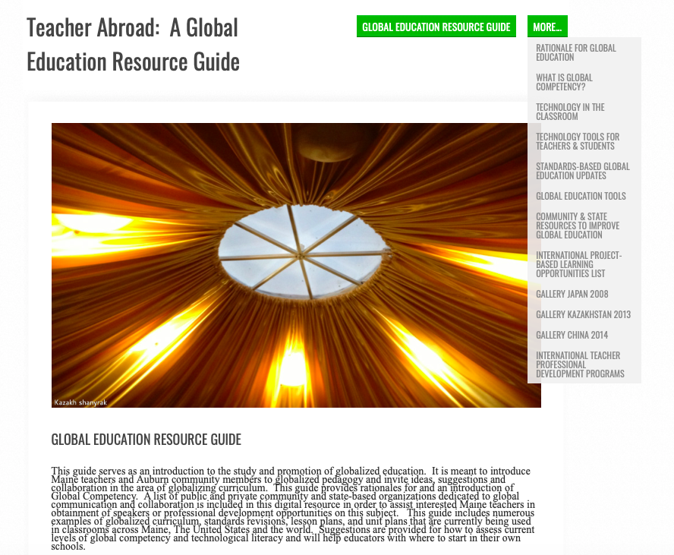
2013 - Fulbright Teachers for Global Classrooms Program: Kazakhstan
Global Education Online Course
Global Symposium - Washington DC
International Field Experience
Capstone Project
Alumni Network
Deliverable: Online Global Education Guide
Notes:
Visits to US Embassy, museums, city tours, cultural sites (Almaty), flights north to Russian border, host teacher experience, schools (pre-schools, elementary, middle, high), universities (lectures), governmental authorities, religious sites, authentic banya experience), Good Morning Kazakhstan

Slide 7
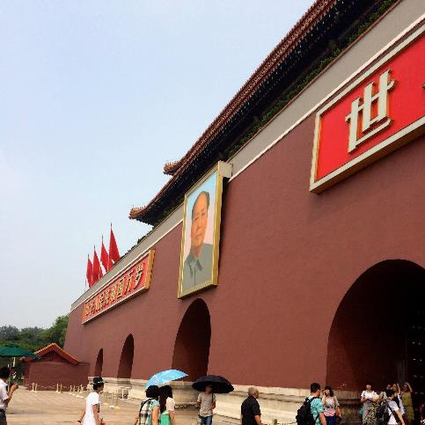

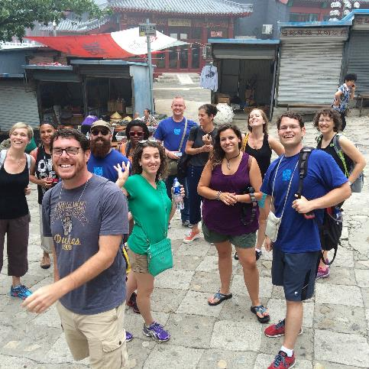

Slide 8

Fulbright-Hays Seminars Abroad
Summer Seminars
Educators K-8
Secondary Educators
Post-Secondary Educators
Typically four weeks
Deposit Required
Small Stipend
Unit Plan Required
Notes:
Visits to Beijing, Xian, Chongqing, Shanghai
Studied City Centers

Slide 9
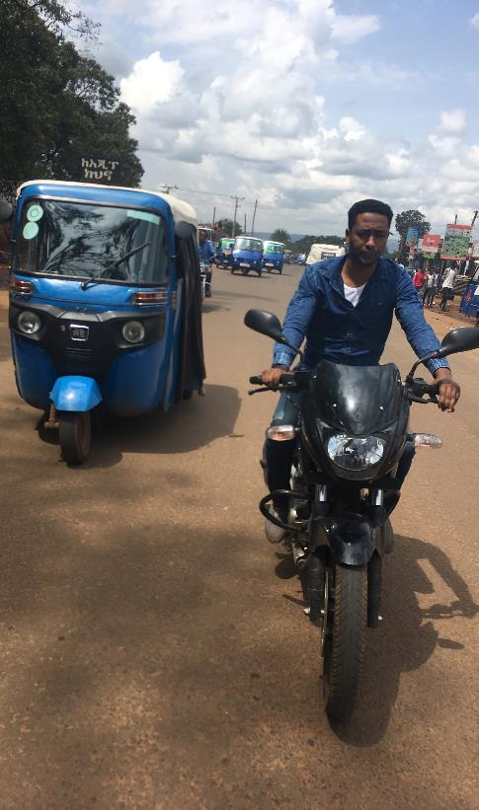
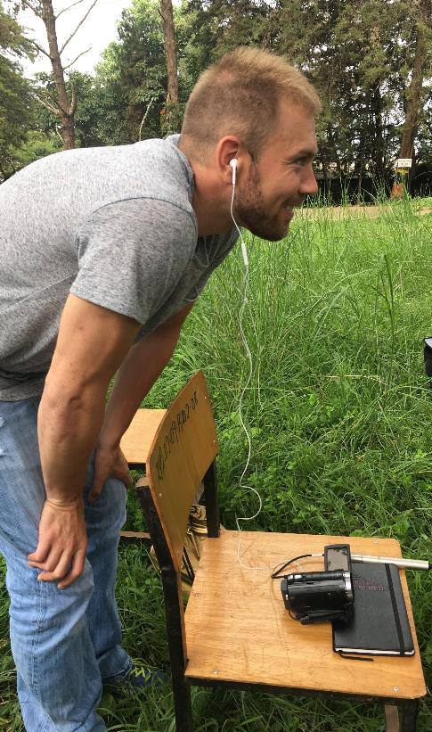
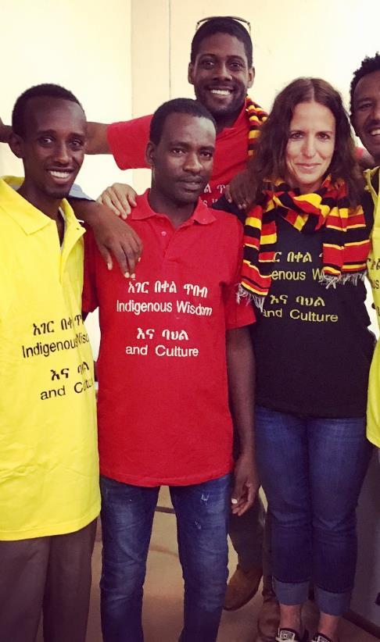

Slide 10
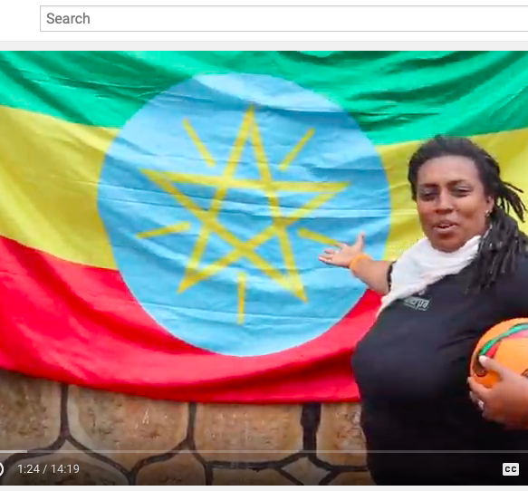
Fulbright-Hays Groups Projects Abroad Program
Administered by universities around the USA
Application process is through universities
UPItt - Ethiopia Indigenous Culture and Wisdom
Four required meetings in USA
Language Studies
Collaborative Group Project Requirement

Slide 11
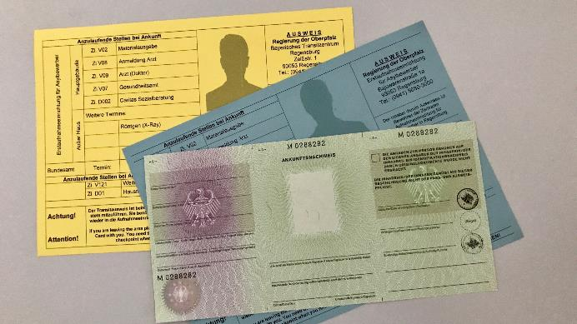
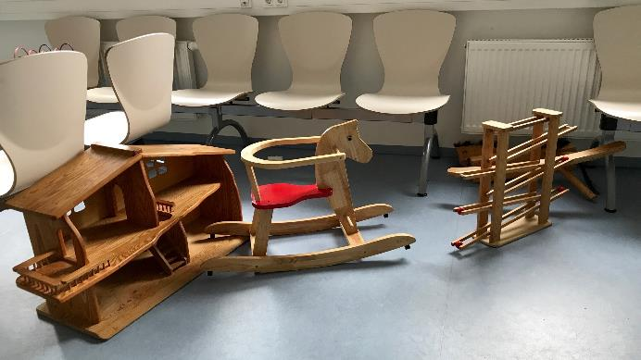
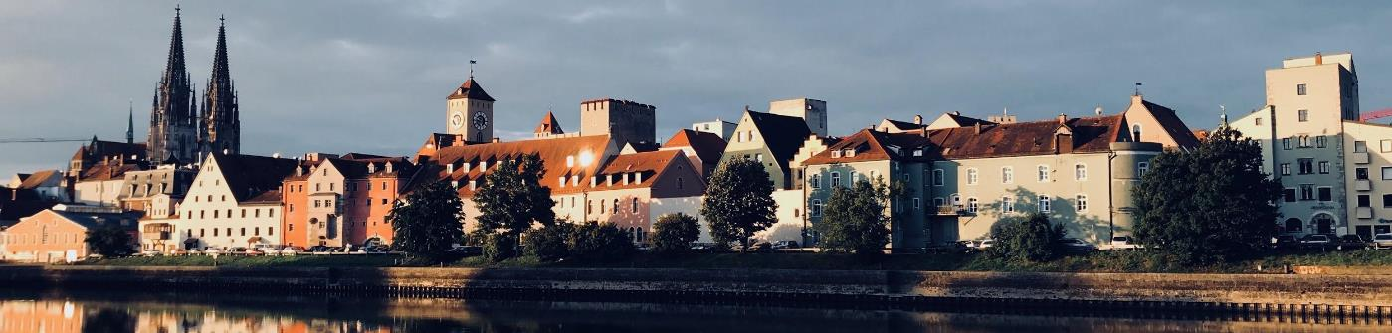

Slide 12
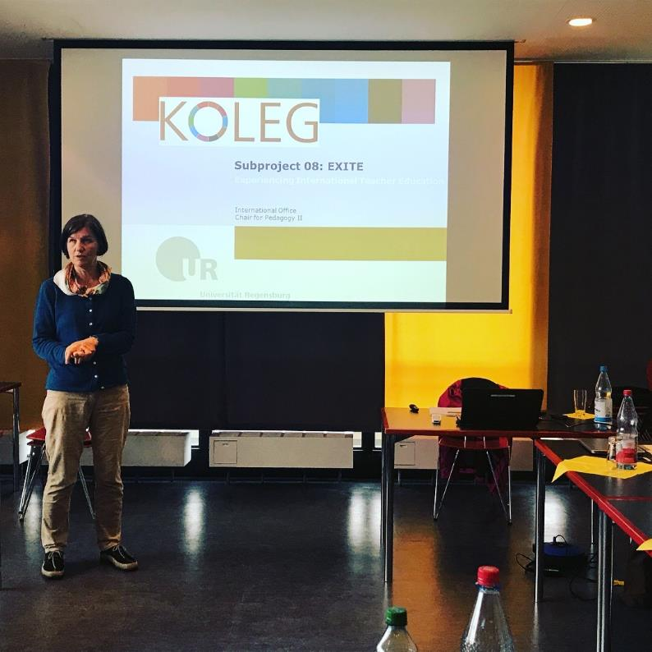
Education in Germany - German American Fulbright Commission
Study of German education system
Impact of refugees
German standards and teacher education programs
Lectures
4 weeks
One free weekend
Group Twitter and Reflection Requirement

Slide 13
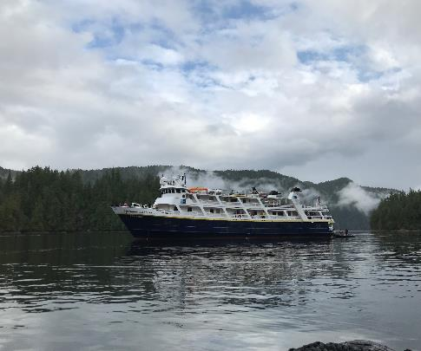
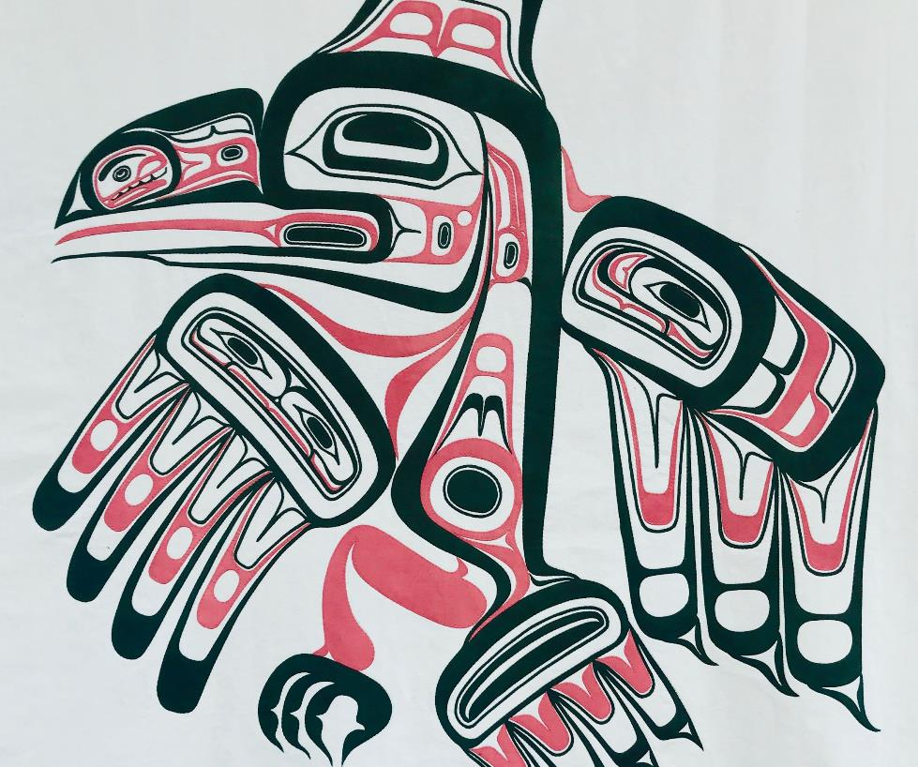
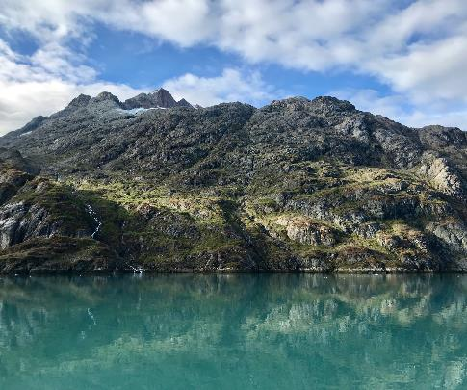

Slide 14
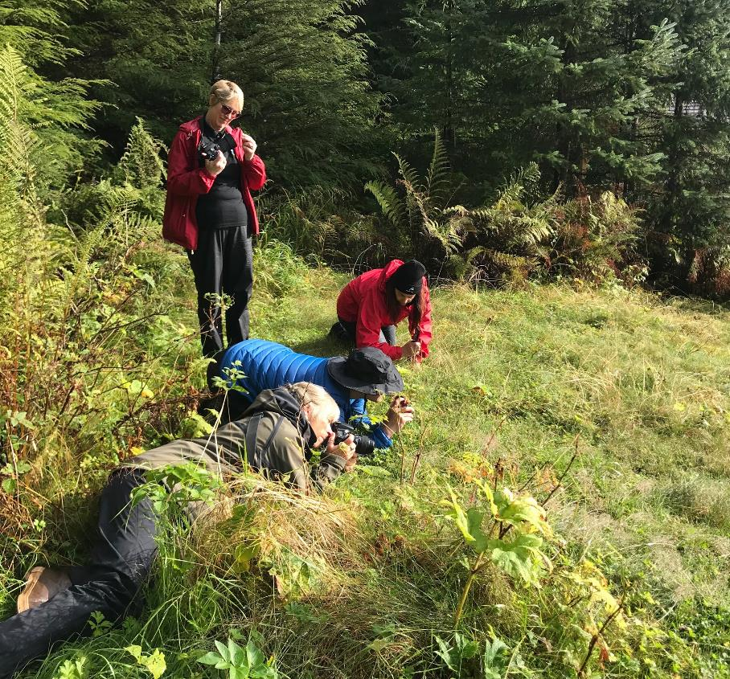
National Geographic Grosvenor Teacher Fellows Program
Administered by National Geographic - Lindblad Expeditions partnership
2 year professional development opportunity
Pre-Departure Training - National Geographic Headquarters
2-3 Week Expedition: Alaska, Arctic, Antarctica, Galapagos
Deliverables Required
Mentor, curriculum development, leadership, etc. year 2

Slide 15
Check Out Other Programs!!!
PolarTrec
NOAA Teacher at Sea
Qatar Foundation International
Teachers Educating Across Cultures in Harmony (TEACH) Bahrain
Facebook: Scholarships, Grants and Summer Institutes for Teachers

Slide 16
Application Tips
Answer the question being asked.
Answer all parts of the question being asked.
Avoid spelling/grammatical errors.
Remember your focus: students
Add personality and stories if possible (as they relate directly to question)
Check with administration before you apply.
If administration says no, contact the grantor.
Post-program, apply to read application for next round.

