Slide 1
Talk Time
Unit 2, Week 10

Slide 2
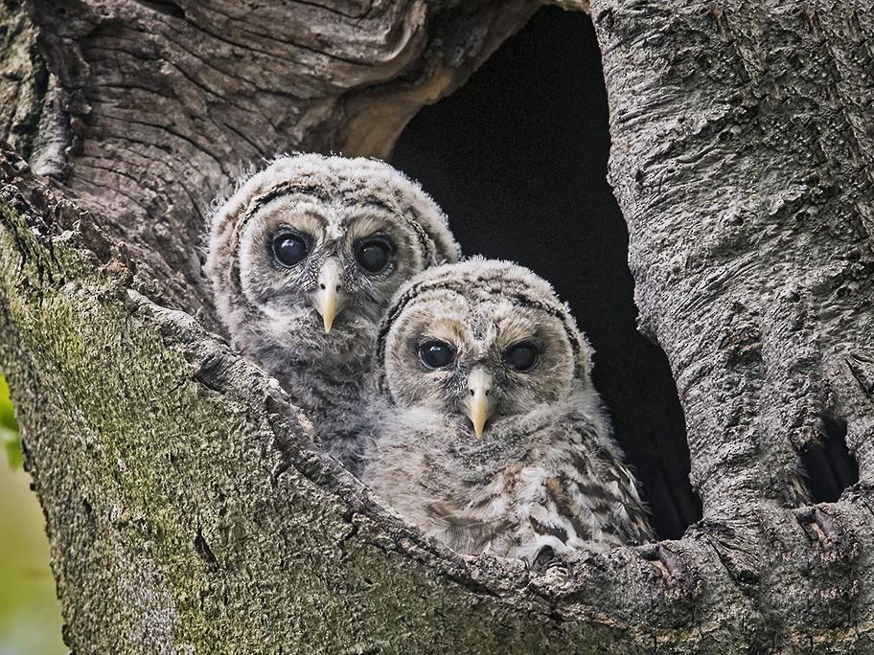
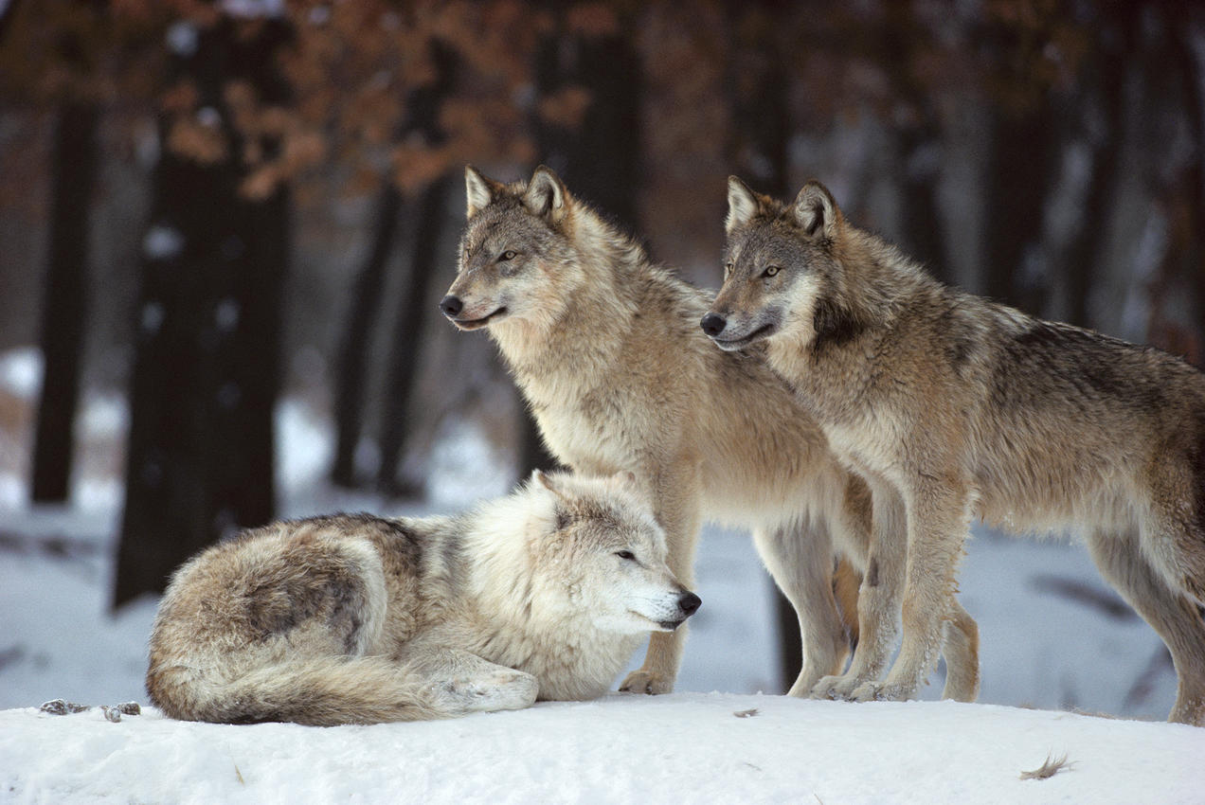
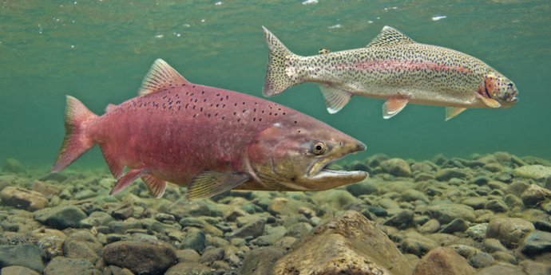
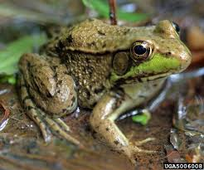
https://www.canr.msu.edu/news/science_ideas_for_preschoolers_part_3_rock_n_roll_frogs, https://www.kxly.com/salmon-could-return-to-columbia-river/,
https://ebird.org/species/brdowl. https://www.nrdc.org/resources/ensure-thriving-populations-wolves
Notes:
What do we know now about these animals and their habitats? How did we learn these things?

