Slide 1
Using Document Shuffles
Jamie Karaffa (jkaraffa@rsu16.org)
8th Grade Social Studies Teacher
Bruce M. Whittier Middle School
Poland, Maine

Slide 2

“I could not start my course with the first event to be covered in curriculum. Instead I needed to teach my students how to think historically.”

Slide 3
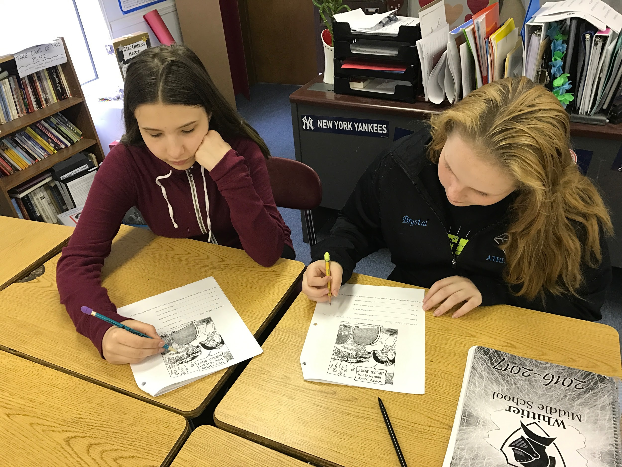
What is a Document Shuffle?
-Collection of primary sources
-Usually post them around the room
-Students get handout to guide them
-Students work in groups of 2-3
-Students spend 2 minutes with each document
-Go through documents as a class discussion

Slide 4
When to Use a Document Shuffle?
-To determine what your students know about thinking historically
-To introduce a topic
-To explore documents using knowledge acquired on a topic
-To practice using primary sources in your classroom

Slide 5
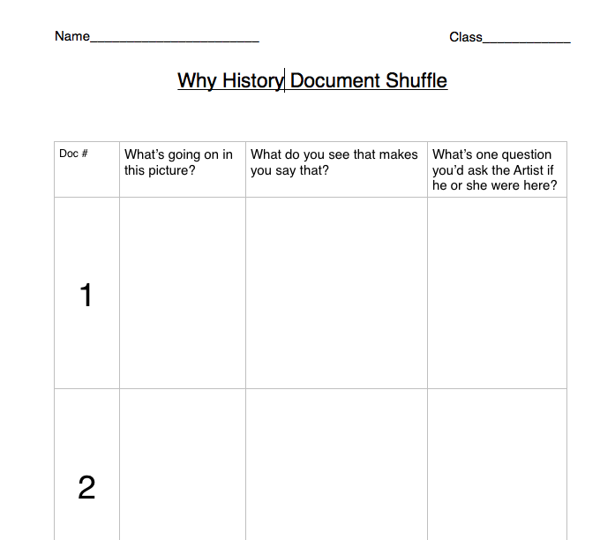
Document Shuffle Notes

Slide 6
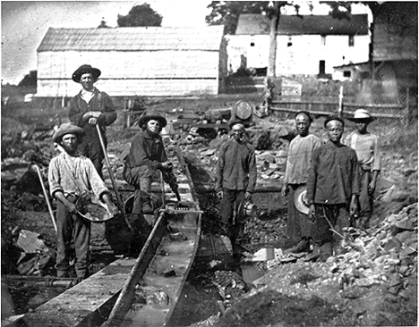
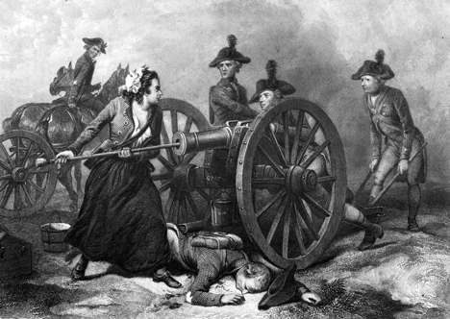
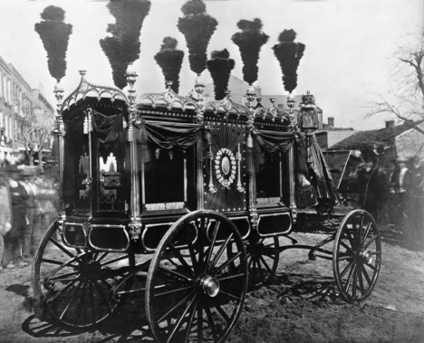
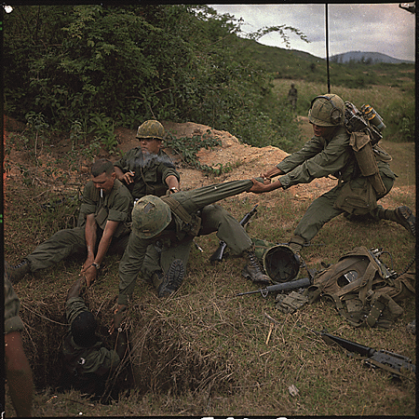
Introduction to Document Shuffles
-Random documents from history
-Choose documents that are interesting or strange
-Choose documents that look like one thing but are something else

Slide 7
What do you see?
Typical Student Responses
-Cart or carriage
-Smoke coming off top
-Blurry people
-Buildings
-Black and white photo
-Dirt street

Slide 8
What’s going on?
Typical Student Response
-Some sort of carnival
-Parade
-Gypsy cart
-Famous person traveling

Slide 9
What do you see?
Typical Student Response
-Dead Man
-Woman
-Cannon
-Men
-Horses
-Bucket (praise this student)

Slide 10
What’s Going On?
Typical Student Response
-Woman is angry at the men and trying to stop them from shooting
-Men are angry at the woman and want her to get out of the way
-Woman is cleaning the cannon
-Woman is loading the cannon

Slide 11
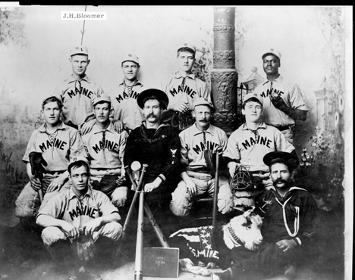
Student Assumptions

Slide 12
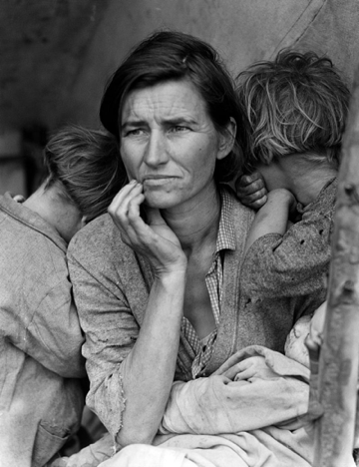
Questions to further class discussion
What time period? How do you know?
What are the facial expressions telling us in this picture?

Slide 13
What Words Stand Out To You?
“Having undertaken for the Glory of God and advancement of the Christian Faith and Honour of our King and Country, a Voyage to plant the First Colony in the Northern Parts of Virginia, do by these presents solemnly and mutually in the presence of God and one of another, Covenant and Combine ourselves together in a Civil Body Politic…”

Slide 14
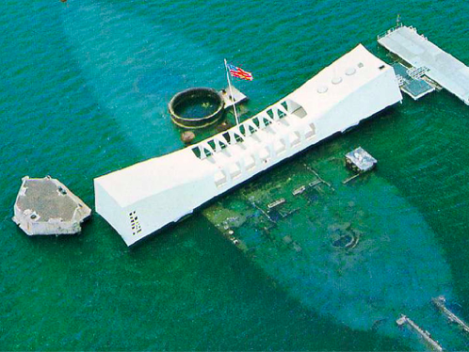
How To Use Documents as an Introduction to a Topic
Pearl Harbor Sit and Begin:
What are 5 observations you have of this photograph?
What is this?

Slide 15
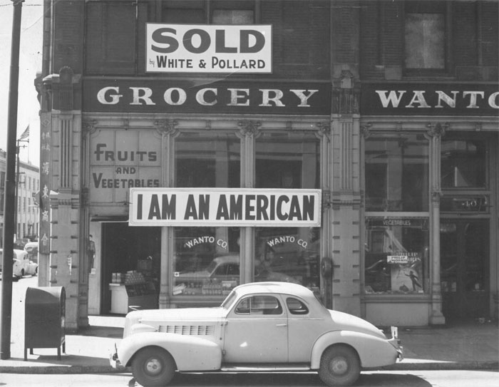
How To Use Documents as an Introduction to a Topic
Japanese Internment Sit and Begin:
In what country was this photograph taken? Around what year? What’s your evidence?
What kind of business is pictured in this photograph? Who owns it?
Why do you think the business has been sold?
Why would someone create a sign that says “I am an American” and post it outside of a business?

