Slide 1
Social Justice and Social Studies
Teaching Social Justice with the Maine Learning Results for Social Studies

Slide 2
While We Wait…
What words come to mind when you think of social justice????
https://www.polleverywhere.com/free_text_polls/G5gj5hobrJDWsFQdfBfAb
Notes:
https://www.polleverywhere.com/free_text_polls/G5gj5hobrJDWsFQdfBfAb

Slide 3
It is imperative that we maintain hope even when the harshness of reality may suggest the opposite.
-From Pedagogy of the Heart by Paolo Freire

Slide 4

Welcome
While we wait – Please jot down the following in the chat box:
  Name
  Grade/courses you teach
  What do you want to mentally put aside so that you can focus on this conversation?

Slide 5
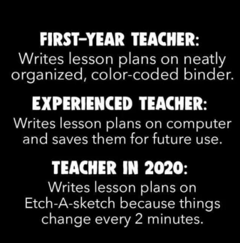
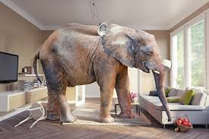
Honoring Current Context

Slide 6

Protocol for Interaction
Be present and participate.​
Assume good intent.​
Listen to understand.​
Be open to new ideas.
Be open to working outside your comfort zone.
Take time to reflect.​
Please keep muted unless speaking to cut down on background noise.​
Use chat box to communicate any responses or technical issues.​
Others…?

Slide 7
Goals for Session
Discuss the concept of Social Justice.
Dig deeper into the connections between social justice and the Maine Learning Results for Social Studies
Discuss how to identify entry points in your current curriculum
Understand the key concepts of social justice as they relate to social studies.
Unpack strategies and tools to support connecting social justice and social studies

Slide 8
What is Social Justice?
In the chat box jot down…
What social justice is…….
What social justice is not……
Notes:
https://www.cultofpedagogy.com/concept-attainment/
http://www.ascd.org/ascd-express/vol4/420-silver.aspx

Slide 9
Defining Social Justice
“Social justice may be broadly understood as the fair and compassionate distribution of the fruits of economic growth.”
United Nations
“Social justice is the view that everyone deserves equal economic, political and social rights and opportunities. Social workers aim to open the doors of access and opportunity for everyone, particularly those in greatest need.”
National Association of Social Workers
“Social justice encompasses economic justice. Social justice is the virtue which guides us in creating those organized human interactions we call institutions. In turn, social institutions, when justly organized, provide us with access to what is good for the person, both individually and in our associations with others. Social justice also imposes on each of us a personal responsibility to work with others to design and continually perfect our institutions as tools for personal and social development.”
Center for Economic and Social Justice
Social justice education is both a process and goal (Bell, 1997), and educators have a long history advocating its importance as a means to address inequalities related to race, immigration, and women’s rights (Crocco & Davis, 2002; Evans, 2004; Stanley, 2005; Watkins, 1993).
Notes:
What do these have in common?
Equal rights
Equal opportunity
Equal treatment
https://www.sdfoundation.org/news-events/sdf-news/what-is-social-justice/

Slide 10
Connecting Social Justice and Social Studies
Defining Social Justice and Social Studies We define social justice education as the pedagogical practice of guiding students toward critically discussing, examining, and actively exploring the reasons behind social inequalities and how unjust institutional practices maintain and reproduce power and privilege that have a direct impact on students’ lives.
Contemporary social studies scholars (Au, 2009; Banks, 2004; Tyson & Park, 2006; Wade, 2007) continue to promote social justice education as a primary curricular and pedagogical mechanism in an increasingly globalized world and among increasingly diverse student populations. Social justice educators help students “unveil the world of oppression, transforming it into a just world for the purpose of empowerment” (Tyson & Park, 2006, p. 23).
Since the purpose of social studies education “is to help young people make informed and reasoned decisions for the public good as citizens of a culturally diverse, democratic society” (NCSS, 1994), many scholars believe social studies education is an appropriate field to explore these topics of injustice (Banks, 2004; Wade, 2007).
It is not enough, however, that students only understand that injustices are happening. They also must recognize that they are agents of change who can make a difference in the world. Therefore, following Freire’s sense of consciousness raising, awareness turns to action and transformation of the world around them
Notes:
https://scholarworks.gsu.edu/cgi/viewcontent.cgi?referer=https://www.google.com/&httpsredir=1&article=1045&context=mse_facpub
National Council for the Social Studies. (1994). Expectations of excellence: Curriculum standards for social studies. Washington, DC: Author

Slide 11
Key Elements of Teaching for Social Justice

Slide 12
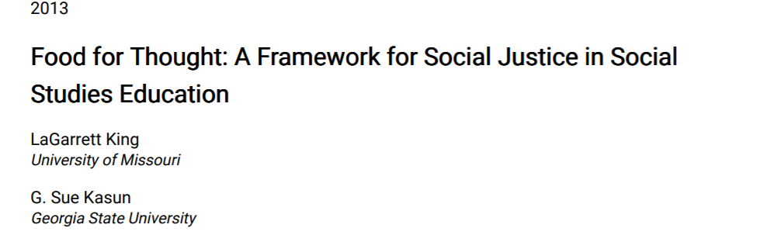
Ideas that connect to your current work
Ideas that surprise you
Ideas that you want to build off of
Questions you still have
Notes:
Have them read and jot down notes

Slide 13
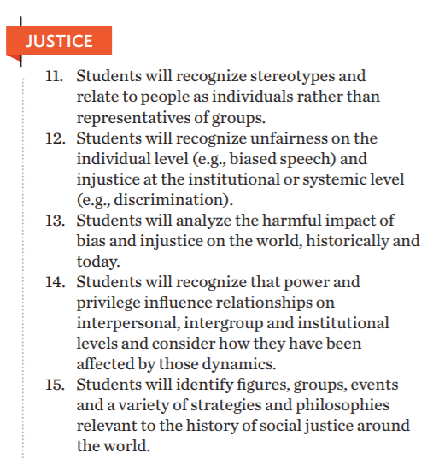
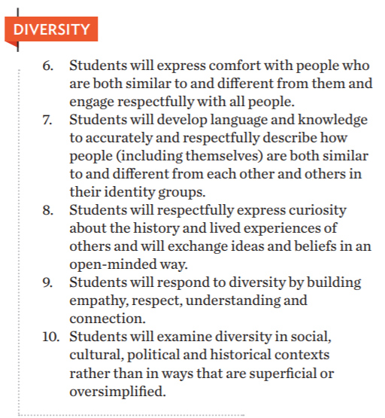
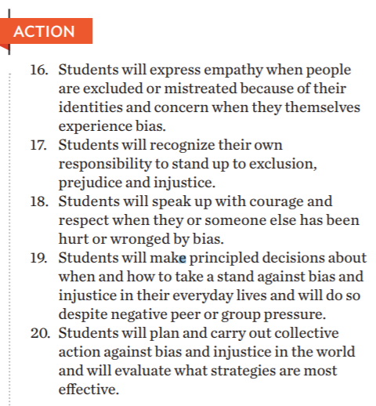
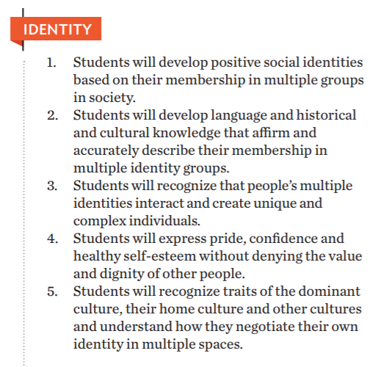
Teaching Tolerance Standards
Notes:
https://www.tolerance.org/sites/default/files/2020-09/TT-Social-Justice-Standards-Anti-bias-framework-2020.pdf

Slide 14
Where is this supported in your standards?

Slide 15
Connections to Maine Learning Results for Social Studies
Notes:
Discuss how to use the standards to address the issues with the concept of social justice

Slide 16
What Does it Mean to Be Proficient in Social Studies
Commits to democratic values, skills, and practices as preparation for democratic decision-making and participation in civic life. (NCSS, 2010)
Has deep and enduring understandings, concepts, and skills from the disciplines and uses their knowledge to interact with their community, nation, and world. (NCSS, 2010)
Collaborates as part of the decision-making and problem-solving process. (NCSS, 2010)
Applies inquiry processes as they locate, explore, and organize information so that it can be interpreted, analyzed, synthesized, and evaluated. (NCSS, 2010)
Uses interdisciplinary applications and integration of the arts, humanities, and other academic and career or technical content areas. (NCSS, 2013)
Understands that when evaluating information, the source and context must be considered along with multiple perspectives and viewpoints. (SHEG, 2013)
Applies geographic perspectives, knowledge, and skills in the workforce, academic settings, and daily life. (NCGE, 2012)
Understands the economic reasoning embedded in personal financial literacy and applies them when decision making to be wise consumers, investors, and savers. (CEE, 2010 & 2013)
Recognizes and evaluates varied perspectives and cultures, both historic and current. (CCSS, 2010)
Notes:
Do you see connections to what we discussed regarding social justice?

Slide 17
Guiding Principles
Clear and Effective Communicator: Students research and use background knowledge to give audiovisual presentations about current and historical issues.
Self-Directed and Lifelong Learner: Students generate questions and explore primary and secondary sources to answer those questions while demonstrating a growth mindset.
Creative and Practical Problem Solver: Students draw conclusions about current and historical problems using valid research and critical thinking.
Responsible and Involved Citizen: Students practice and apply the duties of citizenship through the exercise of constitutional rights.
Integrative and Informed Thinker: Students compare and contrast to analyze point of view and differentiate between reliable and unreliable primary and secondary sources.

Slide 18
Skills
The application of skills in Social Studies is crucial to any curriculum. Best practices in Social Studies reflect curriculum, instruction, and assessment that give students opportunities to demonstrate research and develop positions on current Social Studies issues. Students will be asked to identify key words and concepts related to research questions and locate and access information by using text features. Additionally, students will demonstrate facility with note-taking, organizing information, and creating bibliographies. Students will distinguish between primary and secondary sources as well as evaluate and verify the credibility of the information found in print and non-print sources. Equally important is that students use additional sources to resolve contradictory information.

Slide 19
Key Ideas
Growth mindset - Our mindset includes beliefs about our abilities and qualities that include intelligence, creativity or musicality. Having a growth mindset means that students know that their abilities and strengths can change or develop, and that those changes are within their control.
Various -The Social Studies Standards refer to “various" peoples, nations, regions of the world, historical eras, and enduring themes. School administrative units should develop a local curriculum that assists students in gaining a coherent, broad perspective on a variety of peoples, nations, regions, historical eras, and enduring themes.
Major Enduring Themes - The term “major enduring themes” is used in several places in the Social Studies Standards. This term refers to general topics or issues that have been relevant over a long period of time. Using a consistent set of themes can serve as a framework within which other concepts, topics, and facts can be organized. It can also help students make connections between events within and across historical eras, and use history to help make informed decisions. The Civics and Government, Personal Finance and Economics, Geography, and History Standards all include performance expectations that address individual, cultural, international, and global connections. It will be up to the School Administrative Units to determine whether they use these performance expectations as an opportunity to integrate across the disciplines of the social studies or address them separately. The “enduring themes,” some of which overlap, include:

Slide 20
Enduring Themes
Freedom and Justice
Conflict and Compromise
Technology and Innovation
Unity and Diversity
Continuity and Change Over Time
Supply and Demand

Slide 21

Entry Points
Where do I start?

Slide 22



Content
Teaching For Social Justice
Pedagogy
Practice
Notes:
Again note how integrating and focusing on these three areas can get at the key aspects of social justice without red flagging the ideas people have about social justice – its just good practice

Slide 23
Content
Educators can begin with the textbook, but must be able to move beyond it to explore a deeper understanding that considers multiple perspectives of historically underserved communities, critiques common sense notions that often only serve the interests of the most powerful (Kumashiro, 2004), and demonstrates the importance of micro and macro analyses. If students are not exposed to or given the opportunity for a critical historical analysis, knowledge becomes ahistorical and decontextualized.

Slide 24
Content
Thinking Like A….
Teaching For Social Justice
Pedagogy
Practice
Notes:
But where can I find multiple perspectives: A place to start
Smithsonian Lab - https://learninglab.si.edu/
LOC Primary Source Sets - https://www.loc.gov/classroom-materials/

Slide 25
Pedagogy
Pedagogy should focus on helping student to critically examine knowledge as multifaceted, complex, and—depending on the creator—either oppressive or liberatory. Educators need to teach students to identify why and how knowledge is created and who its creators are and their interests, as well as to uncover commonsense assumptions of knowledge while recognizing multiple and oppressed voices. In this way, they will be able to promote social change. Freire (1970) believes we should teach students to “read and write the world,” which requires not just understanding but also questioning institutionalized knowledge as well as facilitating solutions for injustices.

Slide 26
Student Centered Social Studies
Consistent opportunities for inquiry
Purposeful integration of content and skills
Focused deliberation and discussions
Strategic cross-disciplinary connections
Intentional analysis of multiple perspectives,
Deliberate examination of information
Notes:
https://docs.google.com/document/d/1vKWflx_nKmv08gWg5RAIbwc1zasbaPoDmvrIsPfHEvI/edit
https://www.maine.gov/doe/learning/content/social/pedagogy
https://docs.google.com/document/d/1kr36-SG1ZP17zOX5OCIeNmXxTJUVAn4_EtPOJHU-_Lo/edit

Slide 27
Content
Teaching For Social Justice
STRUCTURED ACADEMIC CONTROVERSY
Pedagogy
Practice

Slide 28
Practice
Fostering a classroom community of conscience
Helping students see each other as co-learners rather than adversaries
Including diverse experiences and backgrounds in classroom materials
Focusing the classroom as a space where students have opportunities to apply social justice principles into an action plan that can be implemented to improve society. This approach helps students understand the link between classroom content and the real world, which increases lesson relevancy. It also empowers students to be agents of change. Application with agency can be implemented in myriad ways. Students can promote awareness of social injustices through artistic expression, writing campaigns to local and national government officials and agencies, and digital media (Facebook pages, Twitter), or through the planning of actual grassroots protests and/or information sharing sessions
Notes:
https://resilienteducator.com/classroom-resources/teaching-social-justice/

Slide 29
Content
Teaching For Social Justice
NORMS LINK
SEL
Pedagogy
Practice

Slide 30
Resources
Teaching Tolerance
https://education.uiowa.edu/social-justice-resources-k-12-teachers
https://www.tolerance.org/sites/default/files/2020-09/TT-Social-Justice-Standards-Anti-bias-framework-2020.pdf
Elementary texts: http://6elementssje.blogspot.com/
Fostering Civil Discourse: A Guide for Classroom Conversations (Facing History and Ourselves)
Digital literacy in the Classroom
Civic Online Reasoning
https://www.theedadvocate.org/teaching-social-justice-in-your-classroom/

Slide 31
Previous Presentations
What Kind of Citizen in a Pandemic and Beyond? Promoting Student Voice (Led by Mary Ellen Daneels - Illinois Civic Mission Coalition
  Presentation
  Folder of Resources
The Political Classroom & Structured Academic Controversies (Led by Dr. Paula McAvoy - Co-Author of The Political Classroom & Prof. of Education at N.C. State University)
  Presentation
Teaching About Controversial Topics (Led by Dr. Diana Hess/Author, Researcher, and Dean of Education - University of Wisconsin)
Amplifying Student Voice Through Project Soapbox (Led by Jill Bass & Mia Salamone - Mikva Challenge)
  Presentation

Slide 32
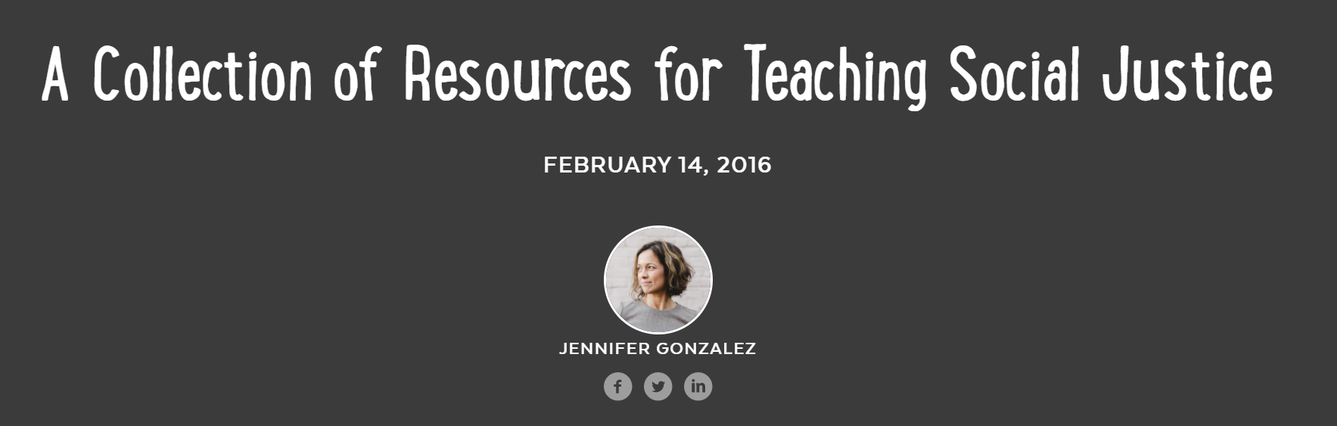
Notes:
https://www.cultofpedagogy.com/6-ed-tech-tools-to-try-in-2020/

Slide 33
Research
Au, W. (2009). The “building tasks” of critical history: Structuring social studies for social justice. Social Studies Research and Practice, 4(2), 25-35.
Banks, J. A. (2004). Teaching for social justice, diversity, and citizenship in a global world. The Educational Forum, 68(4), 296-305.
Bell, L. A. (1997). Theoretical foundations for social justice education. In M. Adams, L. Bell, & P. Griffin (Eds.), Teaching for diversity and social justice: A sourcebook (pp. 3-15). New York, NY: Routledge.
Hackman, H. W. (2005). Five essential components for social justice education. Equity & Excellence in Education, 38(2), 103-109
Stanley, W. B. (2005). Social studies and the social order: Transmission or transformation? Social Education, 69(5), 282-286.
Tyson, C. A., & Park, S. C. (2006). From theory to practice: Teaching for social justice. Social Studies and the Young Learner, 19(2), 23-25.
Wade, R. C. (2007). Social studies for social justice: Teaching strategies for the elementary classroom. New York, NY: Teachers College Press

Slide 34

Thank You!
Beth Ratway
bratway@air.org

