Slide 1

School Finance 101 – Essential Programs and Services
Why EPS?
What is the purpose of EPS?
What data is used in the EPS formula?
How is EPS calculated?
How big is my slice of pie?

Slide 2

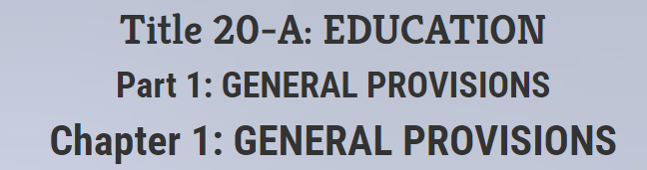
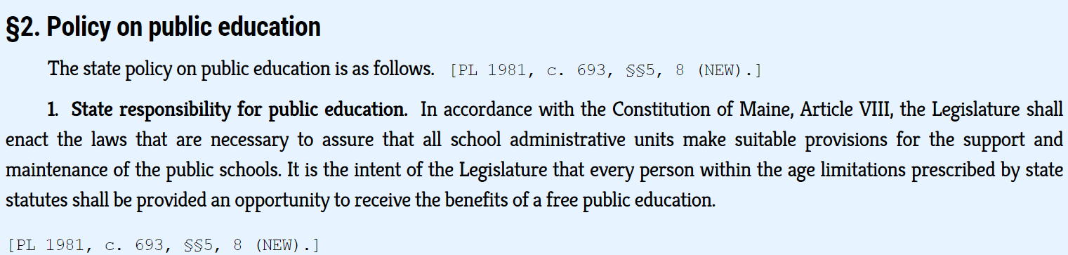

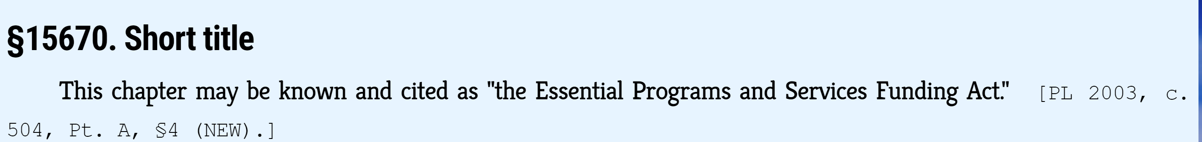
Why EPS? – the Essential Program and Services Funding Act
Constitution of the State of Maine – Article VIII. Part First. Education.
Section 1. Legislature shall require towns to support public schools; duty of Legislature.

Slide 3
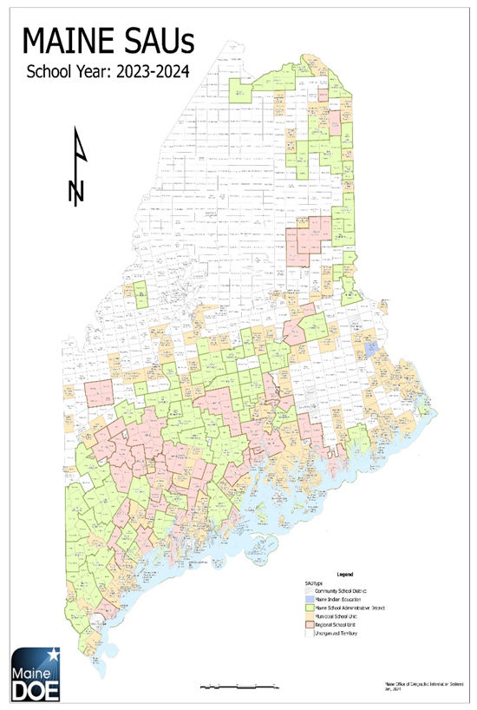
EPS – Why EPS?
Prior to the implementation of the Essential Programs and Service (EPS) Funding Model, traditional approaches to school funding determined education needs in terms of revenue – by taking whatever dollars are available and dividing them in such a way as to ensure there are equal education dollars behind each child.
In contrast, the EPS model focuses first on student outcomes (Maine’s Learning Results), and second, on the services and resources needed to achieve these outcomes.
The EPS model then defines what is adequate in terms of resources and dollars to provide the education necessary for each child to have the opportunity to achieve Maine’s Learning Results.

Slide 4


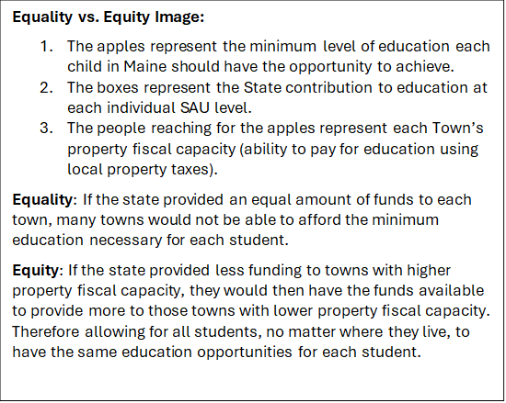
What is the purpose of EPS?
The EPS formula (per Title 20-A, Chapter 606-B) provides the state with a mechanism for establishing a minimum sufficient funding level to ensure the opportunity for all Pre-K to 12 grade level students to meet the standards and goals established in Title 20-A, Chapter 222; (Maine Learning Results) and an equitable way to distribute the funding responsibility between local communities and the state.

Slide 5
EPS – Why EPS?
Essential Programs and Services (EPS) is designed to ensure that all schools have the programs and resources that are essential for all students to have an equitable opportunity to achieve Maine’s Learning Results.
The EPS model provides a basis for adequacy and greater equity in the funding of PreK-12 education because it is mostly cost driven instead of expenditure driven.
The model is designed to respond to student needs and is based on years of research and information gleaned from high performing cost-effective school units.
To receive State subsidy, SAUs must contribute the required local amount per the EPS calculation.
Many SAUs raise above and beyond what the State requires for the local share – that is referred to as "additional local".

Slide 6
EPS
What is it?
  An adequacy funding model
  Provides funding equity statewide
  Utilizes data (information) provided by each school administrative unit
  Accounts for different school administrative unit characteristics/demographics (student populations)
  Determines equitable shares between local school administrative units and the state
  Establishes a monthly state payment schedule
  Required by state statute to be reported out to school districts by Feb 1 of prior fiscal year
  Reported out to school districts on ED279 reports

Slide 7




EPS
EPS does not take away local control.
What it is NOT…
A prescription for how funds should be spent.
The decisive amount to be spent on education in a school administrative unit.
How funds are budgeted and spent on public education is a local decision.
How many staff or what programs are needed in public education is a local decision.

Slide 8


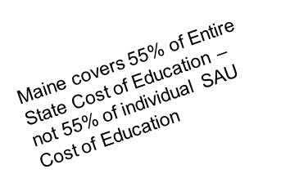
How much pie is needed for the EPS formula?
Total Cost of Education FY 25 EPS Calculation = $2,621,942,627
Local Contribution Cap
(6.62 Mill Rate)
45%
State Contribution
55%
FY 25 State Appropriation for Education = $1,442,068,445
FY 25 Local Required Contribution = $1,179,874,182

Slide 9
How much pie is needed for the EPS formula?
Total Cost of Education FY 26 EPS Calculation = $2,738,246,642
Local Contribution Cap
(6.10 Mill Rate)
45%
State Contribution
55%
FY 26 State Appropriation for Education = $1,506,035,654
FY 26 Local Required Contribution = $1,232,210,988

Slide 10

What data is used in the EPS formula?
  Student Data: All student information that is valid October 1st is part of the enrollment data.
  Synergy – State’s Student Information System https://www.maine.gov/doe/data-reporting/collection/helpdesk/resources/synergy_instructions
    Attending Students – those students attending a school in your district.
    Resident (Subsidizable) Students – those students that reside in a town in your district.
    Superintendent Transfer Students – those students that reside in a town outside of your district, but for purposes of the EPS calculation will be counted as a resident of your district.
    Equivalent Instruction Students – Home School students taking a course(s) in your district.
    Economic Disadvantaged Students – Currently defined as any student that meets the qualifications for federal free or reduced lunch.
  Alternate Economic Disadvantaged Status Form (FY 26 - updated 3/25/2025)
    English (Multilingual) Learners – students that are identified as English learners.
    Special Education Students – students identified as special education students.
    CTE Enrollment – Students flagged as enrolled in CTE programs.
    PreK estimated counts (Title 20-A, §4271 (3-A))
      For new or expanding programs in FY2026, estimated counts are due by November 30th
      Survey must be completed by 11/03/2025
      This includes programs paid for with any federal funds
      All programs must be approved by the Early Childhood program
    Note: All estimate student counts will be reconciled after the collection of the Oct. 1st counts in the next fiscal year.
    Adult Education – course counts for eligible 16 to 20-year-olds
  Staff Data: October 30th snapshot of Full Time Equivalent (FTE) regular instruction staff.
  Budget Data:
    Actual expenditures
    Actual revenues
    Actual balance sheet

Slide 11

What is the ED279 Report?
A detailed report of the Essential Programs and Services (EPS) calculation known as the ED279 is provided each year to every individual School Administrative Unit (SAU).
The ED279s are public reports and can be accessed through the DOE website.
The ED 279 Report provides the detailed EPS calculation for each SAU in 6 sections.
Section 1 = Per Pupil Costs to Operate a School for regular education; used as multiplier in Section 2
Section 2 = Operating Cost allocations for all subsidizable students and additional weights for specific types of student demographics (i.e., Multilingual Learners, Economically Disadvantaged)
Section 3 = Other subsidizable allocations specific to each SAU (i.e., Special Education, Transportation, Gifted & Talented, School Construction)
Section 4 = Determines State and Local required contribution (Local Share and State Share)
Section 5 = Additional adjustments as required
Section 6 = Monthly subsidy allocation expected in fiscal year

Slide 12
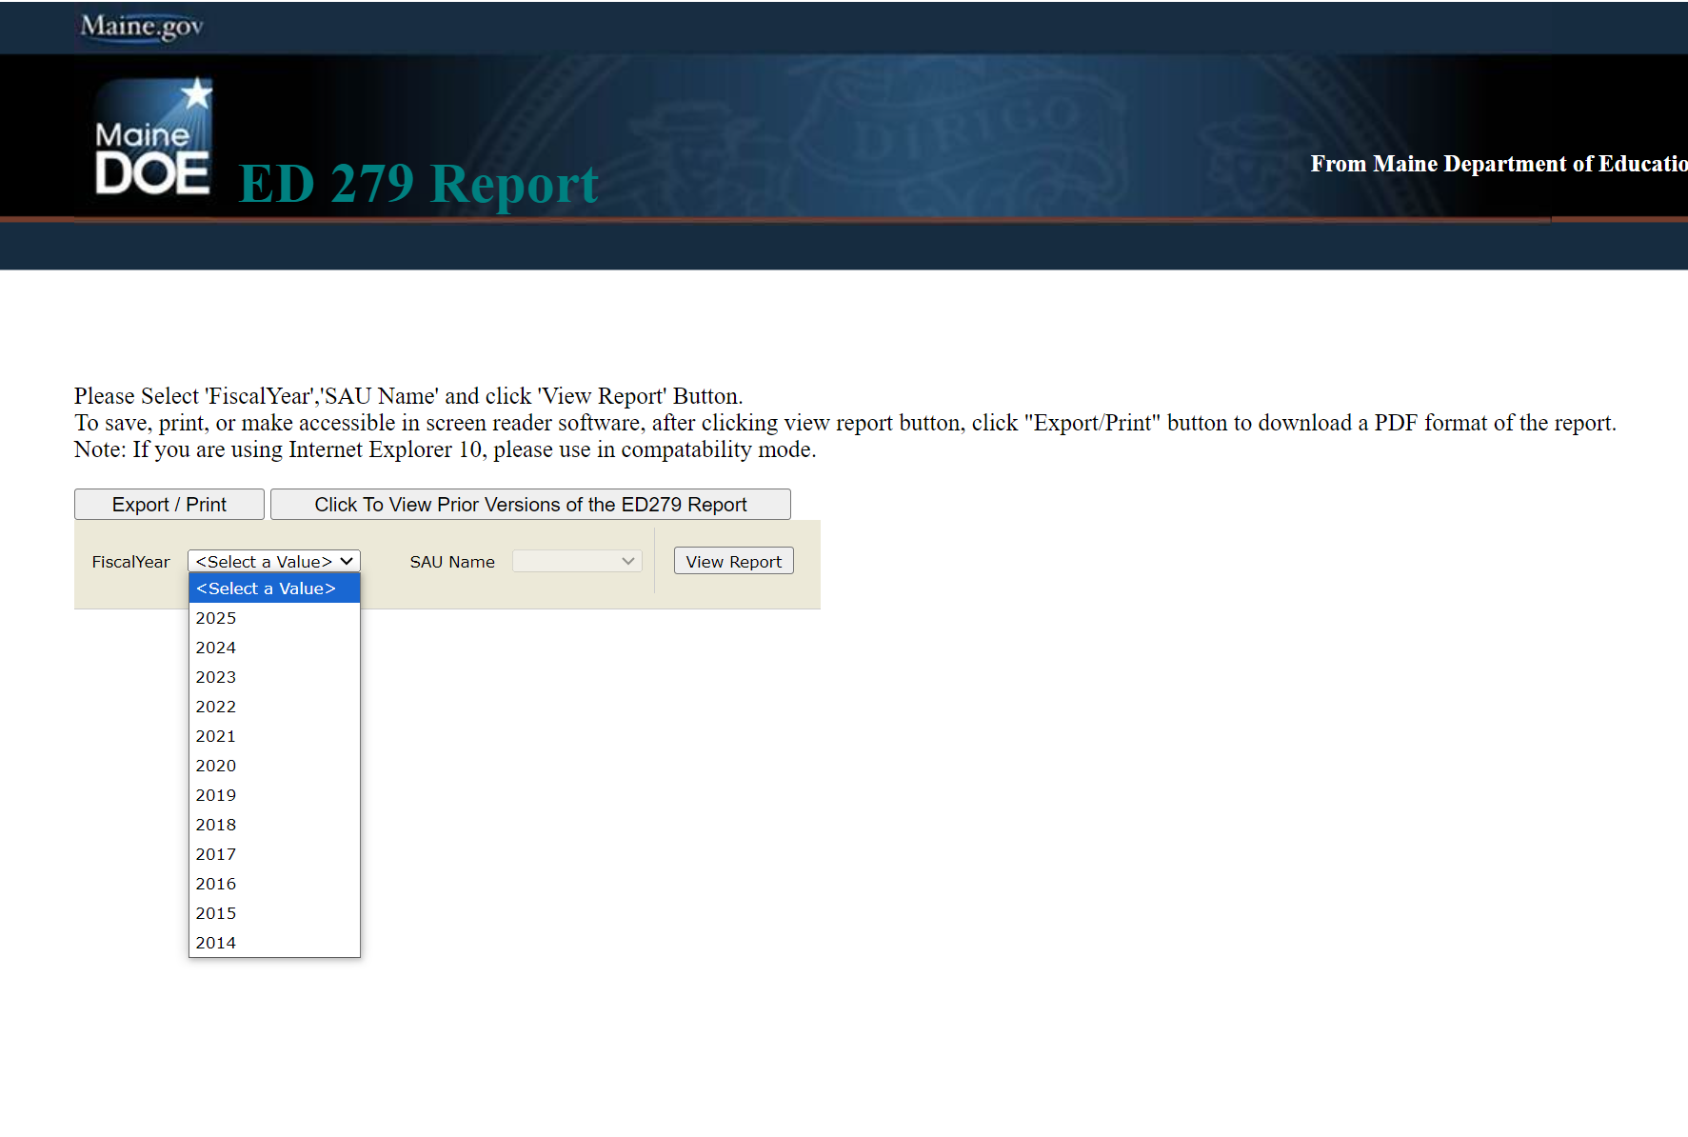
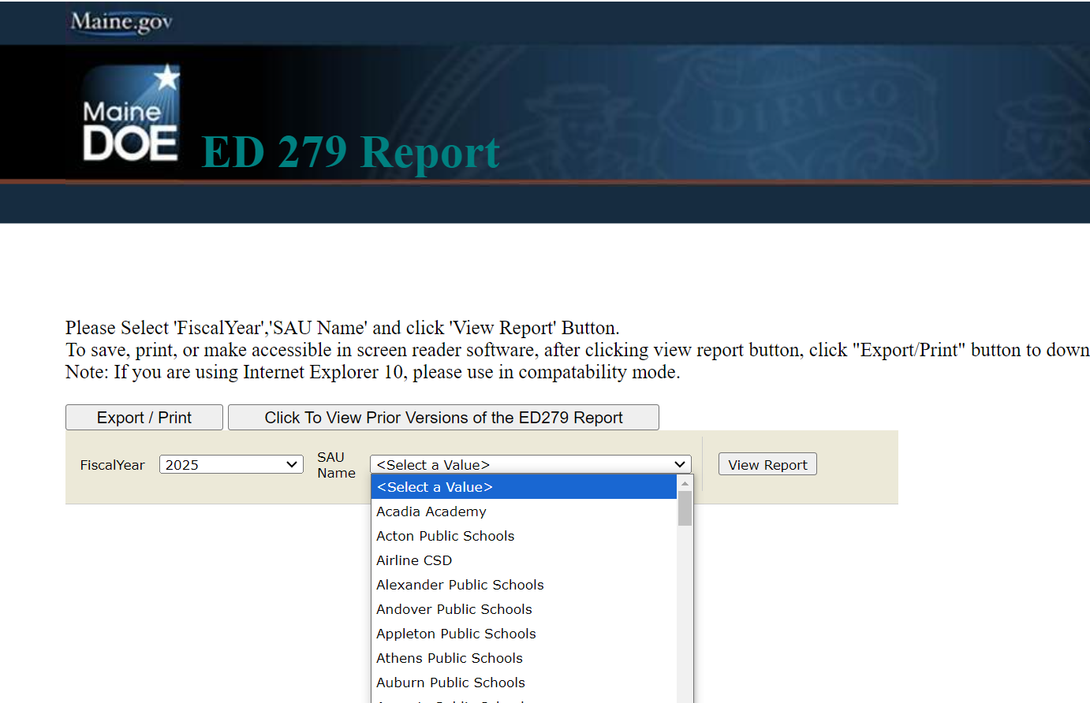
How do I access the ED 279 reports?
Go to https://neo.maine.gov/DOE/NEO/eps/public/ed279.aspx
Choose Fiscal Year:
Choose SAU and then View Report:

Slide 13

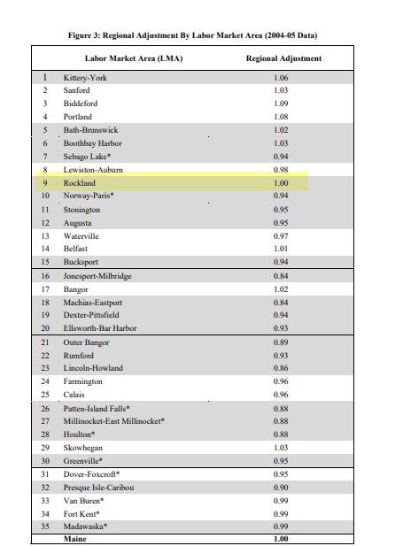
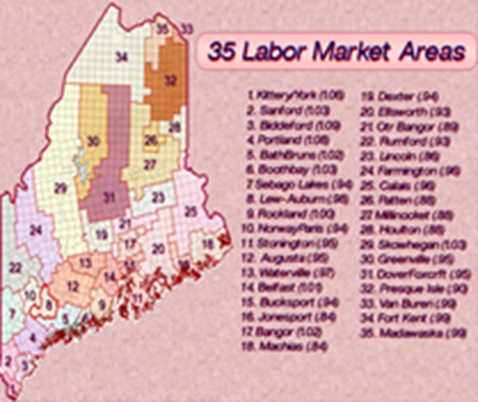
How is EPS calculated? – the Magic 8 Ball
Once we have the data and know the size of the pie… the magic begins.
Section 1. – Computation of EPS Rates - The per-pupil EPS cost rates determined in Section 1 are used as the multiplier to calculate the EPS Operating Cost Allocations in Section 2.
Elementary and secondary per-pupil cost rates are calculated for each school administrative unit; which is the per pupil cost to operate a school for those attending students for general education only (i.e., not Special Education) according to the current determined essential programs and services adequacy funding level.
Elements used in this calculation:
    Number of students attending the schools in the district (1A)
    EPS Staff Positions (1B)
      Experience and education level of staff
      Ratios of students to staff
      Salary matrixes
      (using State average salaries)
    Percentages for benefits (1C)
    Other Support Per-Pupil Costs (1D)
    Regional Adjustments (1E)
    The regional index is a factor using the 35 Labor Market Areas to account for variations in Income Levels and the Cost of living throughout the State of Maine; and the fact that we are using an Average Salary Scale for the entire State when determining the amount of salary to allocate in the EPS calculation.

Slide 14

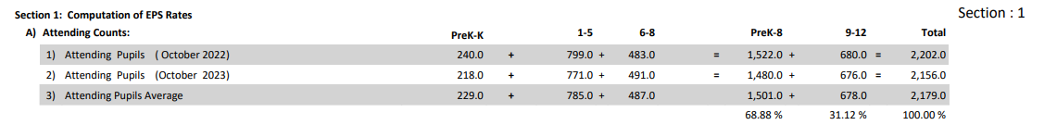

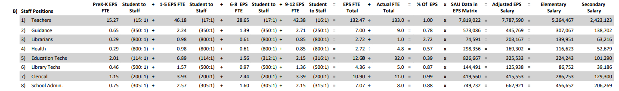
EPS – ED279 Section 1A & 1B – Students and Staff
  Attending Students – students physically attending a school in your district.
  All student information that is valid October 1st is part of the enrollment data.
  Staff Data – Regular education
  October 30th snapshot of Full Time Equivalent (FTE) regular instruction staff.
  Teachers
    Classroom Teacher, Literacy Specialist, Long-term substitute, Title I Teacher, Multilingual Learner Teacher
  Guidance
    School Social Worker, Director of Guidance, Guidance Counselor
  Librarians
  Health
  Education Techs
  Library Techs
  Clerical
    Building level
  School Admins
    Principal, Assistant Principal, Teaching Principal

Slide 15
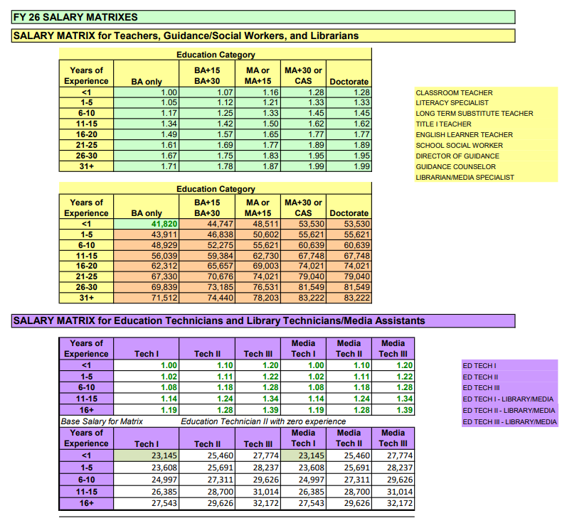
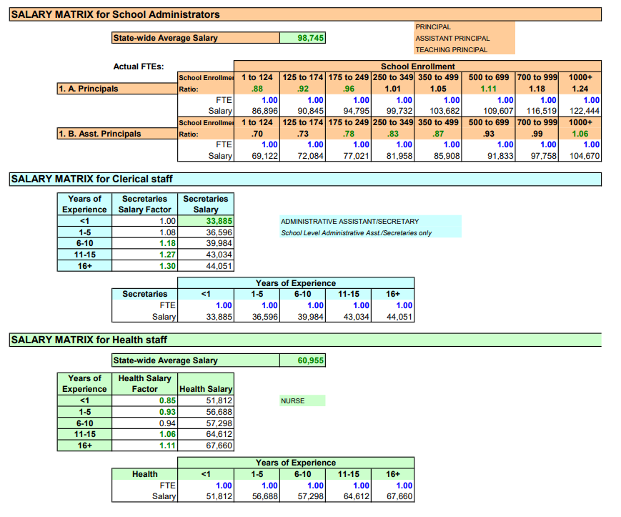
ED 279 Section 1: Computation of EPS Rates
Section 1 B – Staff Positions and Salary Matrices

Slide 16
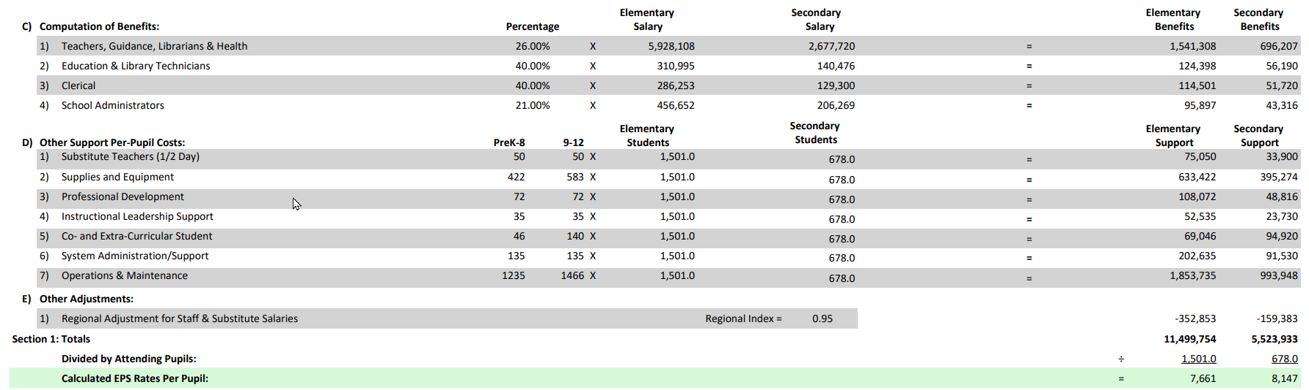
ED 279 Section 1C, 1D & 1E – Benefits, Other Support & Adjustments
EPS Per Pupil cost rates used in Section 2 Calculations

Slide 17

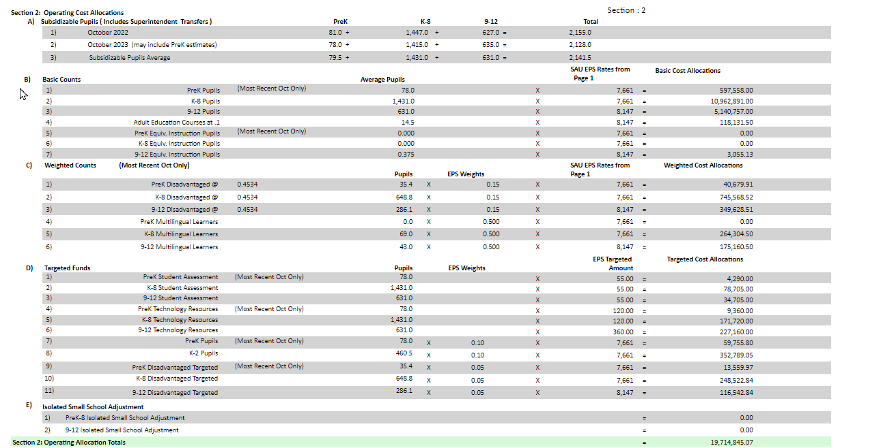
ED 279 Section 2: Operating Cost Allocation
Key components for operating allocations:
Subsidizable student counts: students whose parents or legal guardians reside within the SAU
  PreK, K-8, and 9-12 (using current and prior year October average for K-12 and current year only for PreK)
  Adult Ed course counts for 16–20-year-olds
  Equivalent instruction (Home School Students)
Weighted student Counts:
  Economically Disadvantaged (0.15)
  Multilingual (English) Learners
    based on # of students
      1 to 15 - 0.7
      16 to 250 - 0.5
      251 or more - 0.525
Additional Targeted Funds:
  Assessment
  Technology Resources
  PreK and K-2 (.10)
  Economically Disadvantaged (.05)
Isolated & Small School Adjustments
  Must meet size and distance criteria
  Based on individual school buildings
      Does not apply to sections and wings

Slide 18


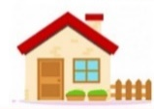



ED 279 Section 3 - Additional Operating Cost Allocations
Key components for other allocations
  Other Subsidizable Costs
    Approved Gifted & Talented programs
    Special Education (multi-component calculation & maintenance of effort adjustment)
    High Cost Out-of-District Special Education Allocation
    Transportation Operating – EPS Allocation
    Approved Bus Purchases
  Teacher Retirement – Normalized Cost (employer share)
  Debt Service Allocations
    Principal & Interest Payments for approved school construction projects
    Approved Costs for Instructional Space Leases
    Insured Value Factor for Private School Tuition
For more information and to apply for the bus program, contact Maine DOE’s Transportation Coordinator,
Cheryl Brackett Cheryl.Brackett@maine.gov

Slide 19
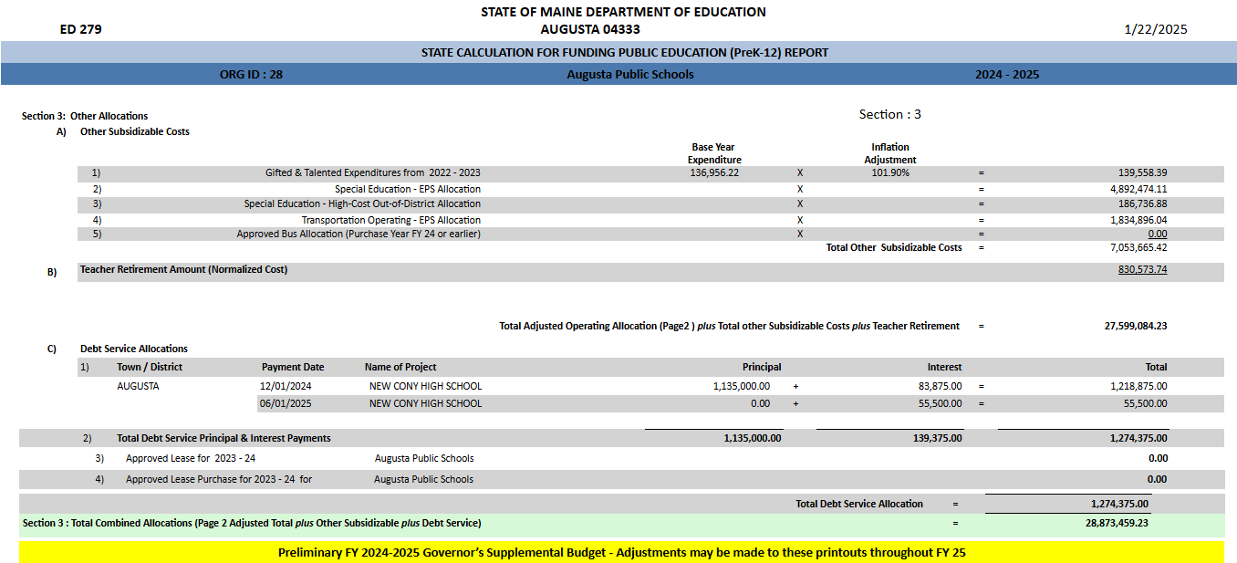
ED 279 Section 3 - Additional Operating Cost Allocations

Slide 20


ED 279 Section 4 - State and Local Shares
Now that we now know the size of the pie - How do we cut up the pie into State and Local shares?
Key components in Determining Required Local Share:
  Valuation by town as provided by the Maine Revenue Service each year, which determines ability to contribute locally toward the cost of education.
  Percentage of students by town within a combined SAU, used to determine distribution of Total Cost of Education by Town.
  Mill Expectation (Local Contribution Cap) is calculated after determining Total Cost of Education, State Funds Available, and Valuation by Town.
  Current FY 26 Mill Rate = 6.10
State and Local Share:
  To receive State subsidy, SAUs must contribute the required local amount per the EPS calculation.
  Many SAUs raise above and beyond what the State requires for the local share – that is referred to as "additional local".

Slide 21
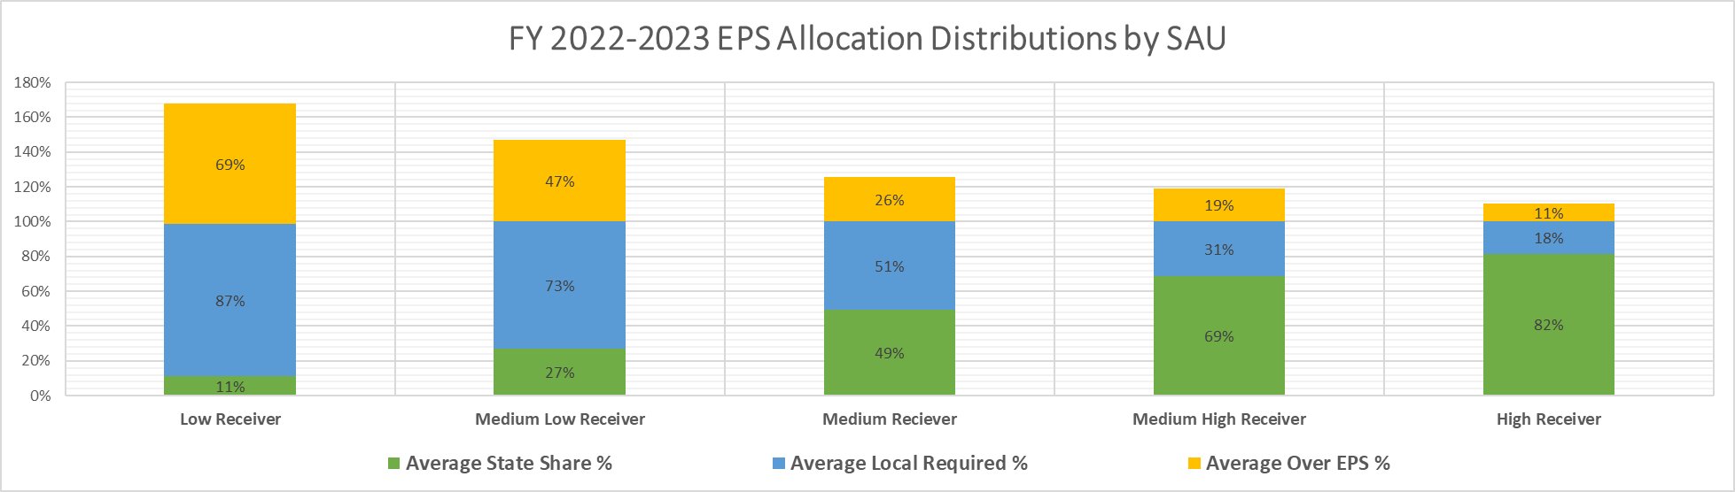
ED 279 Section 4 - State and Local Shares
  Many SAUs raise above and beyond what the State requires for the local share – that is referred to as "additional local".
Remember, EPS is not expected to be able to determine all costs of education for every SAU; the actual needs and subsequent costs are a local decision and may not match exactly what the EPS formula has determined.
The EPS formula (per Title 20-A, Chapter 606-B) provides the state with a mechanism for establishing a minimum sufficient funding level to ensure the opportunity for all Pre-K to 12 grade level students to meet the standards and goals established in Title 20-A, Chapter 222; (Maine Learning Results) and an equitable way to distribute the funding responsibility between local communities and the state.
As a result, many SAUs raise additional local funds to cover the costs over and above the “minimum sufficient funding level” that EPS has determined. The amount of additional local funds is a local decision based on the local school budget and school board determination of the needs of the local SAU.

Slide 22
ED 279 Section 4 - State and Local Shares
  Many SAUs raise above and beyond what the State requires for the local share – that is referred to as "additional local".
  Low Receiver = 0-19% State Share EPS Funding – has a higher ability to contribute locally with property taxes.
  Medium Low Receiver = 20-39% State Share EPS Funding
  Medium Receiver = 40-59% State Share EPS Funding
  Medium High Receiver = 60-79% State Share EPS Funding
  High Receiver = 80-100% State Share EPS Funding – has a lower ability to contribute locally with property taxes.

Slide 23

ED 279 Section 4 - State and Local Shares
Key components for state and local share determination:
Subsidizable (Resident) Student Counts
Total Allocations are summed and divided within each district based on percentage of subsidizable pupils by member municipality:
  Operating Cost Allocation (Section 2 totals)
  Other Subsidizable Cost Allocation (Section 3)
  Teacher Retirement Allocation (Section 3)
  State Approved Debt Service Allocation (Section 3)
Fiscal Capacity – State Valuation by Town
  Lesser of 3-Year Average Valuation or Previous year Valuation
  EPS Mill rate i.e., Local Contribution Cap – (not the same as the mill rate towns use for taxes)
  Municipality’s Ability to contribute toward local cost of education
State Appropriation = Total EPS Cost of Education - Required local contribution

Slide 24

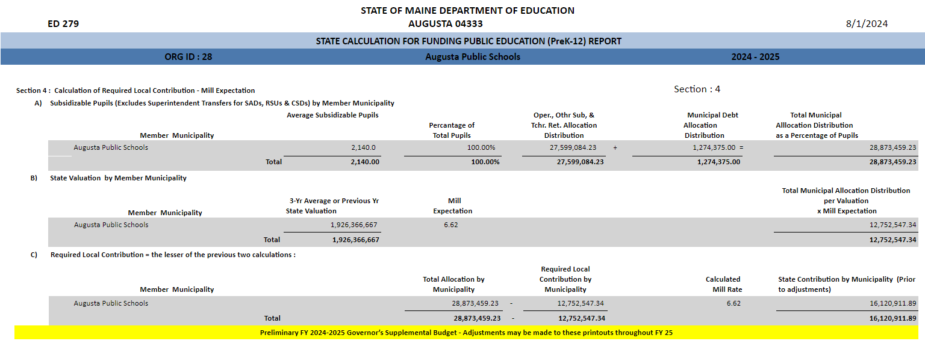




ED 279 What is the EPS Local Required Mill Rate?
The mill rate is the cap for the required local contribution for all towns in Maine per the EPS Formula.
It is the most any town will be asked to contribute towards the cost of education in their SAU for that fiscal year.
If the amount calculated by the EPS formula as the total cost of education for a town is less than the ability to contribute using the current mill rate (cap) times the towns valuation, then they will be required to contribute the lower amount, in effect, contributing less than the mill rate cap (aka: minimum contributor).
The mill rate changes each year and is determined after the Total Cost of Education for all SAUs, and other state-funded education requirements is calculated.
Total Cost of Education per EPS in Augusta.
The most Augusta will contribute per EPS.
State Share per EPS.

Slide 25
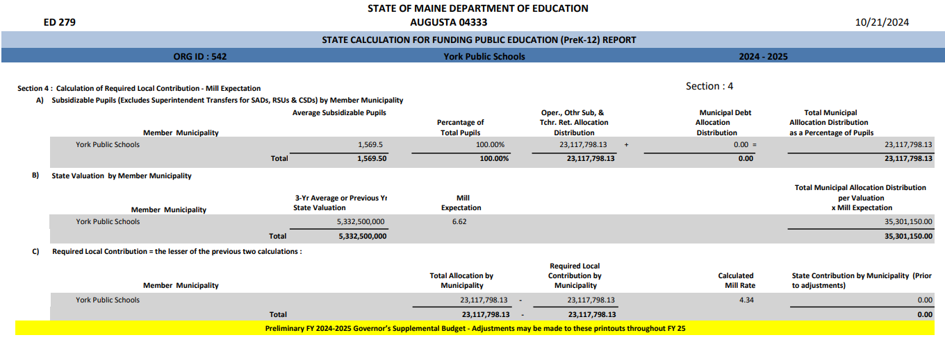
Minimum Contributor Status – what does it mean?
Remember, the EPS funding formula is used to equitably distribute limited State funds to the areas that need them the most.
In FY 26, 81 out of 252 School Administrative Units (SAUs), 32% are minimum contributors.
  In other words, towns contributed less than the current Mill Rate local contribution cap, because the cost of education they were responsible for was less than the mill rate cap x their town’s valuation.
As a result, if an SAU has a higher valuation times the current mill rate cap, (aka: higher ability to pay towards education), the EPS formula will provide less state funds to them, so it can provide more state funds to SAUs that do not have as great an ability to pay for the cost of education using local property taxes.
Total Cost of Education per EPS in York.
The most York could contribute per EPS.
Actual mill rate paid by most towns.
The most York will contribute per EPS, prior to adjustments.
Actual mill rate paid by York.

Slide 26
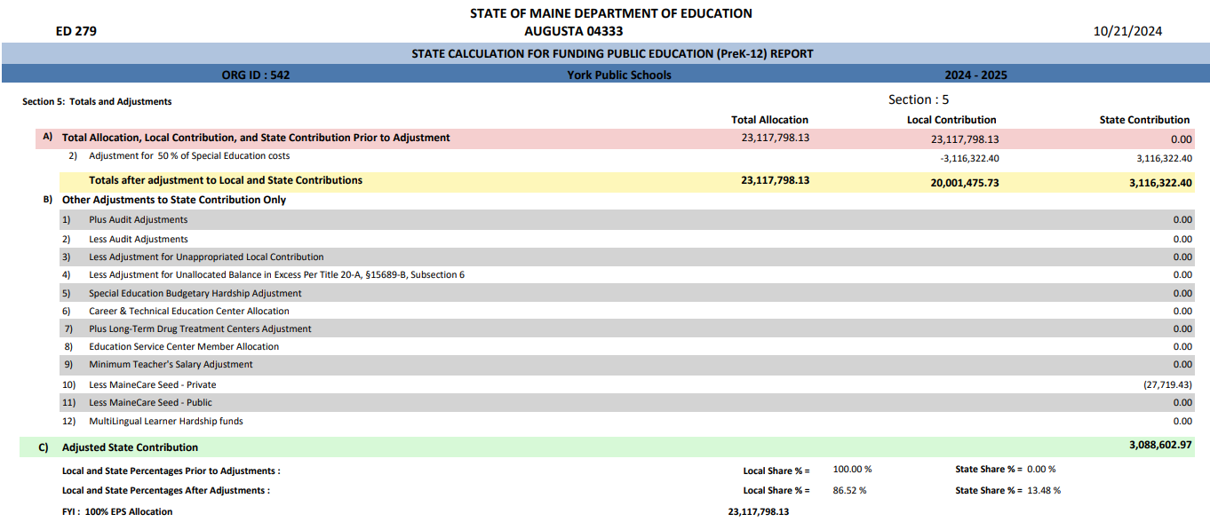
Minimum Contributor Adjustments – how does it work?
Per Title 20-A, §15689, subsection 1: Each school administrative unit must be guaranteed a minimum state share of its total cost of education that is an amount equal to the greater of the following:…
In this example, York receives a minimum contributor adjustment equal to 50% of their special education allocation from Section 3 of the ED 279. The adjustment reduces the local share and increases the state share.
As a result, the actual mill rate that York is contributing towards the cost of education is 3.91 mills.
Adjustment reduces local contribution & increases state contribution

Slide 27
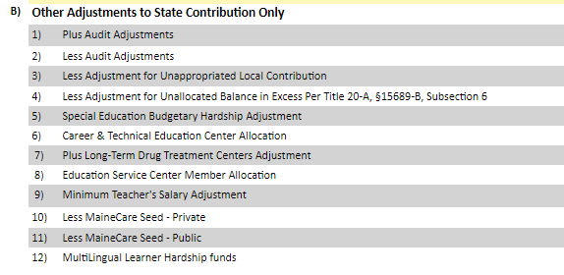

ED 279 – Section 5: Total Allocation/Local Contribution/State Contribution Amounts
Section 5B = Adjustments made to State contribution only
Section 5C = Adjusted State Contribution

Slide 28
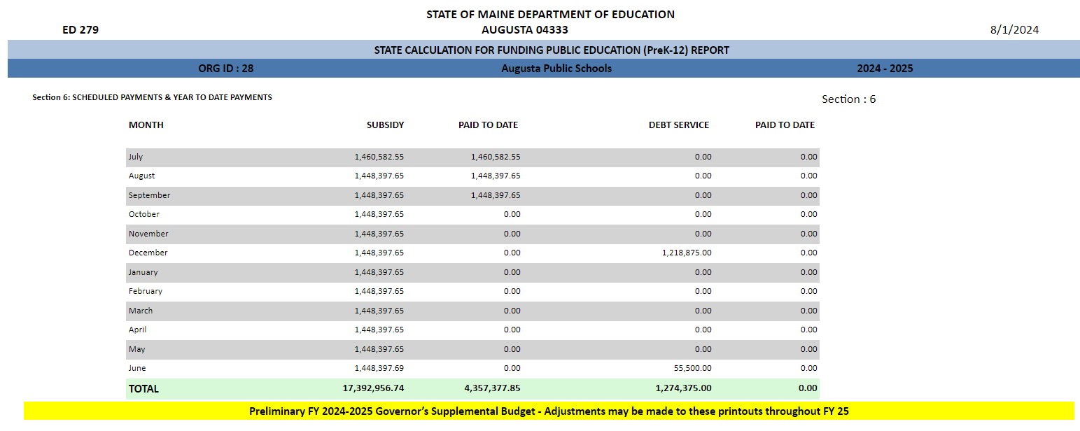

ED 279 – Section 6: Scheduled Payments & Year to Date Payments

Slide 29

Accountability of State Funds
To ensure accountability:
All SAUs are required to submit a financial audit annually per Title 20-A, §6051.
All SAUs are required to submit financials – budgets are compared to actual expenditures.

Slide 30




Helpful Reports and Other Resources
https://www.maine.gov/doe/
Helpful Reports - https://www.maine.gov/doe/funding/reports
Other Resources
Essential Programs & Services website:
  https://www.maine.gov/doe/funding/gpa/eps
Subsidy Printouts (ED279) for school districts:
  https://neo.maine.gov/DOE/NEO/eps/public/ed279.aspx
Law: 20-A MRSA Chapter 606-B:
  http://www.mainelegislature.org/legis/statutes/20-A/title20-Ach606-Bsec0.html

