Slide 1
Summer Food Service Program Staff and Volunteer Training
Notes:
Welcome to Maine Department of Education webinar for Summer Food Service Program This presentation is geared toward frontline staff and volunteers and goes over the basics of day to day operations

Slide 2
Agenda
Meal Counts and Tic Sheets
Identifying a Reimbursable Meal
Program Rules
Food Safety Tips
Civil Rights
Notes:
Our agenda will cover:
How to take meal counts using Tic sheets
Quick ways to identify a reimbursable meals for those serving meals to kids
Some Program rules and food safety tips
And lastly you will have a training on civil rights, which is a requirement for all staff in National School Lunch Programs

Slide 3
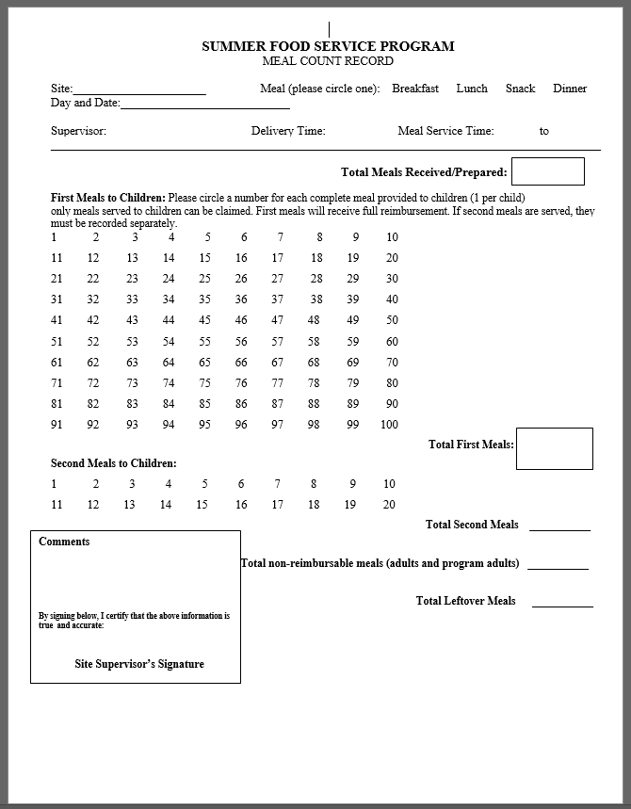
Daily Tic Sheet
Notes:
This is a meal counting sheet, or tic sheet. During each meal service a tic sheet will be used to count the number of meals served. These sheets are saved and later used document reimbursement by the sponsoring agency. Instructions to fill out a tic sheet are as follows.
At the top write the name or address where meals are served, select the meal service you are offering. Breakfast- lunch-Snack-or Dinner.
ALWAYS put the date! The sponsor needs the date to fill out a consolidated form.
Next you will see the section called First Meals to Children it lists numbers1-100. Here you will draw a line or a circle each number as a child takes a meal. Each number represents both a child and a complete meal.. Best practice is to mark off the numbers as the children are served. You may not just circle one number at the end of service. Its very important that all numbers representing meals are are marked off. There is also a section on this page to record seconds meals served to children, Please ask your Sponsor before serving seconds this is up to their discretion.

Slide 4
Identifying a Reimbusable Meal
In order for meal to be claimed a child must take the correct number of meal components, this depends on the type of meal provided (Breakfast, Lunch/Supper, Snack).
Once all required items have been selected, a number can be checked off on the meal count sheet.
Notes:
If you are at the front line while meals are being served, you must make sure that each child takes the correct number of Meal components or items.
The number of meal components will depend on the type of meal served. Once all required items have been selected by the child, a number can be checked off on the meal count sheet.

Slide 5
The SFSP Meal Pattern has 4 Components
Milk
Vegetables and/or Fruit (considered 1 component)
Grains
Meat/Meat Alternate
Notes:
The Summer Food Service Program has 4 Meal components.
Milk
Vegetables and/or Fruit (considered 1 component at lunch)
Grains
Meat/Meat Alternate Depending on the Meal, whether it is breakfast, Lunch/Supper, or snack. The number of components and the serving sizes will differ

Slide 6
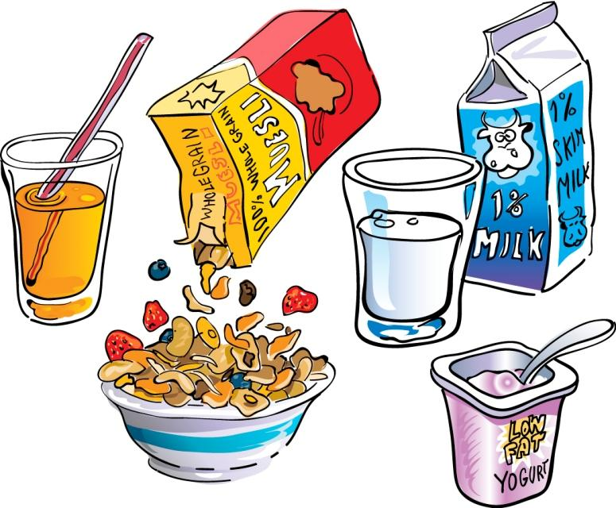
Breakfast Components
Component | Serving | Serve all three
Milk | 1 Cup | Required
Vegetables or Fruit | ½ Cup or 4 oz. Juice | Required
Grains | 1 oz. Equivalent | Required
Meat/Meat Alternate | 1 oz. Equivalent | Optional
A child must take three of these components
Notes:
For Breakfast, make sure a child takes 3 DIFFERENT Components .
8 oz of milk , ½ of fruit or vegetable and a 1oz grain completes a reimbursable breakfast offering a meat/meat alternate is optional.

Slide 7
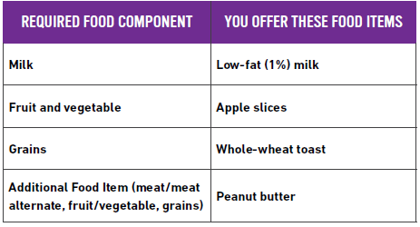
Offer Vs Serve at Breakfast?
Offer 4 food Items,
1 Item from each
Component
Milk
Fruit
Grains
Meat/Meat Alternate
A child must take at least 3 different food items out of the 4 food items offered, with the option to take all 4.
Notes:
If the Sponsor offers for example 2 TBL of peanut butter along with an 8oz Milk, ½ Cup apples slices and a slice of toast
then the child may select three different food items with the option to take all 4

Slide 8
OVS at Breakfast
A child must take at least 3 food items out of the 4 food items offered.
Notes:
So in this case the child took the milk, toast, and apple slices, and refused the peanut butter. But because they had three meal items that were different it was considered a reimbursable meal.

Slide 9
Lunch/Supper Components
Component | Serving | Serve all 5 items
Milk | 1 Cup | 1 item required
Grain | 1 oz. equivalent | 1 item required
Meat/Meat Alternate | 2 oz. equivalent | 1 item required
Vegetable/Fruit | ¾ Cup total, 2 different Items | 2 items required, items must total ¾ cup, and can be no less than 1/8 cup per item
Notes:
Lunch and Supper follow the same meal pattern.
The 4 meal components that must be offered are: 8 ounces of milk, 1 ounce grain , 2 ounces of meat or meat alternate and ¾ cup mixture of 2 different fruits, 2 different vegetables or a combination of fruits and vegetables equaling ¾ cup ( this can be something like ¼ cup blueberries and ½ cup of strawberries)

Slide 10
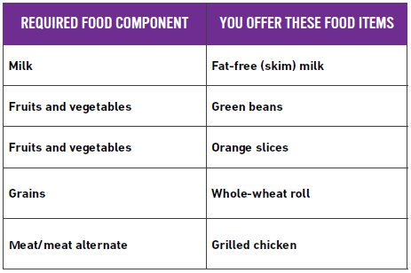
OVS at Lunch or Supper
Offer five food items
from the four food
components:
Milk
Fruits &vegetables
Fruits &vegetables
Grains
Meat/meat alternate
All food items offered must be different from each other. For example, orange slices and orange juice are two types of oranges that are not identical, but they are the same food item.
Notes:
Same as the example that was given for breakfast,
if you were to offer an additional component making 5 to choose from,
the child can select at least three of the components to make a complete meal In this example if the child had to choose from Milk, Green beans & apples (together making ¾ cup) Orange slices & celery (making ¾ cup) a roll and grilled chicken
The child needs to select at least 3 of those offered components to have a complete meal, remember the ¾ cup mixture of fruits and vegetables is considered 1 component.

Slide 11
OVS at Lunch or Supper
A child must take at least 3 food components out of the 5 food items offered.
The child may select all 5 food items!
Notes:
So here the child selected the green beans and apples, the roll and the chicken to make a complete meal

Slide 12
Snack Components
Two Different Components, in any combination
Milk – 8 ounces/1 cup
Vegetable and/or Fruit – ¾ cup
Grains
Bread- 28 grams slice is 1 ounce equivalent
Cereal – 1 ounce
Meat/Meat Alternate
Meat and cheese- 1 ounce equivalent
Nut butter – 2 tablespoons
Nuts- 1 ounce
Yogurt- 4 ounces/ ½ cup
Notes:
The snack meal pattern is the easiest to follow. Snack service consists of 2 different components in any combination of these listed. The child must take two components to be counted. An example of a snack could be 1 ounce of cheese and 1 ounce of wheat crackers

Slide 13
Important Practices
Notes:
Here are some everyday guidelines you need to follow

Slide 14
All Meals Must Be Eaten Onsite
This is for food safety and to ensure the child is the one benefitting from the meal.
Can take one fruit or vegetable or packaged grain off-site. This is up to sponsor discretion.
Notes:
All meals must be eaten at the location of service.
Often summer site locations are at places like parks.
A rule of thumb is that the child should be consuming the meal where you or a staff member can see them.
Please ask children to stay if they look like they are about leave the location. If this becomes a problem at your site, having a sign that says meals must be consumed in the park or on site may be helpful. Children are allowed to take one whole fruit or vegetable or packaged grain off-site.

Slide 15
Adult Meals
Meals are for children only (18 and under).
Meals are allowed for staff involved in the program, these adult meals must be documented separately than meals served to children.
Adult meals cannot be included in the Total Meals category!
Notes:
Meals are for children only,
Meals are allowed to be offered to staff involved in the program, these adult meals must be documented separately than meals served to children. Adult meals cannot be included in the Total meals.

Slide 16
Serving Times
The designated serving time will vary depending on the sponsor.
Make sure you are only serving within the designated serving time.
If you have concerns with the time allotted to meal service, please ask the sponsor if they can change the serving time.
Notes:
The designated serving time will vary depending on the sponsor and site.
Make sure you are only serving within the designated serving time.
If you have concerns with the time allotted to meal service, please ask the sponsor if they can change the serving time.

Slide 17
Food Safety Tips

Slide 18
Hand Washing
Takes approx. 20 seconds.
Wash hands between tasks and when getting more product.
Sanitizer Solution is not acceptable
Use clean disposable towels to dry hands.
Use “Single Use Disposable Gloves”
Gloves come off, they go in the trash.
Notes:
Remember to wash your hands before and after handling food
Hand sanitizer is not an alternative when it comes to washing your hands, in some cases it is better than nothing if a hand washing facility is not available always ----used clean disposable towels after washing

Slide 19
Personal Hygiene
Clean clothes every day.
No jewelry on hands or arms except a plain rings such as a wedding band is allowed.
Hair restraints, to include beards.
No fake nails or nail polish.
Notes:
If you are working in the kitchen prepping the food make sure you are :
Wearing Clean clothes every day.
Not wearing jewelry on hands or arms except a plain rings such as a wedding band is allowed.
Have a Hair restraint if you are involved in food preparation
And don’t wear fake nails or nail polish.

Slide 20
Temperatures
Check coolers upon receiving meals and again
before and after service.
Notes:
If you are working at a site that uses coolers, the best practice is to check the temperature of the food when you receive it as well as before service.
If you are keeping leftovers for the following day make sure the meals have been kept appropriate temperature
Foods should not be in the temperature range of 41-135 for more than 4 hours

Slide 21
Civil Rights
Notes:
And the last thing we will cover is the civil rights , this is required for all program staff.

Slide 22
Non-Discrimination and Equal Access
Federal Regulations are in place to ensure:
All children are served regardless of race, color, national origin, age, sex, and disability
Maine protected classes: religion, ancestry, and sexual orientation
All children have equal access to services and facilities
Reasonable accommodations are provided for language assistance and disabilities, including food allergies/intolerances
Know what is in the food and be able to communicate that with customers
Work with sponsoring organization to properly accommodate
Notes:
Federal Regulations are in place to ensure all children are served regardless of race, color, national origin, age, sex, and disability
Maine has additional protected classes which include religion, ancestry, and sexual orientation
Because this is a federal and state program All children must have equal access to services and facilities
Reasonable accommodations should be provided for language assistance and disabilities, including food allergies/intolerances
It is important to know what is in the food and be able to communicate with customers incase there is an allergy concern.
Work with the menu planner or sponsor if there is a way to accommodate for the concern

Slide 23
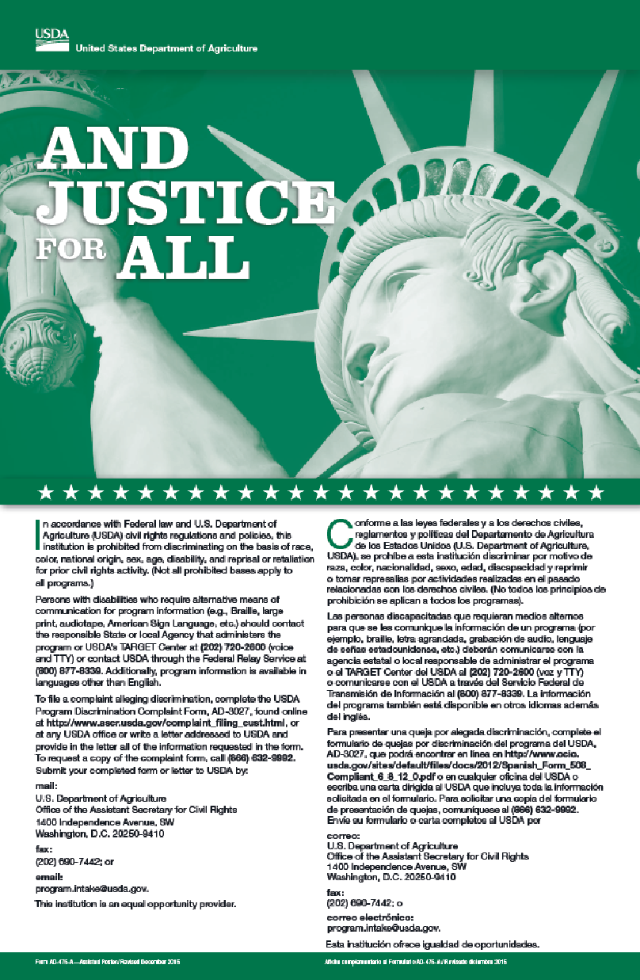
And Justice for All
Display “And Justice For All Poster” at all sites and on field trips
Describes policy and provides information on how to file a complaint
Notes:
This is the a justice for all poster, it should be displayed at all sites and during field trips. Please make sure this is available at your site, contact your sponsor if one can not be found.

Slide 24
Complaints of Discrimination
Follow sponsor established procedures for documenting and reporting complaints
Capture details including date, names, contact information
Refer the person to the USDA website to file a complaint
Submit complaint to FNS Regional Office of Civil Rights
Notes:
If incase a complaint has been made
Contact your sponsor established procedures for documenting and reporting complaints
Capture details including date, names, contact information
Refer the person to the USDA website to file a complaint
Submit complaint to FNS Regional Office of Civil Rights if the complaint falls under the Federal protected classes

Slide 25
Complaints of Discrimination cont.
Maine protected classes: Religion, Ancestry, Sexual Orientation – complaints filed with Maine Human Rights Commission
Notify Maine Department of Education Child Nutrition
Follow required timelines
Confidentiality must be upheld
Notes:
If the complaints fall within the Maine protected classes: Religion, Ancestry, Sexual Orientation
Complaints should be filed with Maine Human Rights Commission
And the Maine Department of Education Child Nutrition should be notified
Confidentiality must be upheld

Slide 26
Customer Service
Good customer service is always important
Is it a Civil Rights violation or a customer service issue?
If needed, file a complaint
Conflict resolution
Be patient, be polite and breathe.
Notes:
If you receive a complaint it is important to continue offering good customer service.
First decipher if the complaint is a Civil rights violation or Customer service issue.
If the complaint doesn't involve a federal or state protective class then work to resolve the problem with the sponsoring agency.

Slide 27
Notes:
This concludes our training for program staff and volunteers. Thank you for watching, and I wish you the best of luck this summer

