Slide 1
Welcome
Leveraging Picture Books For Social Emotional Learning
Sarah Norsworthy
Social Emotional Learning Implementation Specialist
Maine Department of Education
You May Need
Somewhere to Jot
Photo Credit - Sarah CB Norsworthy, Plunge Photography

Slide 2
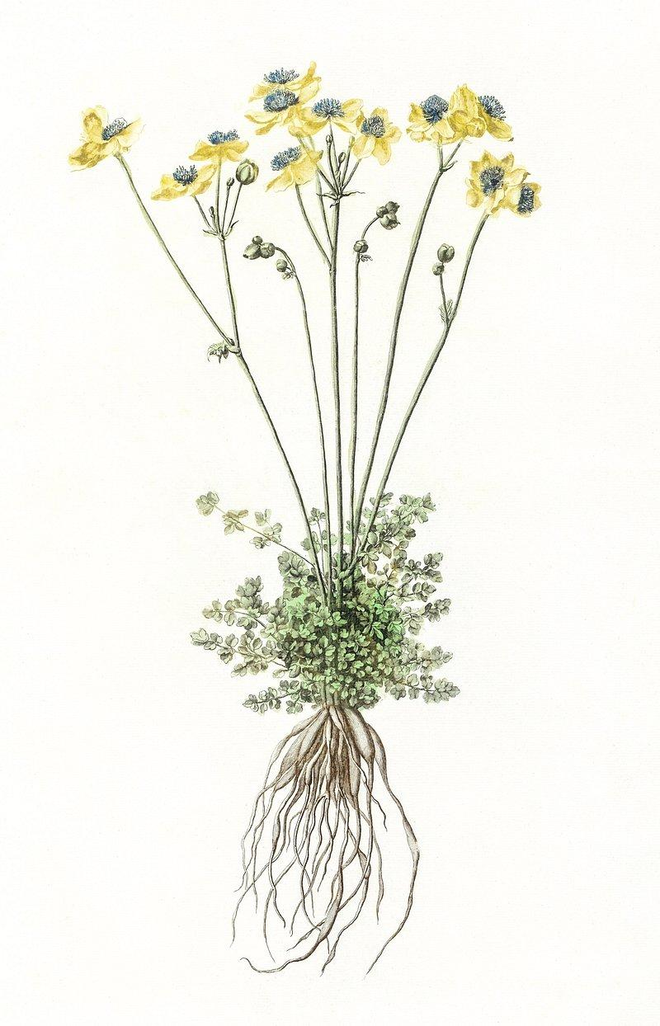
Intended Agenda
Grounding
Expectations, Introductions, Definitions
Framework For Thinking About Picture Books & SEL
Practice
Extending The Conversation
Inspiration
Archiving Impact

Slide 3
Expectations…
Collaboration - all hold knowledge
Participation that feels comfortable to you - diverse learners successfully participate in diverse ways
Discomfort
Non-Closure
Whole group and breakout spaces
Generative Thought Work
Concrete TakeAways
Photo Credit - Sarah CB Norsworthy, Plunge Photography

Slide 4
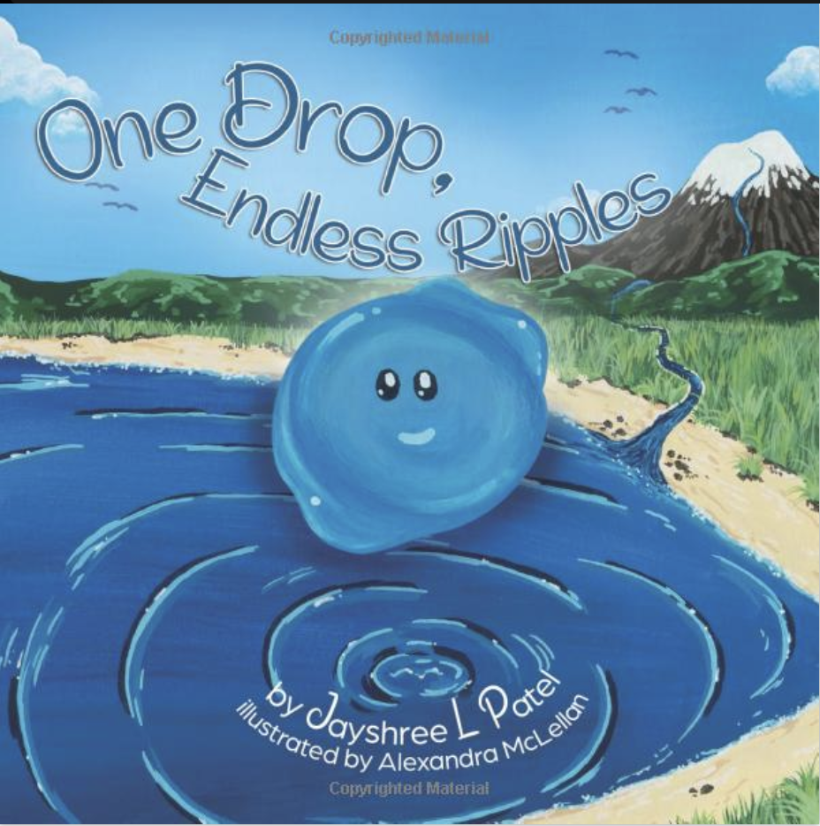
A Check-In
1.
2.
3.
4.
Which cover most closely matches how you are currently feeling?
In the chat, write the number and the emotion.
Notes:
Anonymous and jamboard

Slide 5
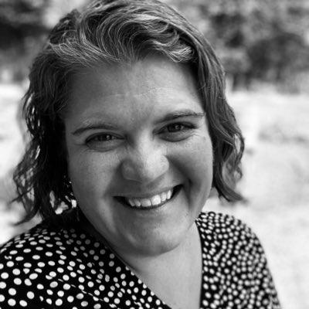
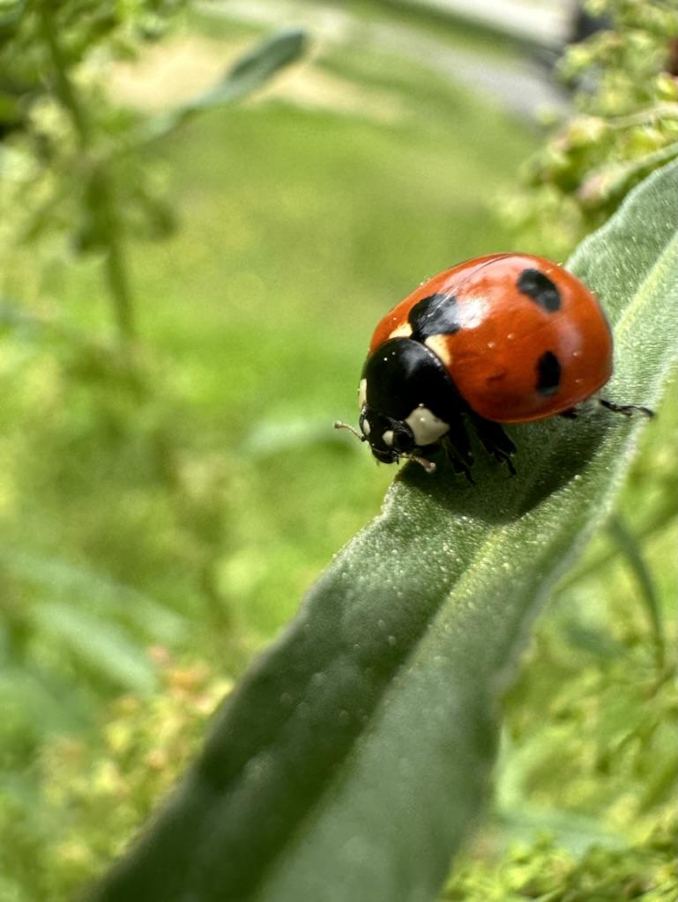
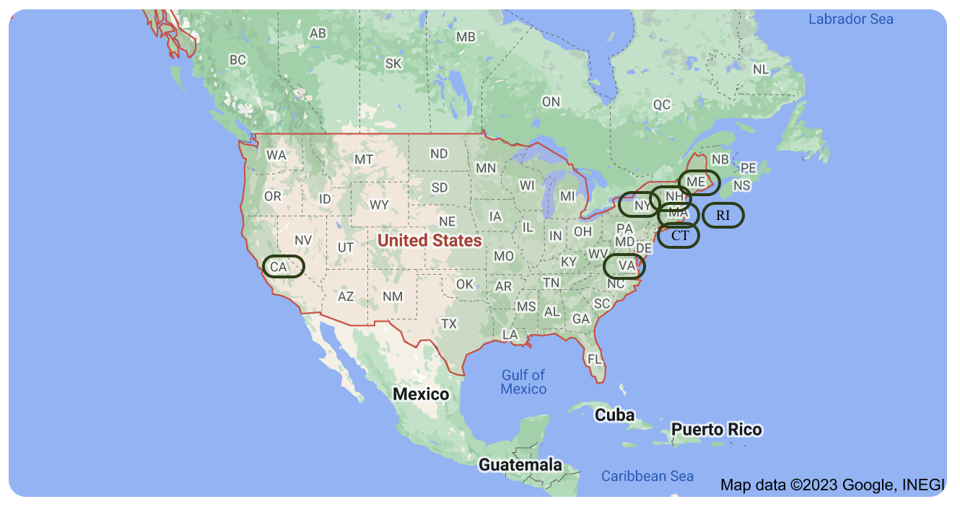
Introduction
Notes:
Parent, educator, doctoral candidate - SEL Implementation Specialist, Photographer, Details & Perspective - One country, Eight States - both coasts, urban, suburban, rural - private and public school -

Slide 6
Introductions
First name and one thing about you.
Use thumbs up, if it is true for you, too.
Unmute or use the chat and I will read aloud.
Notes:
Parent, educator, doctoral candidate - SEL Implementation Specialist, Photographer, Details & Perspective - One country, Eight States - both coasts, urban, suburban, rural - private and public school -

Slide 7
What is SEL?
“…the process through which people acquire and apply the knowledge, skills, and attitudes to develop healthy identities, manage emotions and achieve personal and collective goals, feel and show empathy for others, establish and maintain supportive relationships, and make responsible and caring decisions.”
What isn’t…?
https://casel.org/fundamentals-of-sel/

Slide 8
Social Emotional Learning
Self Awareness Identity
Self Management Agency
Social Awareness Belonging
Relationship Skills Collaborative Problem Solving
Responsible Decision Making Curiosity

Slide 9
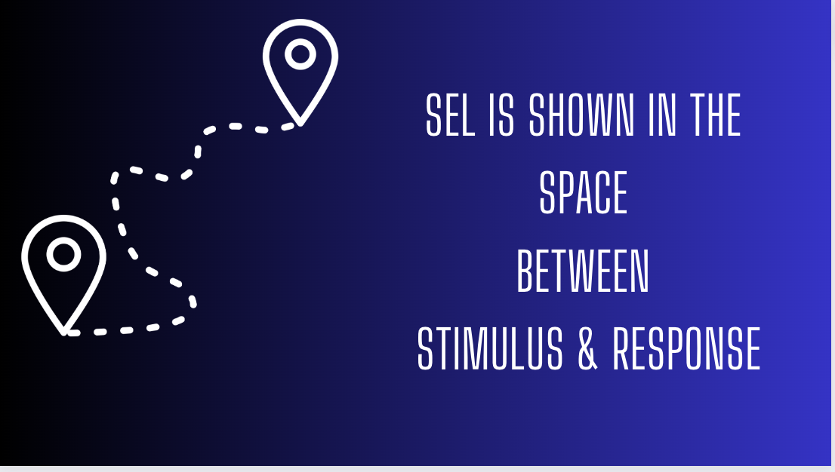

Slide 10
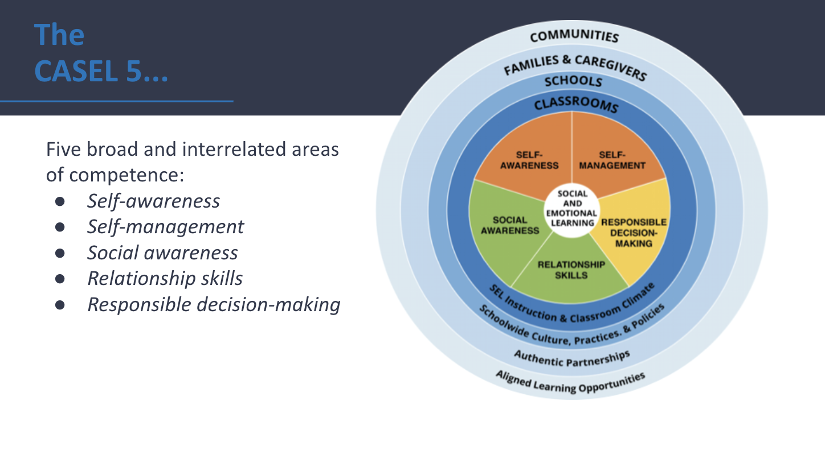
Classroom Adult Emotional Literacy
Adult SEL Matters
Student Emotional Literacy
The exploration of social and emotional learning happens at an adult level and then at a student level.
Notes:
The supportive process between caring adults and children, youth, or young adults that fosters self-regulation development is called “co-regulation.” This term began as a description of adult support for infants, but is now used to describe an interactive process of regulatory support that can occur within the context of caring relationships across the lifespan.

Slide 11
3 Parts to Perspective Taking
I have a perspective, here, now.
I - here - now.
______________________
If there is an I, there is a they.
If there is a here, there is a there.
If there is a now, there is either a past, or future - likely both.

Slide 12
People may have different feelings than I do.
“may” - nonbinary
Feelings change.
Emotional responses mean something important is at stake.

Slide 13
What are picture books?
Rich Images
May Have Text - adding complexity
White Space
Designed To Be Read Communally (lap/small group)
Format vs Content
Notes:
For the purpose of this study, I draw on descriptions of picture books by Nodelman (2008) and Spence, (2000); books with simple texts and rich images on most pages that add complexity to the story, or stories, being told. These are texts designed to be read communally with font large enough so that the books can be held in a lap, and read with ease or read with images large enough to share with a small group. Picture books, in this study, are identified by their format and not by their content.

Slide 14
Intended Agenda
Grounding
Expectations, Introductions, Definitions
Framework For Thinking About Picture Books & SEL
Practice
Extending The Conversation
Inspiration
Archiving Impact

Slide 15
Leveraging Picture Books In Support of SEL
Knowledge of Social Emotional Teaching
Predictable Routines
With Multiple Modes Of Communication
Picture Books
Sarah CB Norsworthy
Attuned Instruction ™
SEL Informed, Responsive
Education

Slide 16
What ADDITIONAL information may be necessary to understand & affirm?
SEL Competencies
Accessing Competencies
Identity Self-Awareness
Agency Self-Management
Belonging Social-Awareness
Collaborative Problem Solving Relationship Skills
Curiosity Responsible Decision Making
Notice
Think
Wonder
Feel
Imagine
Consider Responses
Prepared by the Maine DOE, SEL Implementation Specialist

Slide 17
What ADDITIONAL information may be necessary to understand & affirm?
SEL Competencies
How are you preparing yourself, or being supported in, this critical work?
Accessing Competencies
Identity Self-Awareness
Agency Self-Management
Belonging Social-Awareness
Collaborative Problem Solving Relationship Skills
Curiosity Responsible Decision Making
Notice
Think
Wonder
Feel
Imagine
Consider Responses
What other routines might you consider?
Prepared by the Maine DOE, SEL Implementation Specialist

Slide 18
Where are you learning about picture books?
Where are you talking about picture books?

Slide 20
Leveraging Picture Books In Support of SEL
Knowledge of Social Emotional Teaching
Predictable Routines
With Multiple Modes Of Communication
Picture Books
Sarah CB Norsworthy
Attuned Instruction ™
SEL Informed, Responsive
Education

Slide 22
Notes:
What do you notice and what do you wonder?

Slide 23
Notes:
What you notice? Again. Now - about yourself and the noticing?

Slide 24
Universal
Similarities
Differences
Cultural
Notes:
Thinking & Talking Prompts
As you begin to read, notice how your body feels - as you read, how does that change?
Think about the characters in this book - In what ways are they like you? In what ways are they different from you?
Did any parts of this book give you big feelings? What were they? How did you manage them?
Who is included in this story? Who is left out?
What history is told in this story? What history has been left out?
Imagine telling this story from another perspective, how might it go?
How do the pictures add to or change your understanding of the story?
What does the information in this book have you wondering about?
What problems in our world might you be interested in solving?
How has this book added to your thinking about justice?

Slide 25
After Reading Educator Reflection
What came up around…?
Assessing For Transformative Social Emotional Teaching And Learning After Sharing Picture Books
Identity: What affirmed identities that are held by the group? Who was affirmed? Over time - affirming the value of the multiple identities of all in the group must occur for this to be a socially and emotionally supportive activity..
Belonging: Where was belonging, connection, surfaced? How was the power of connection, belonging, demonstrated?
Agency: Where was agency, power, held? What connections to the power held by group members was lifted?
Collaborative Problem Solving: What competing needs arose in the text? How were they negotiated? In what ways might the needs in the books connect to the needs those in the group may have?
Curiosity: Consider the depth and breadth of curiosity displayed by by the group. Over time, noticings and wonderings, will deepen. What captured the attention of the group during this reading?
Sarah CB Norsworthy
Attuned Instruction ™

Slide 26
Intended Agenda
Grounding
Expectations, Introductions, Definitions
Framework For Thinking About Picture Books & SEL
Practice
Extending The Conversation
Inspiration
Archiving Impact

Slide 27
Determine Your Purpose

Slide 28
You Might Choose Your Focus
SEL Competency
Collaborative Problem Solving: What competing needs arose in the text? How were they negotiated? In what ways might the needs in the books connect to the needs those in the group may have?
(Might Be Explicit - Might Be In Your Head)

Slide 30
You Might Choose Your Focus
SEL Competency
Collaborative Problem Solving: What competing needs arose in the text? How were they negotiated? In what ways might the needs in the books connect to the needs those in the group may have?
(Might Be Explicit - Might Be In Your Head)

Slide 31
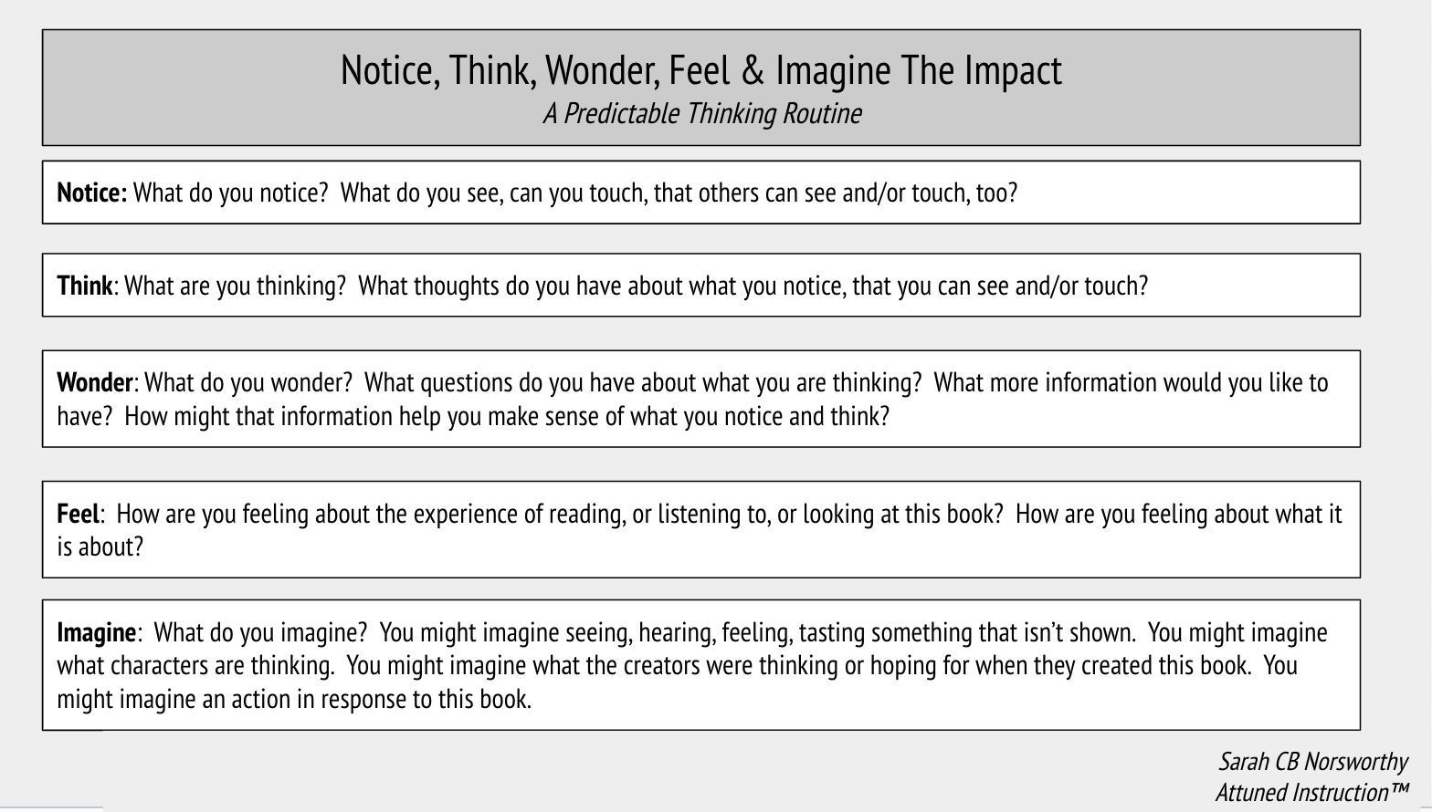
Feel: How are you feeling about the experience of reading, or listening to, or looking at this book? How are you feeling about what it is about?
Collaborative Problem Solving: What competing needs arose in the text? How were they negotiated? In what ways might the needs in the books connect to the needs those in the group may have?

Slide 32
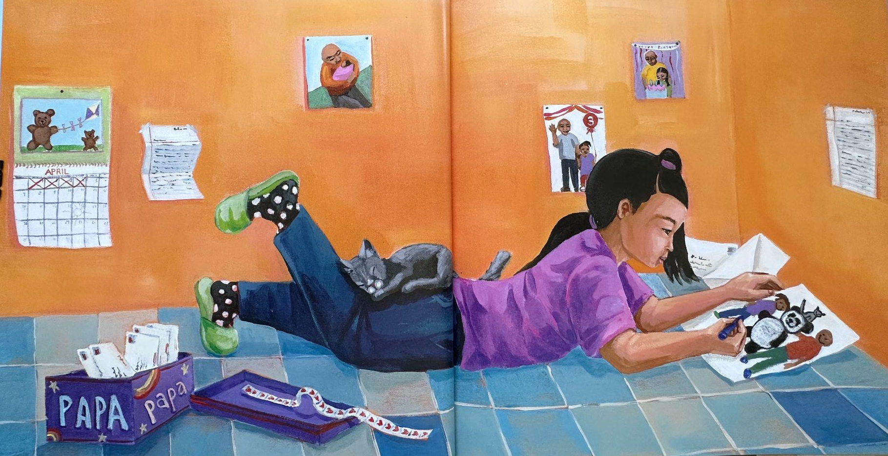
What do you?
Notice…Think…Wonder…Feel…Imagine

Slide 33
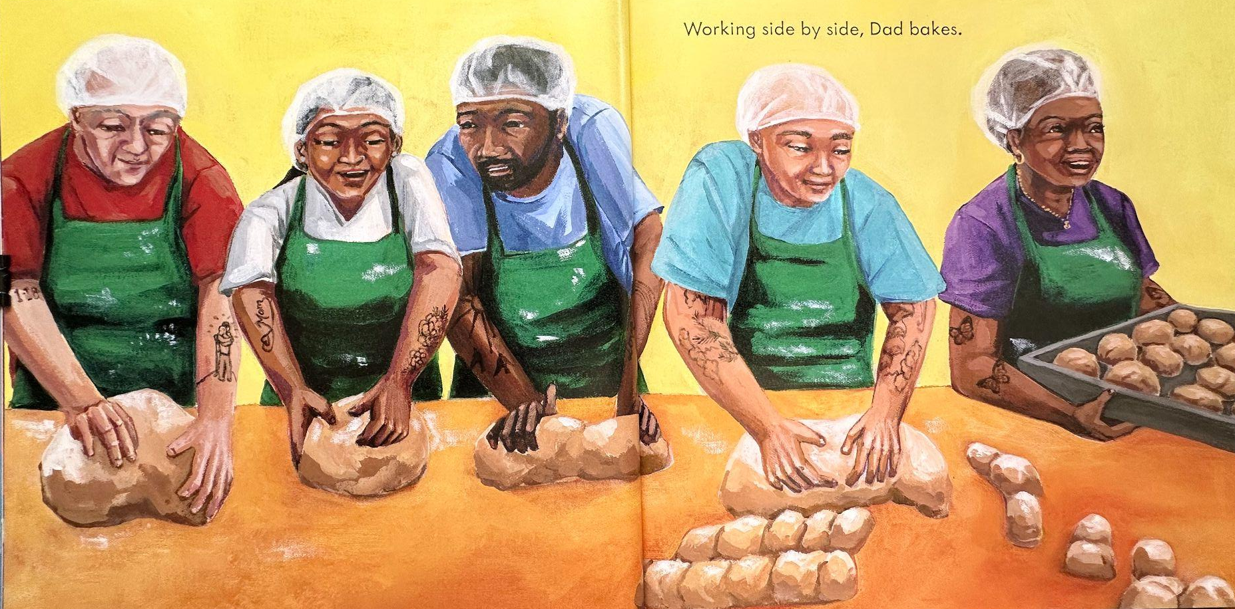
What do you?
Notice…Think…Wonder…Feel…Imagine

Slide 34
What do you?
Notice…Think…Wonder…Feel…Imagine

Slide 35
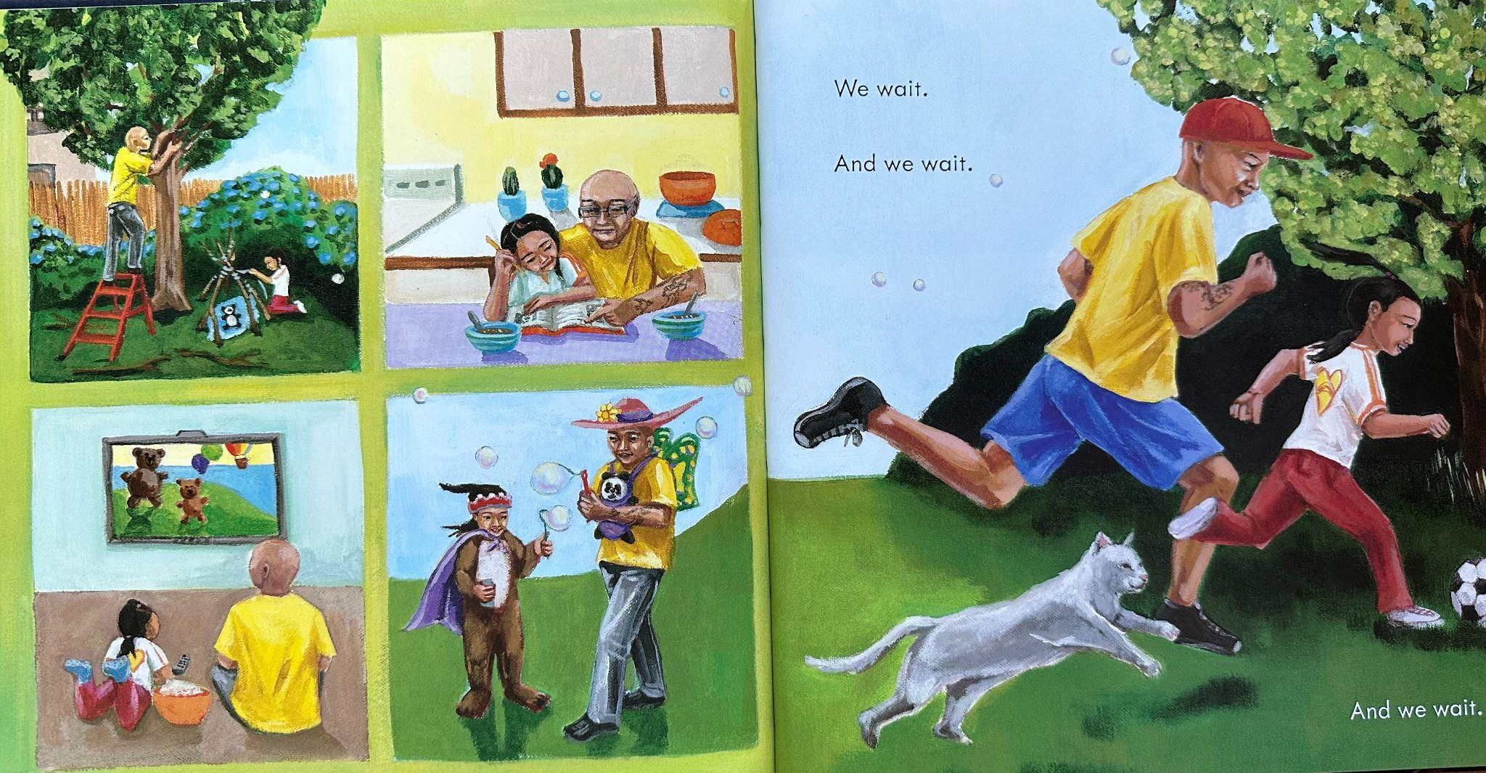
What do you?
Notice…Think…Wonder…Feel…Imagine

Slide 36
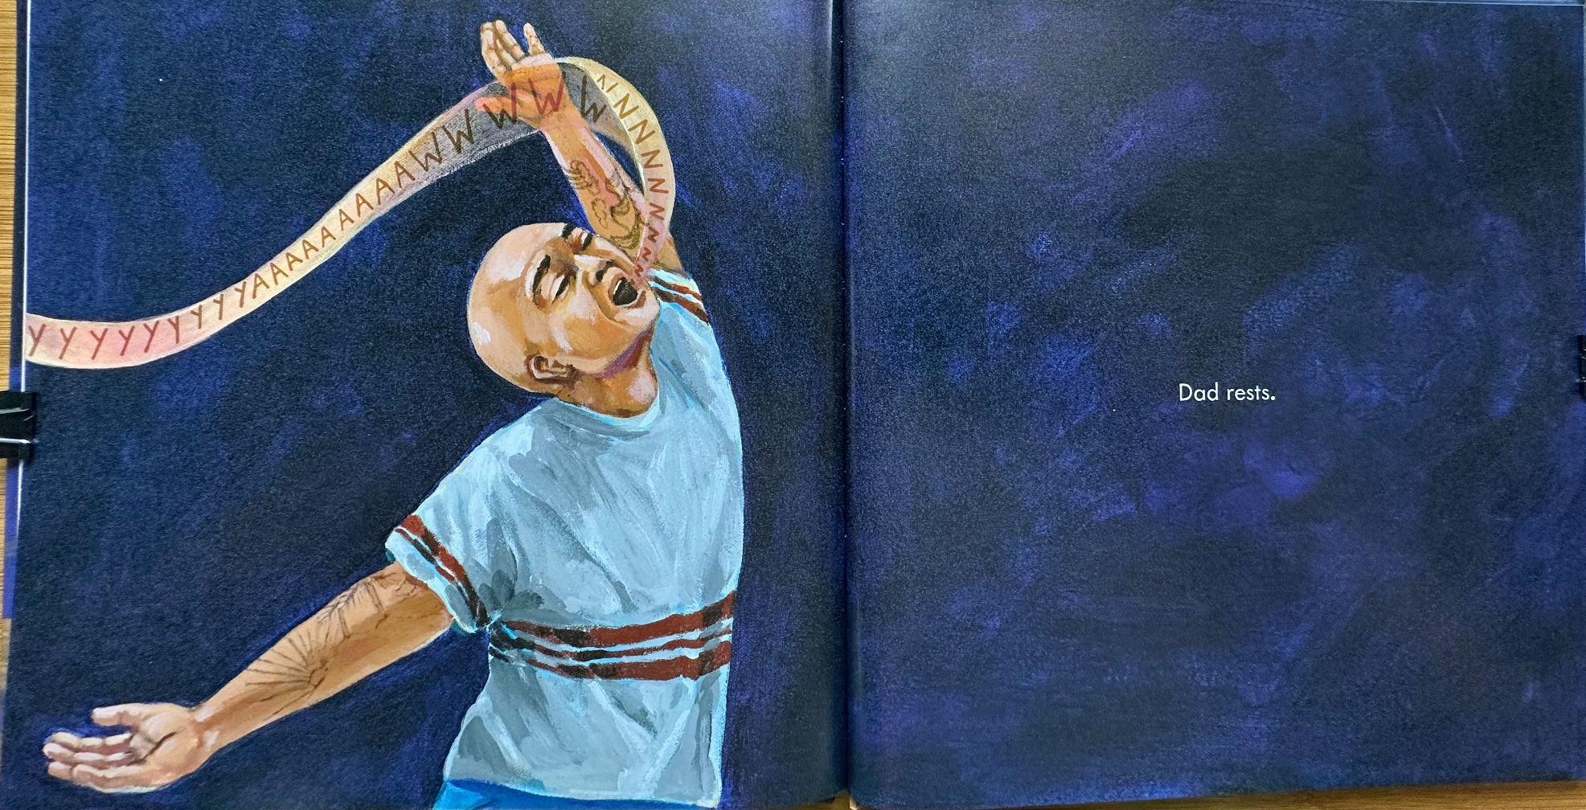
What do you?
Notice…Think…Wonder…Feel…Imagine

Slide 37
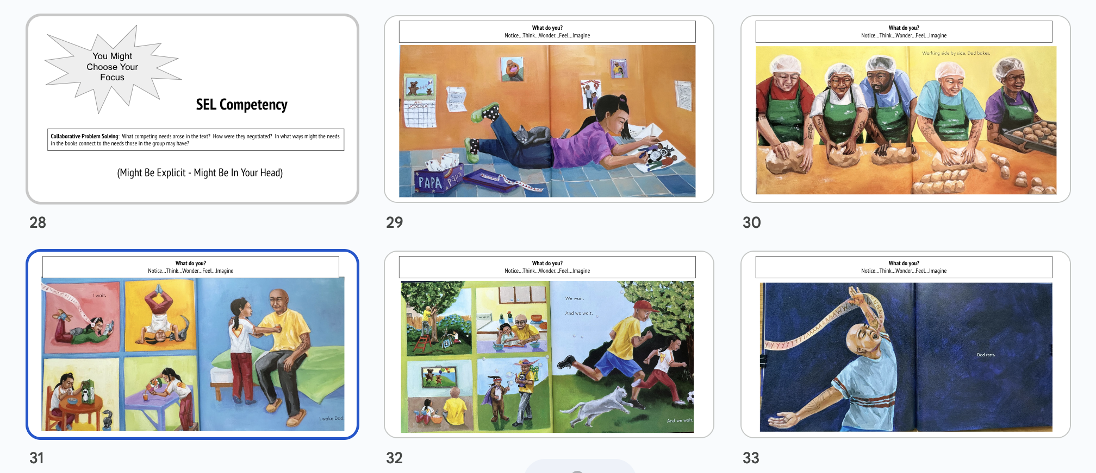
Notice, Feel, Think, Wonder, Imagine
Collaborative Problem Solving: What competing needs arose in the text? How were they negotiated? In what ways might the needs in the books connect to the needs those in the group may have?

Slide 38
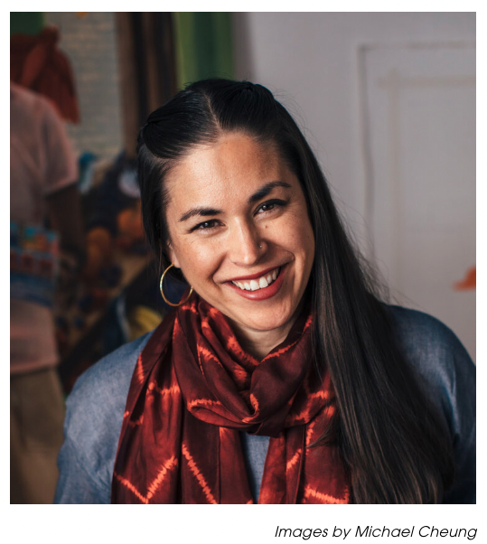
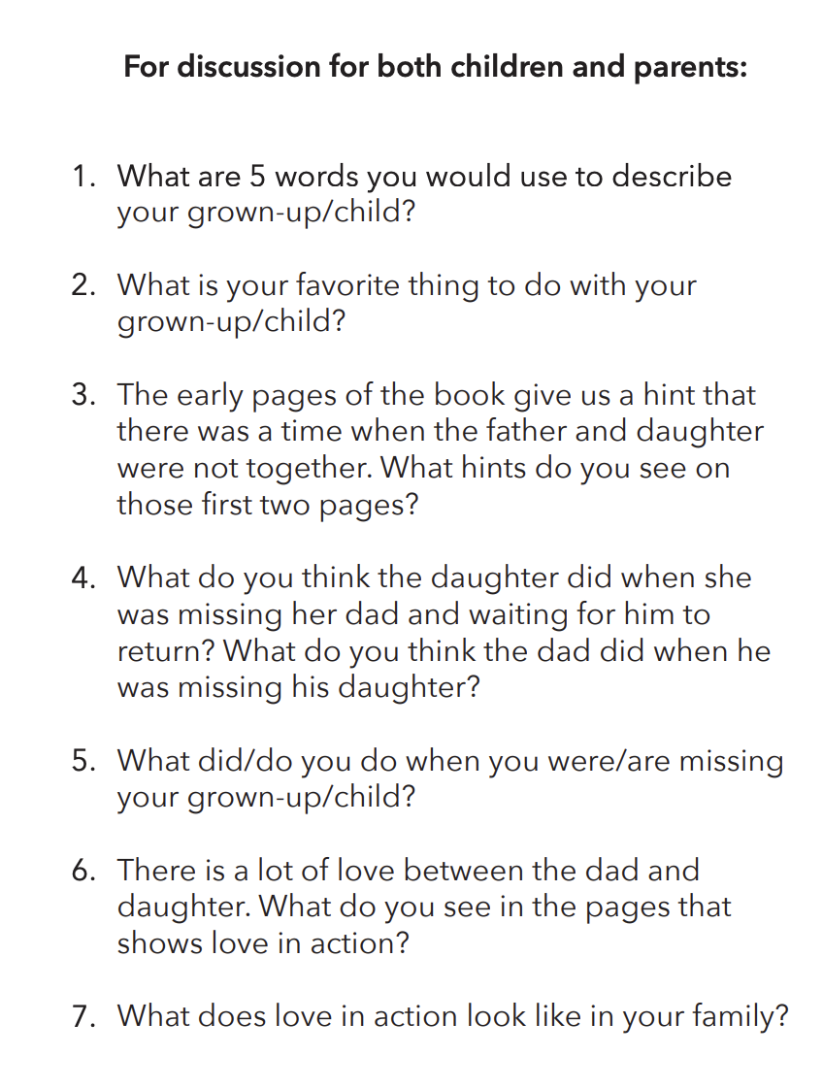
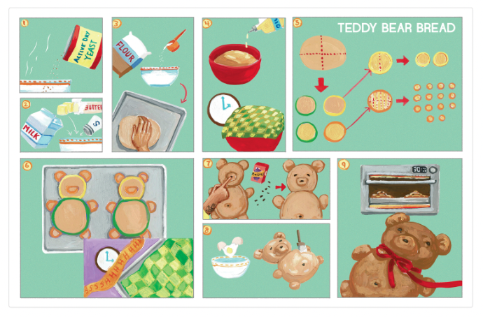
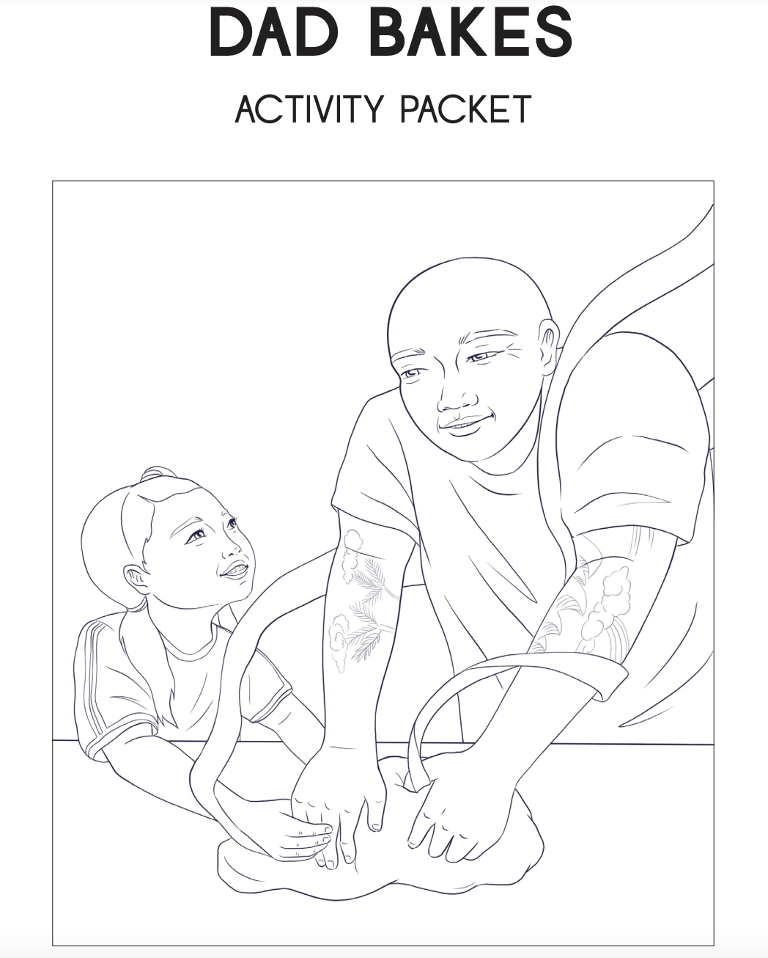
A story of reconnection, after parental incarceration.
Learn More @ KatieYamasaki.com
Materials Available On KatieYamasaki.com

Slide 39
Leveraging Picture Books In Support of SEL
Collaborative Problem Solving / Relationship Skills
Knowledge of Social Emotional Teaching
Predictable Routines
With Multiple Modes Of Communication
Notice, Feel, Wonder, Think & Imagine
Dad Bakes
Picture Books
Sarah CB Norsworthy
Attuned Instruction ™
SEL Informed, Responsive
Education

Slide 40
Intended Agenda
Grounding
Expectations, Introductions, Definitions
Framework For Thinking About Picture Books & SEL
Practice
Extending The Conversation
Inspiration
Archiving Impact

Slide 41
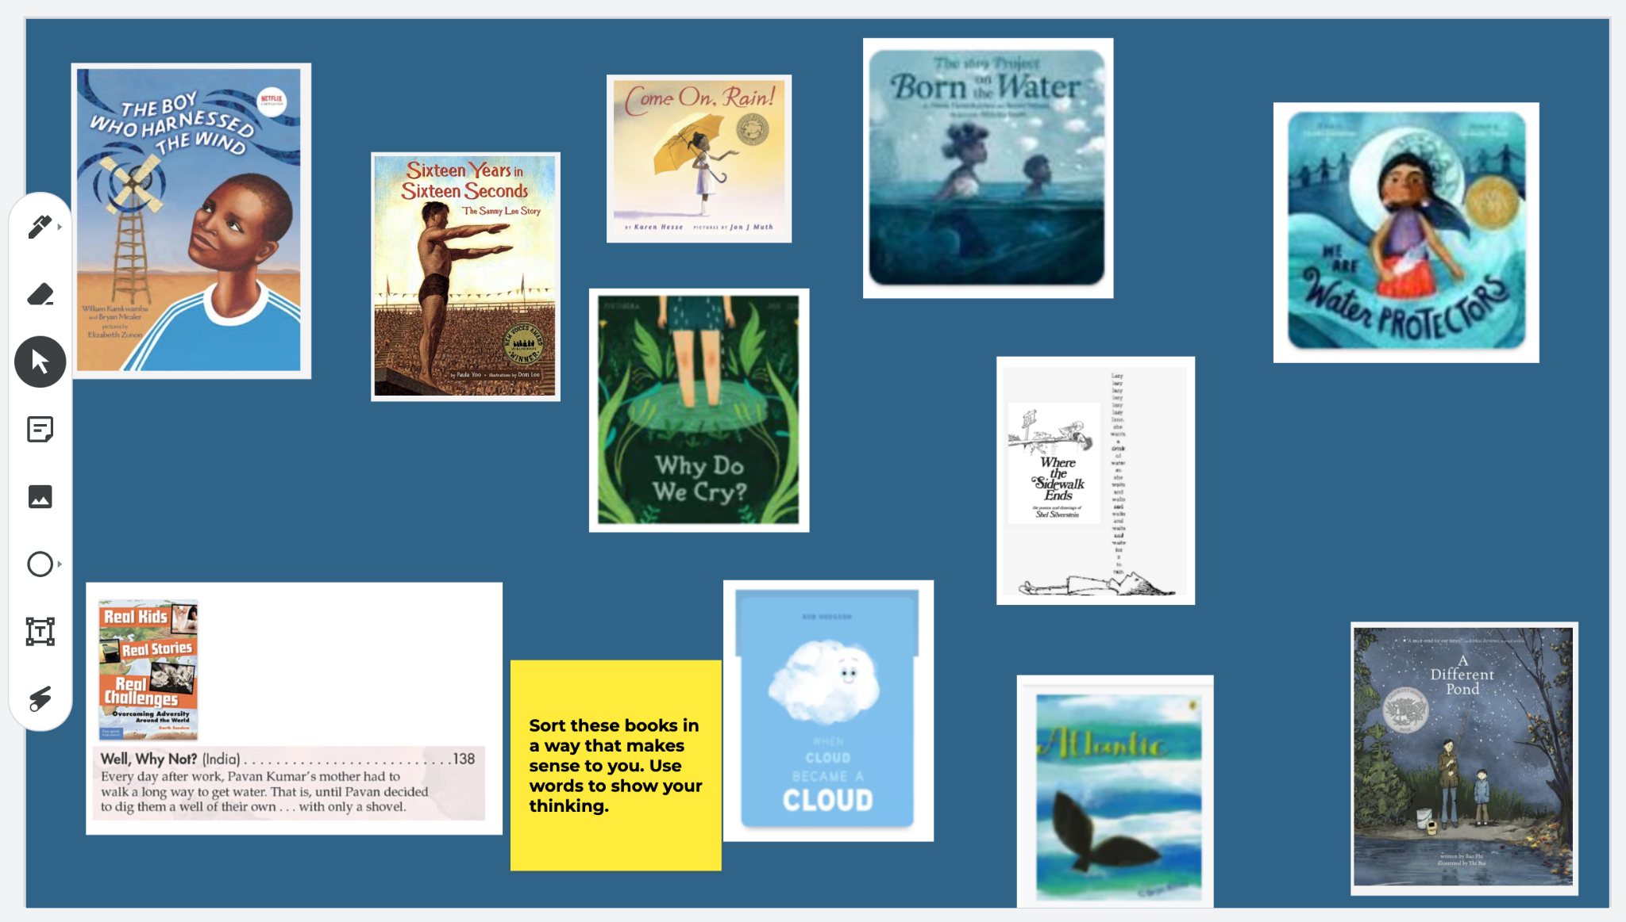
The Power of Sorts
Shows understanding
Develop new understandings
Jamboard
Padlet

Slide 43
“Remarkably, eight books (15%) about starting kindergarten show no kindergarten teacher at all.”
Cutler, L., & Slicker, G. (2021). Depictions of teachers and teacher practices in picture books about starting kindergarten. Journal of Early Childhood Literacy, 0(0). https://doi-org.ezproxy.neu.edu/10.1177/14687984211029031
Notes:
What do you think? Wonder? Imagine?

Slide 44
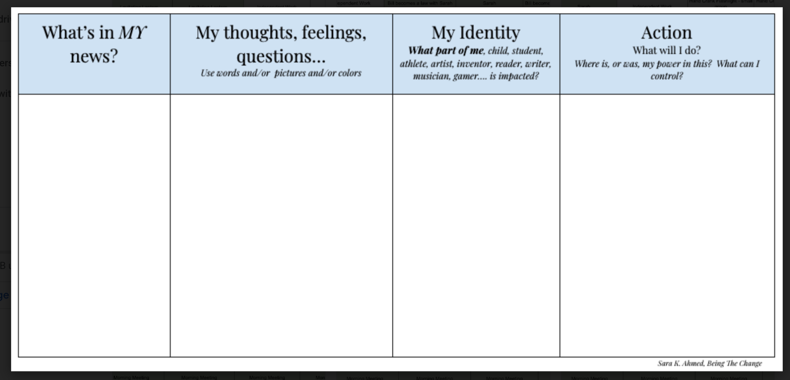
When BIG Feelings Arise
Normalize (Belonging)
Pause (Agency)
Name (Identity)
Consider (Curiosity)
Act (Problem Solving)

Slide 45
Sources For Texts
The Walter Awards - We Need Diverse Books
#DisruptTexts
American Indians In Children’s Literature
Latinxs in Kid Lit
#BlackBoyLit

Slide 46
Drs. Debbie Reese & Jean Mendoza
American Indians In Children’s Literature
Through AICL, she shares information that she think will help readers learn about and understand the 500+ federally recognized Native Nations in the United States. Most people know about the federal government and the state governments, but very few know about tribal governments. Very few people know that American Indians in the United States have a status that makes them distinct from other minority or underrepresented populations. A common phrase used to describe minority or underrepresented populations is "people of color." American Indians are not, to quote Elizabeth Cook Lynn, a member of the Crow Creek Sioux tribe and founding editor of Wicazo Sa (a leading journal in American Indian Studies), "people of color." Cook-Lynn writes:
Native populations in America are not "ethnic" populations; they are not "minority" populations, neither immigrant nor tourist, nor "people of color." They are the indigenous peoples of this continent. They are landlords, with very special political and cultural status in the realm of American identity and citizenship. Since 1924, they have possessed dual citizenship, tribal and U.S., and are the only population that has not been required to deny their previous national citizenship in order to possess U.S. citizenship. They are known and documented as citizens by their tribal nations. (1)
She goes on to say that placing Native peoples within a multicultural or ethnic studies category has a negative effect because those categories obliterate their political status. The political dimension she refers to is that status as sovereign nations, a distinction based on treaty and trust agreements made between early European nations who came to what we now call the United States, and, later agreements made between the United States and Nation Nations. Those agreements are diplomatic negotiations that take place between heads of state.

Slide 47
Intended Agenda
Grounding
Expectations, Introductions, Definitions
Framework For Thinking About Picture Books & SEL
Practice
Extending The Conversation
Inspiration
Archiving Impact

Slide 48
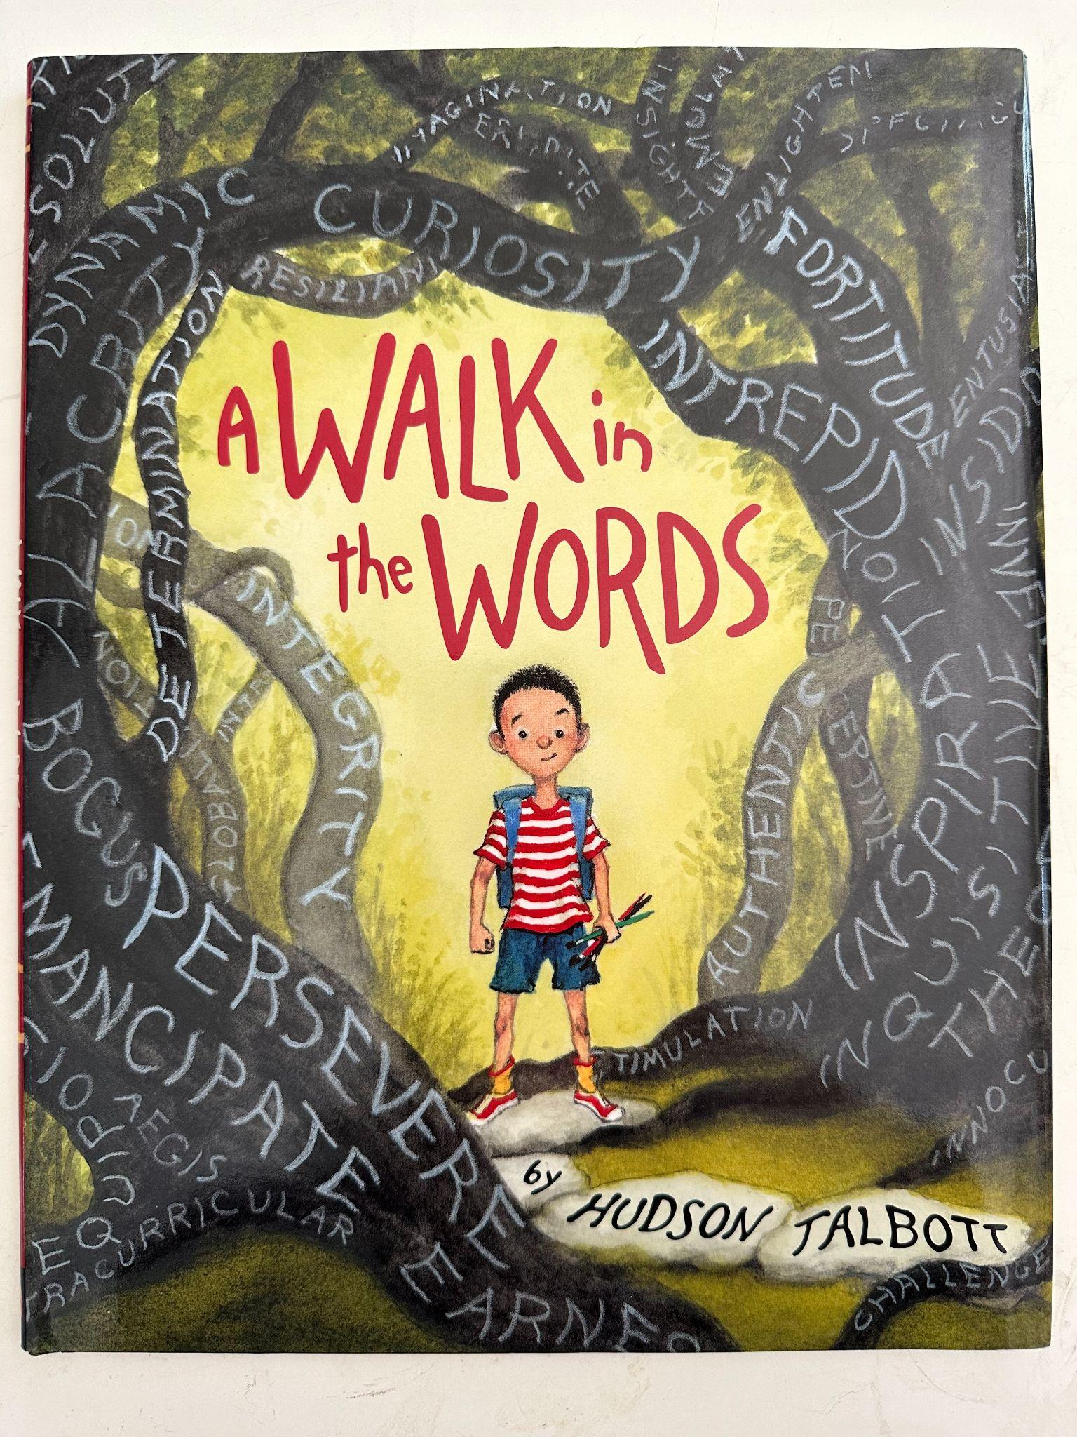
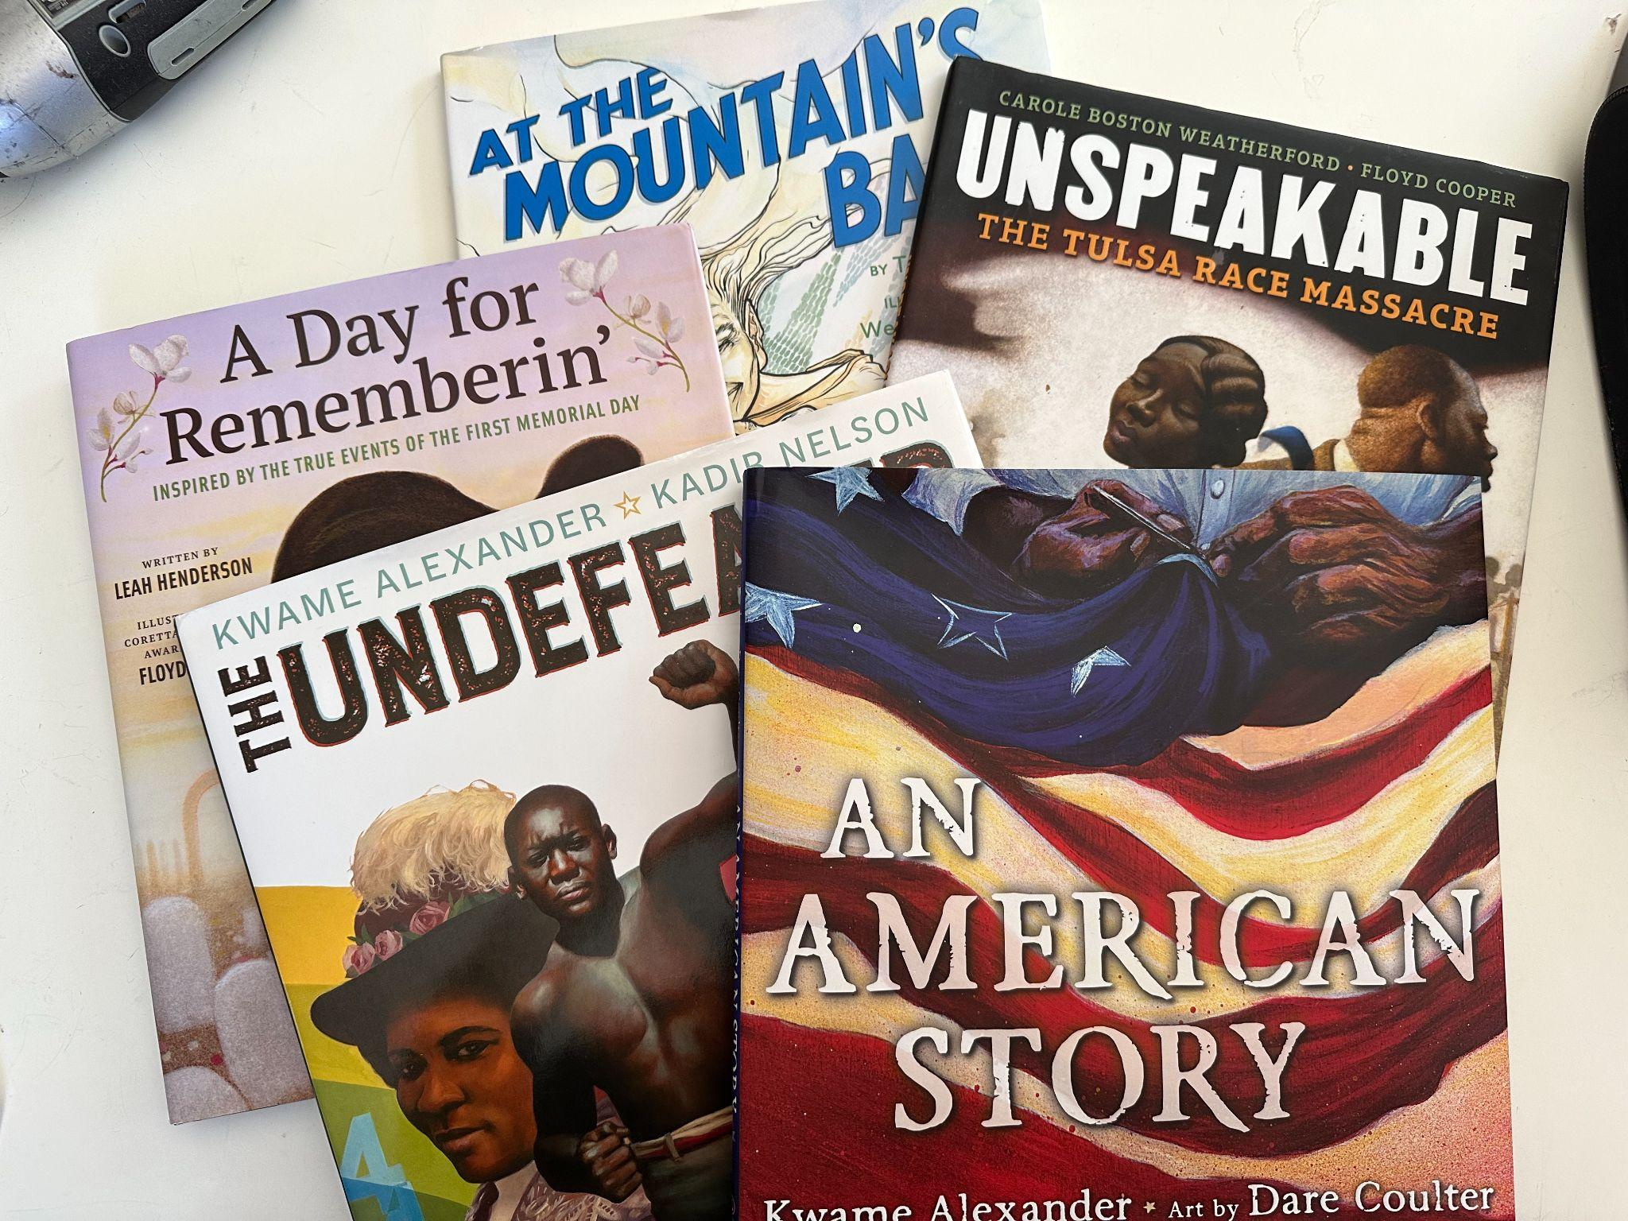
Books About Reading
History

Slide 49
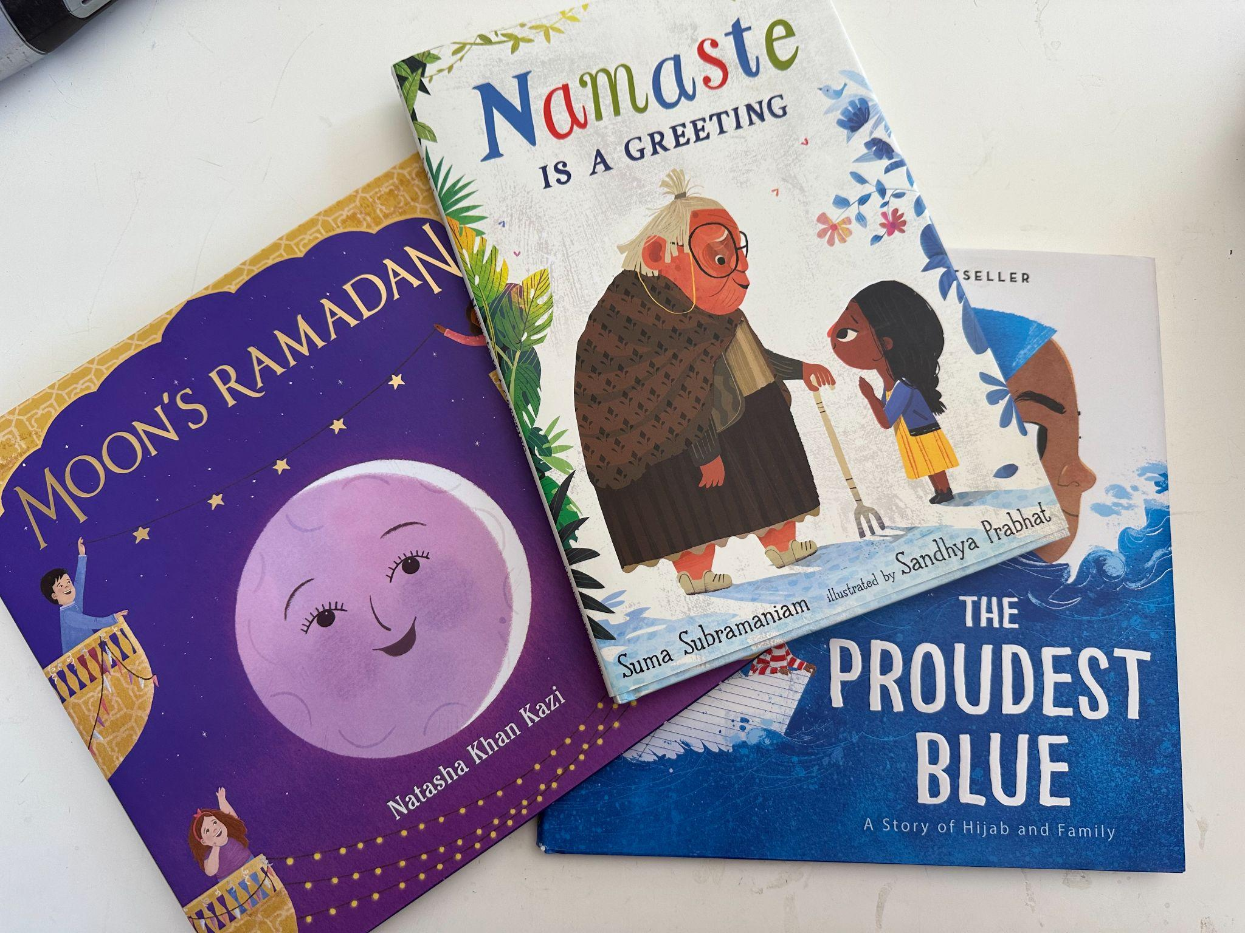
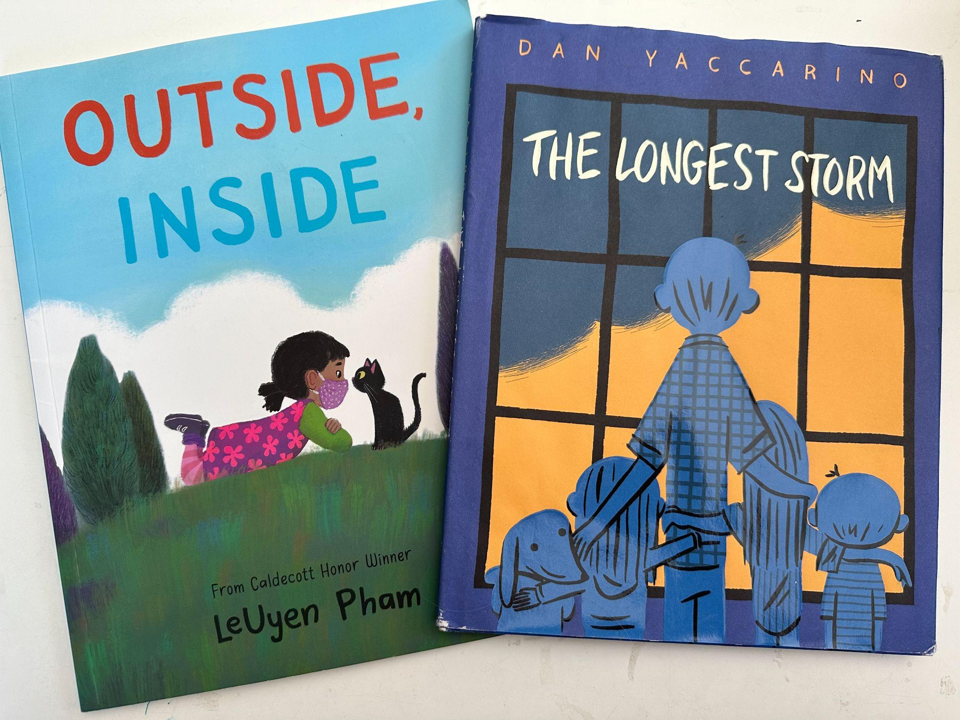
Religion
Covid

Slide 50
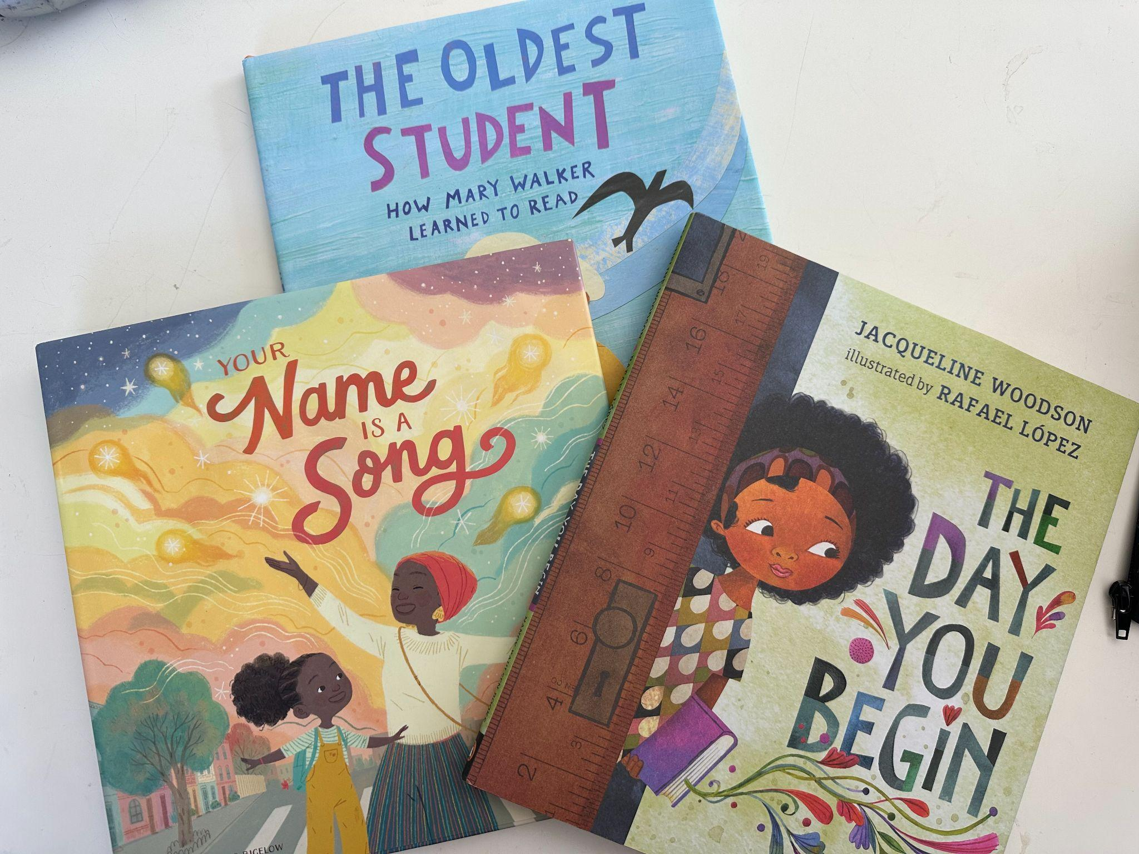
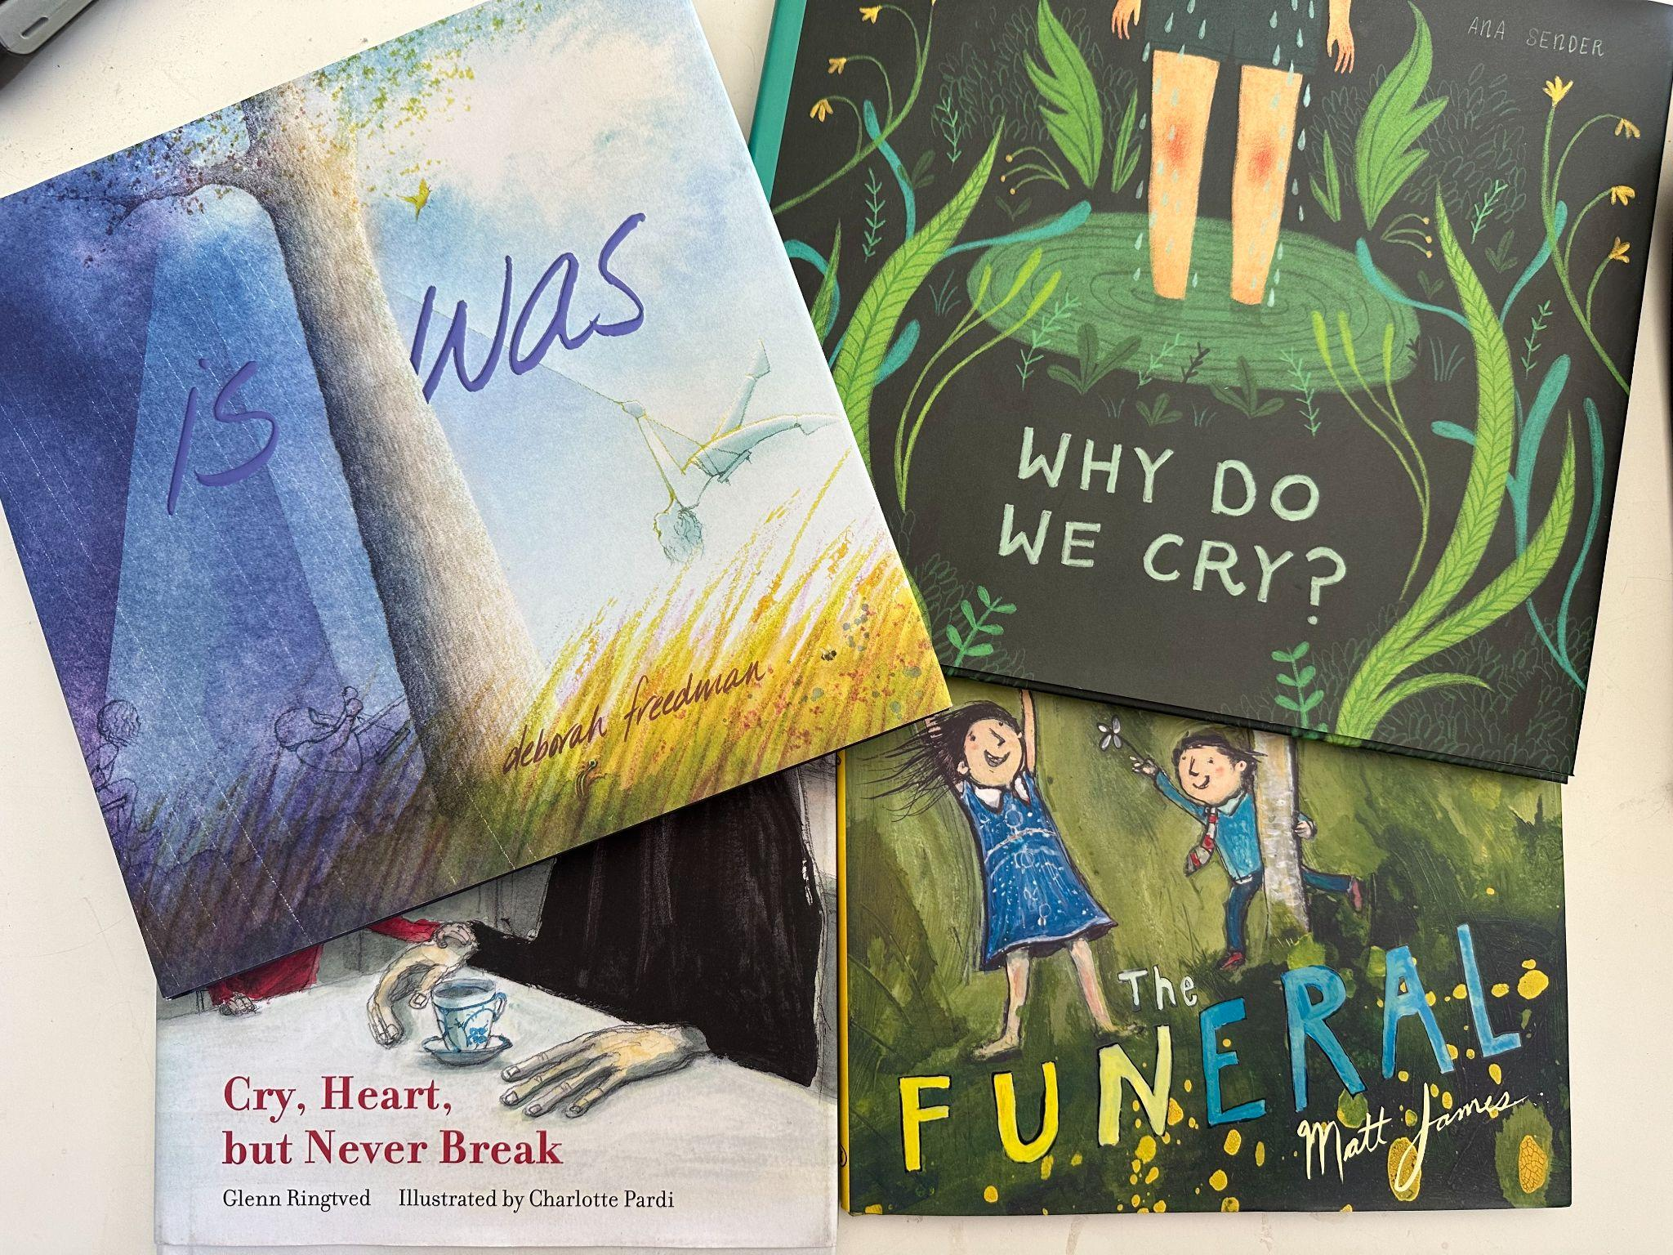
Students
Grief

Slide 51
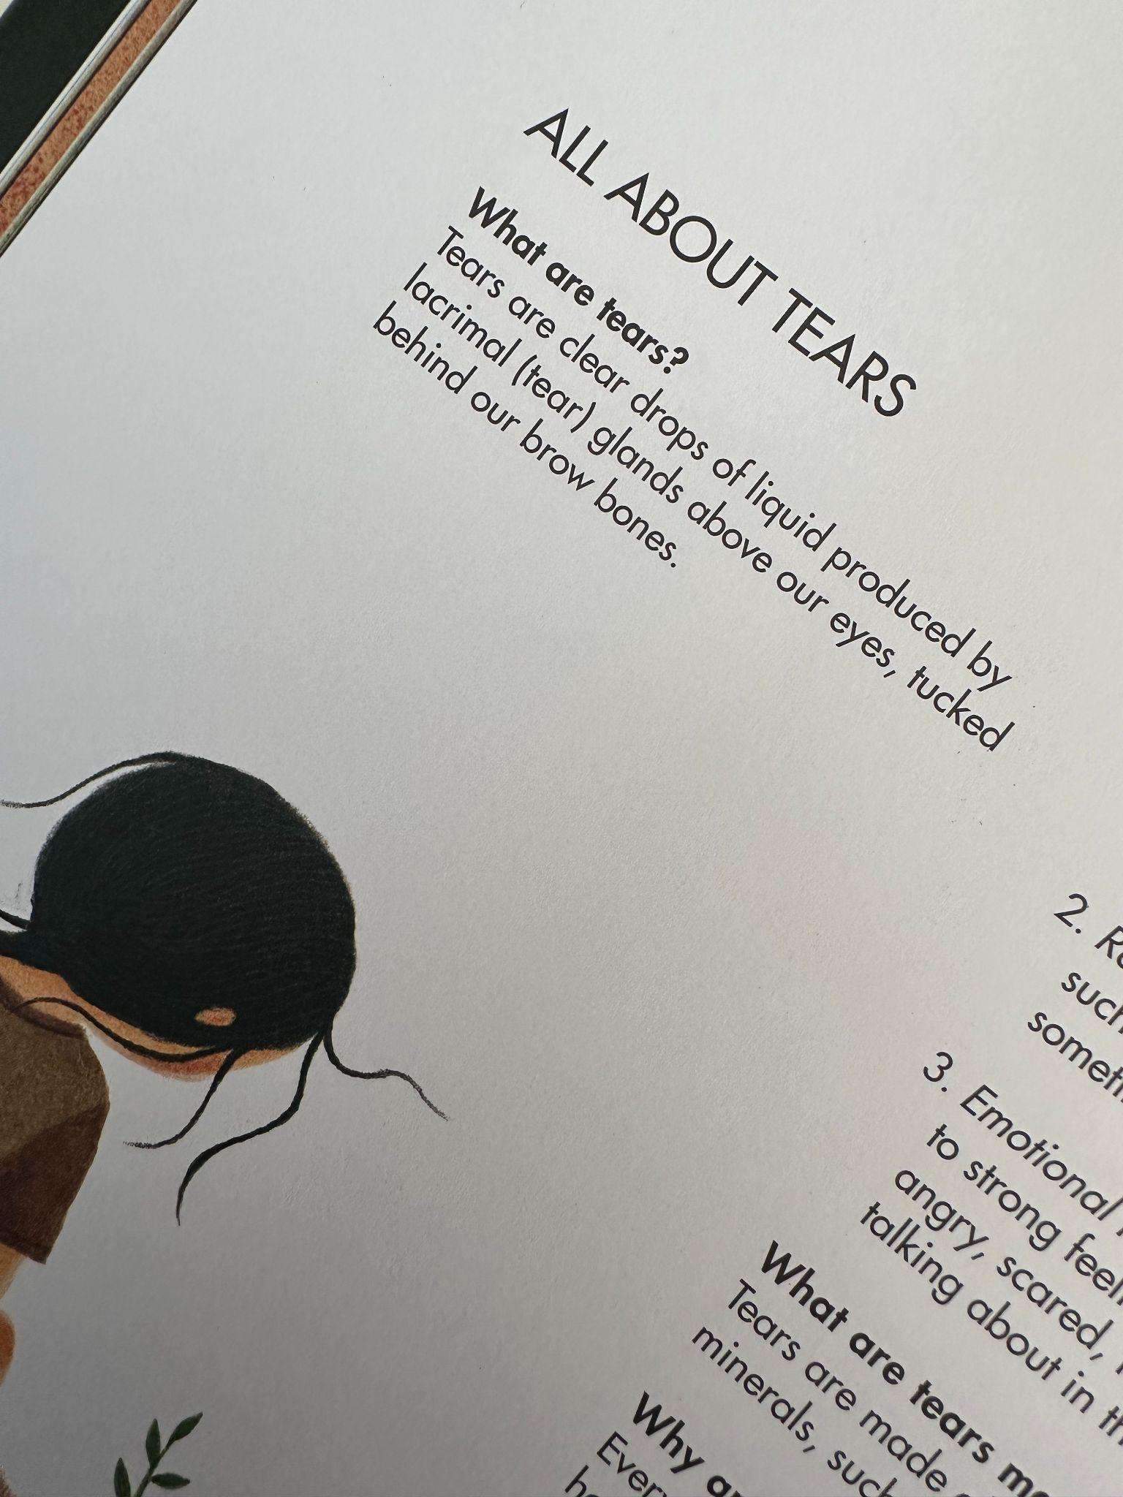
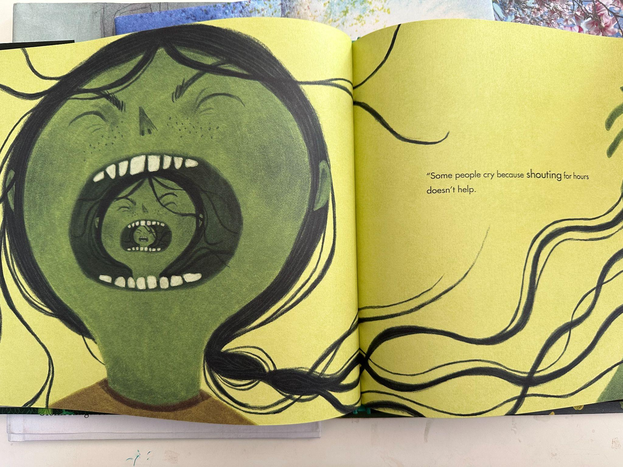
Zooming In

Slide 52
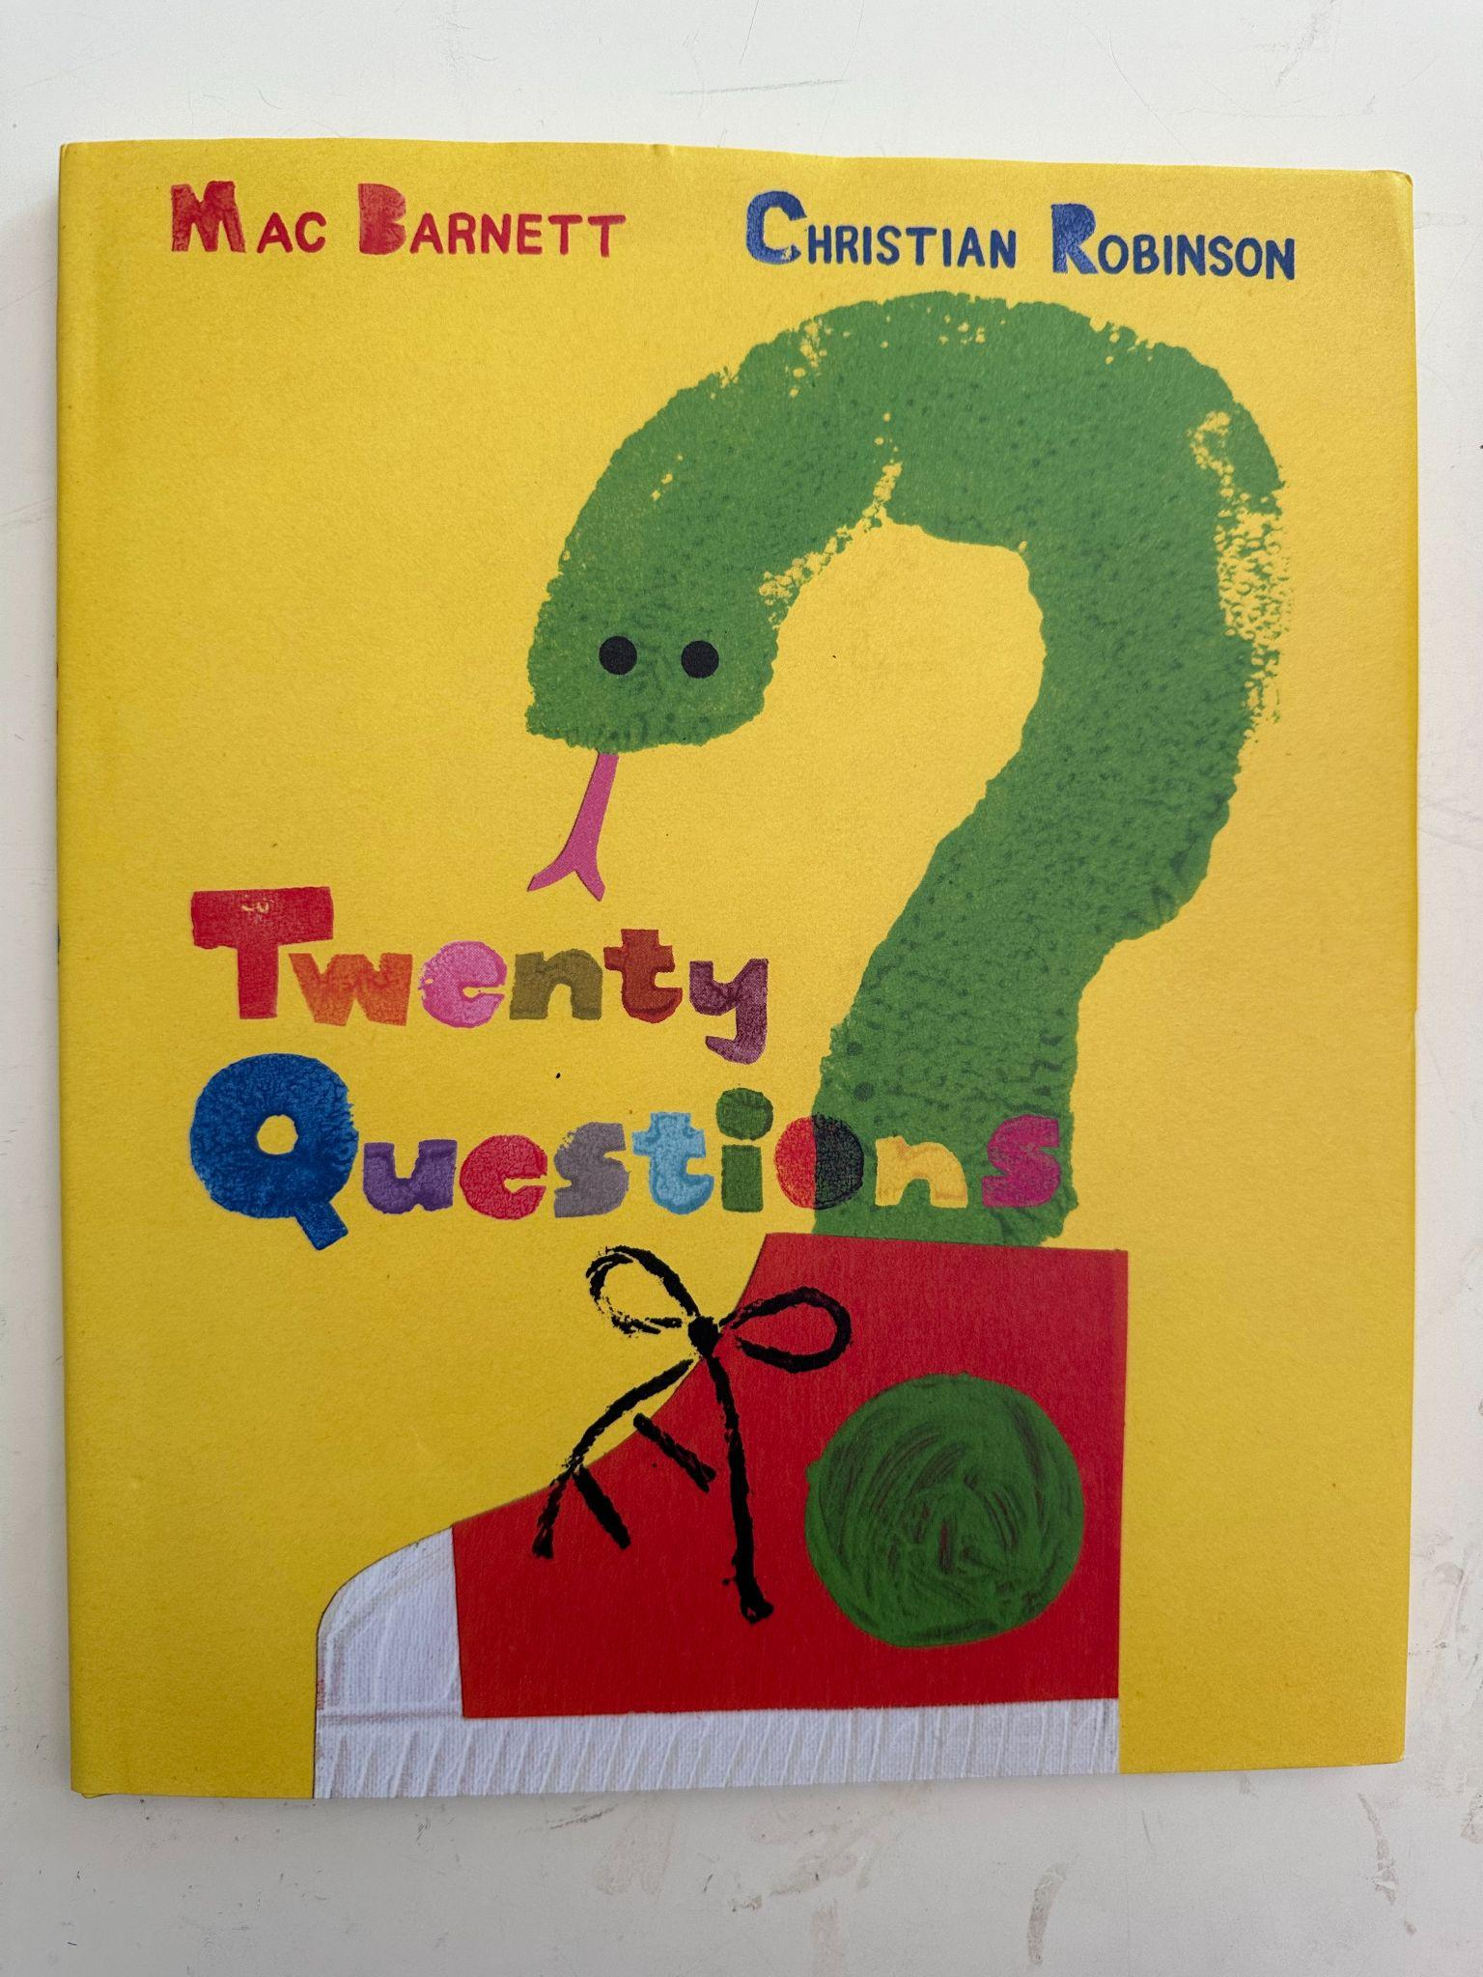
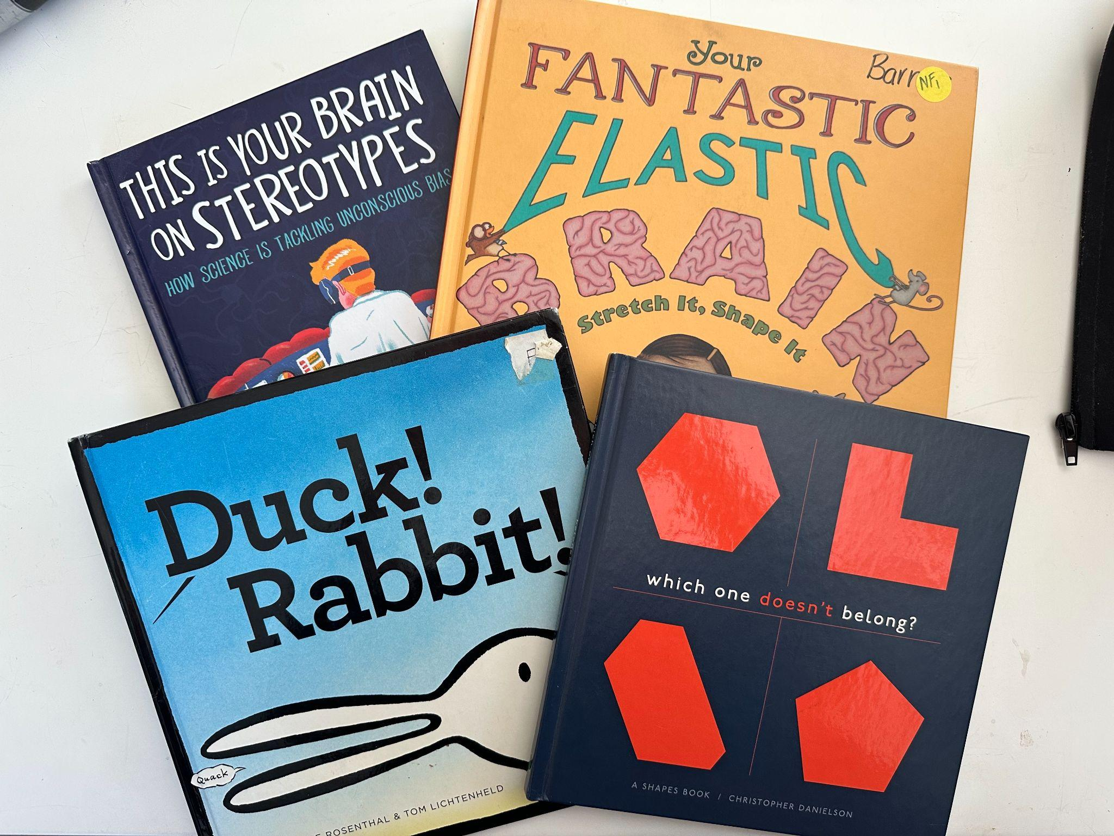
Questioning
Perspective Taking

Slide 53
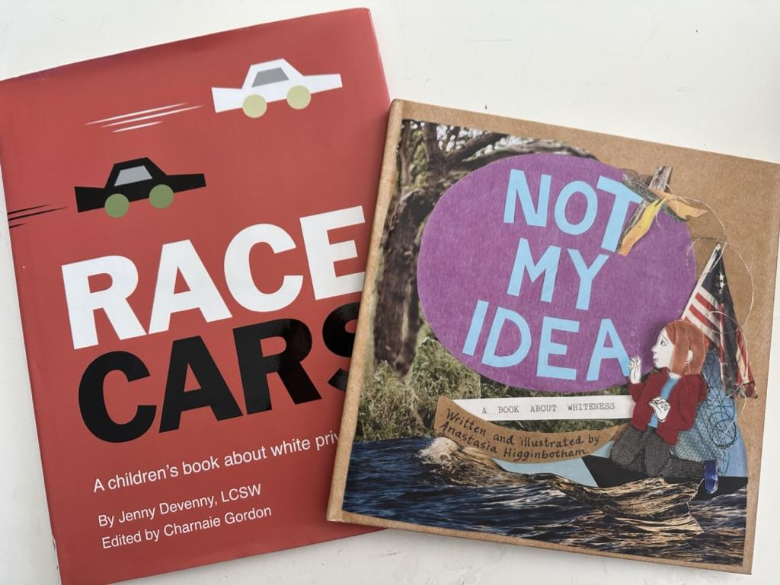
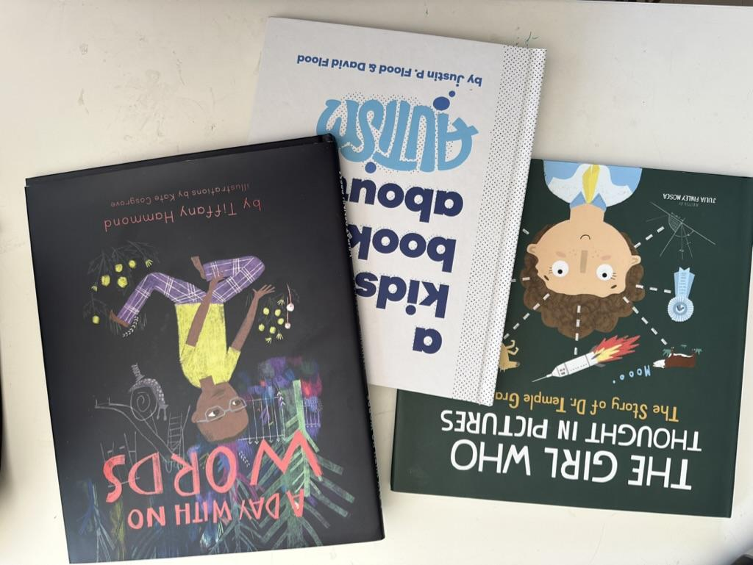
Construct Of Race
Autism

Slide 54
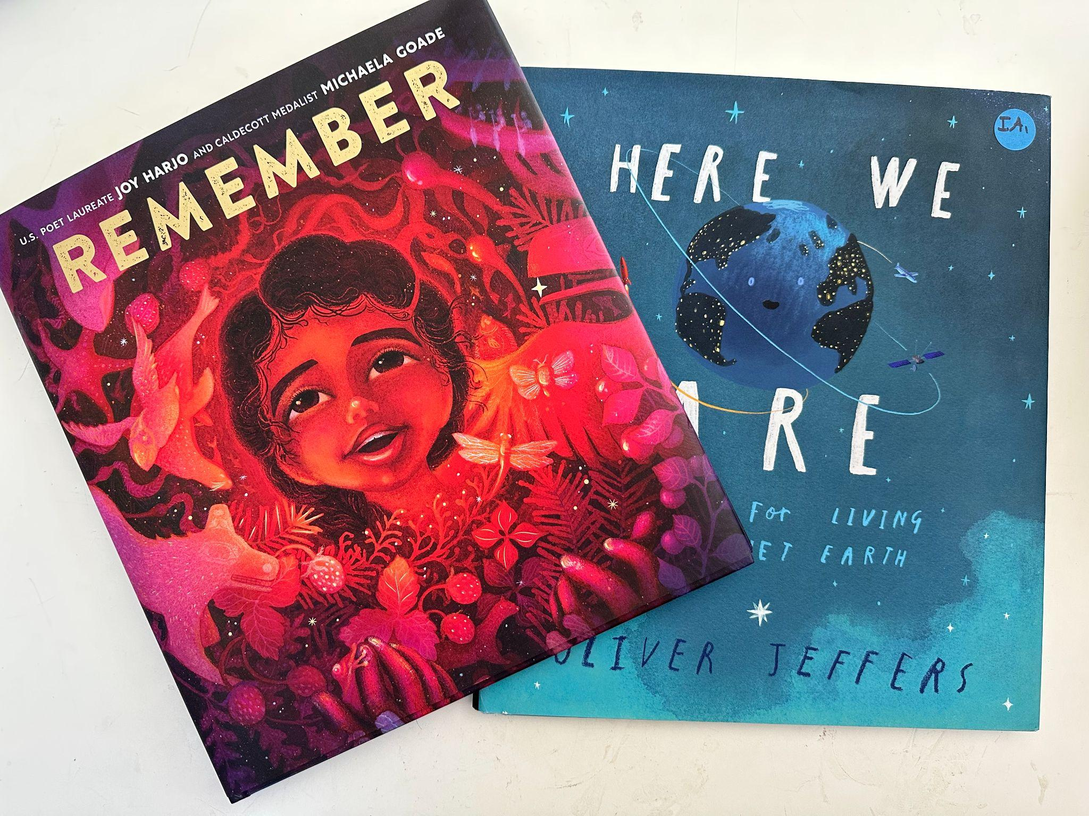
Rest
Wonder

Slide 55
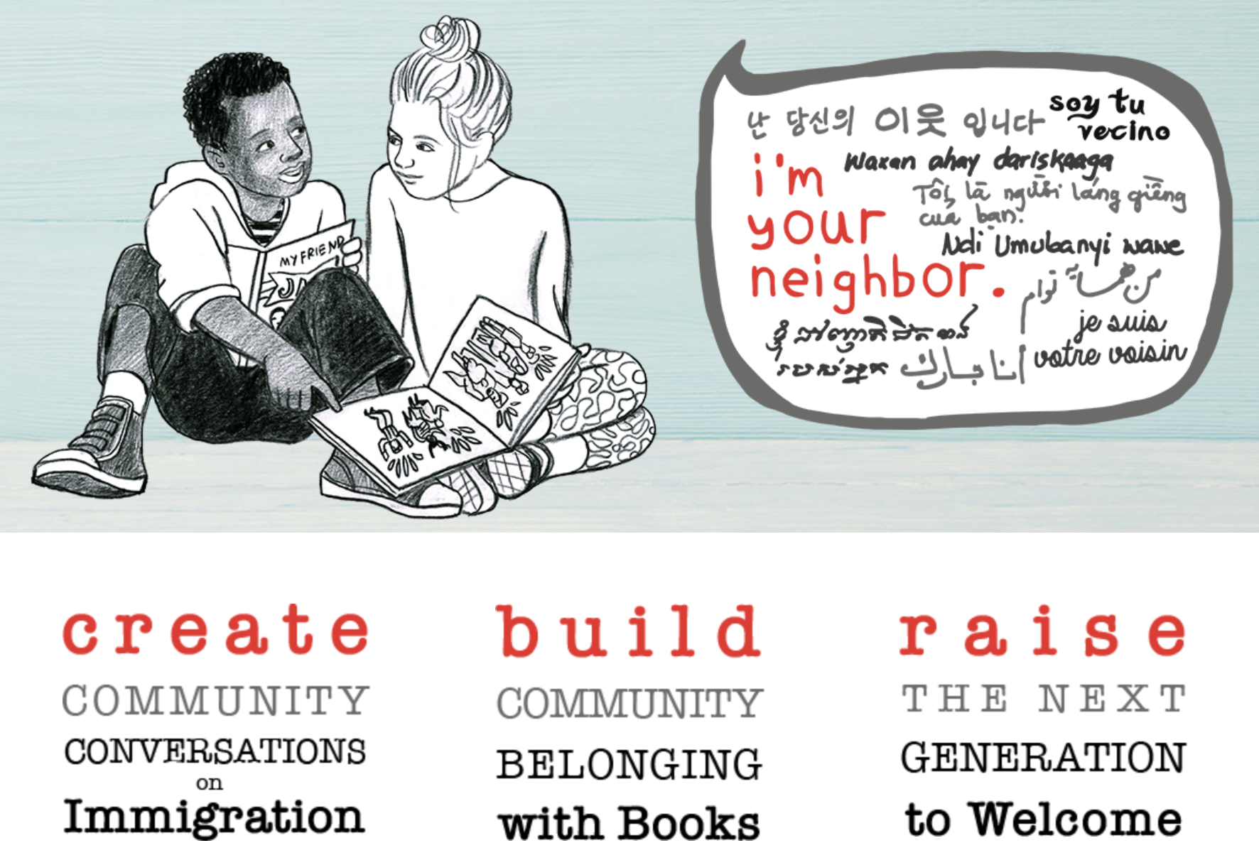
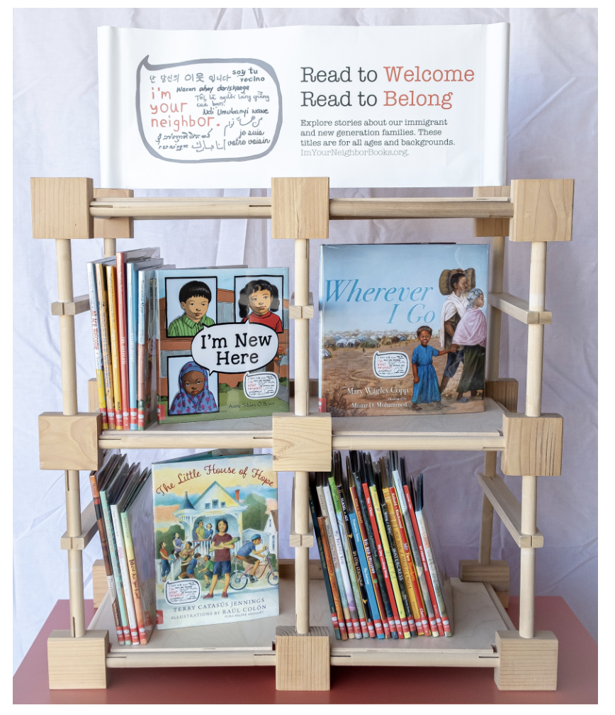
Immigration

Slide 56
Intended Agenda
Grounding
Expectations, Introductions, Definitions
Framework For Thinking About Picture Books & SEL
Practice
Extending The Conversation
Inspiration
Archiving Impact

Slide 57
Moving Into This Work
What? So What? Now What?
I used to think…now I wonder…
I believed I knew…now my understanding is…

Slide 59
2 Question Feedback Survey
With Gratitude For Your Time
Notes:
https://docs.google.com/forms/d/e/1FAIpQLSdVPmBwHhG4jOBQzhk7ooY1DSLX1sTqoDkykStBXjvEcxownw/viewform?usp=sf_link

